Slide 1


The South Indian Association’s
The S.I.A. College of Higher Education
Affiliated to University of Mumbai
Re-Accredited B+ by NAAC
P-88, MIDC Residential Area Dombivli Gymkhana Road,
Near Balaji Mandir, Dombivli (East), 421203.
3.4.1 Extension activities are carried out in the neighbourhood community, sensitizing students to social issues for their holistic development and the impact there of during the years 2022–23.

Slide 2










The South Indian Association’s
The S.I.A. College of Higher Education
Affiliated to University of Mumbai
Re-Accredited B+ by NAAC
P-88, MIDC Residential Area Dombivli Gymkhana Road,
Near Balaji Mandir, Dombivli (East), 421203.
JUNE 2022

Slide 3

The South Indian Association’s
The S.I.A. College of Higher Education
Affiliated to University of Mumbai
Re-Accredited B+ by NAAC
P-88, MIDC Residential Area Dombivli Gymkhana Road,
Near Balaji Mandir, Dombivli (East), 421203.
Activity: Observing World Environment Day in Community.
Date: 05th June 2022
Reflection
2022-23

Slide 4
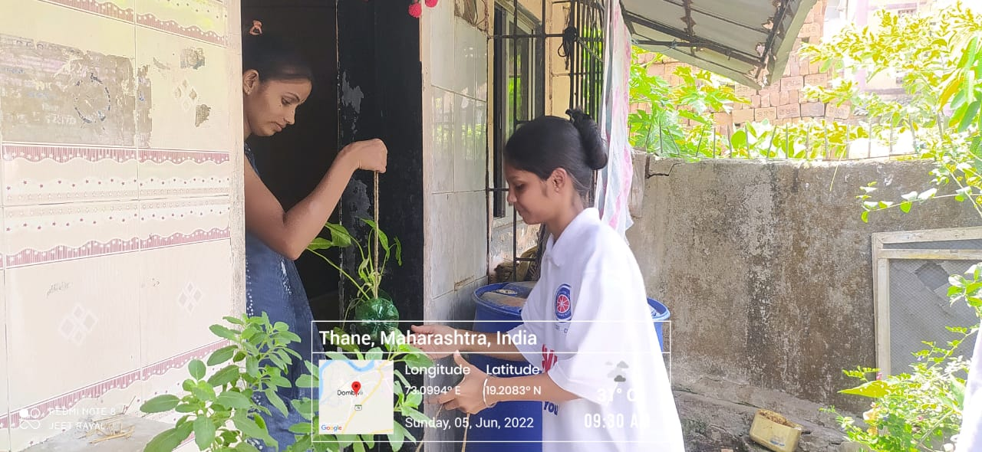
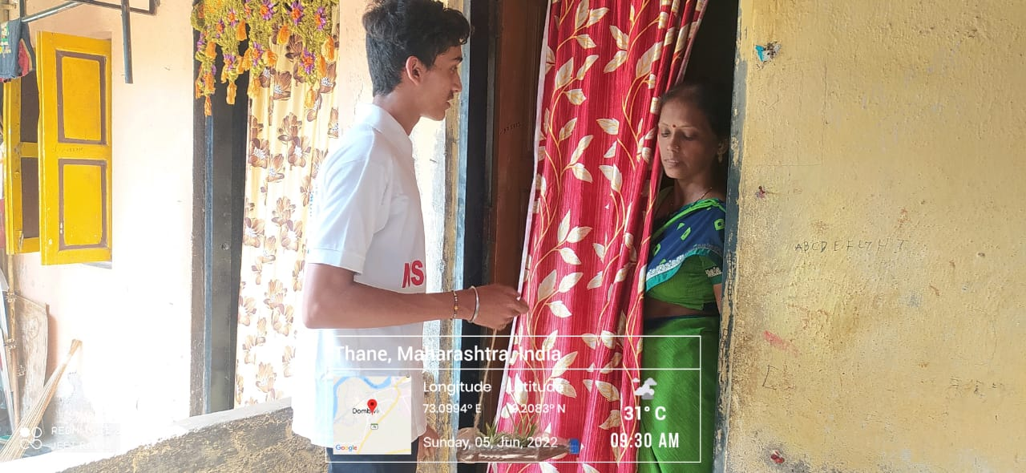
The South Indian Association’s
The S.I.A. College of Higher Education
Affiliated to University of Mumbai
Re-Accredited B+ by NAAC
P-88, MIDC Residential Area Dombivli Gymkhana Road,
Near Balaji Mandir, Dombivli (East), 421203.

Slide 5
The South Indian Association’s
The S.I.A. College of Higher Education
Affiliated to University of Mumbai
Re-Accredited B+ by NAAC
P-88, MIDC Residential Area Dombivli Gymkhana Road,
Near Balaji Mandir, Dombivli (East), 421203.
Activity: Online Guest Lecture on the occasion of Shiv Rajya Abhishek Din.
Date: 06th June 2022
Reflection
2022-23

Slide 6
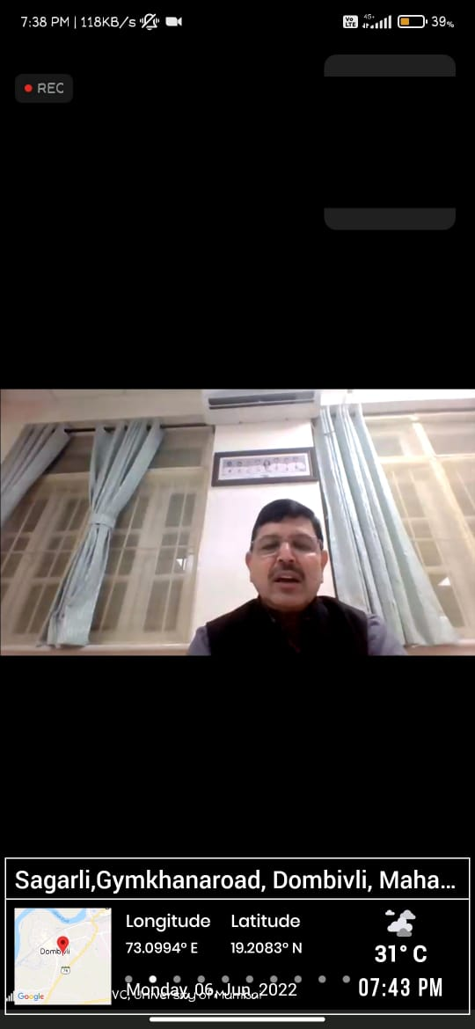
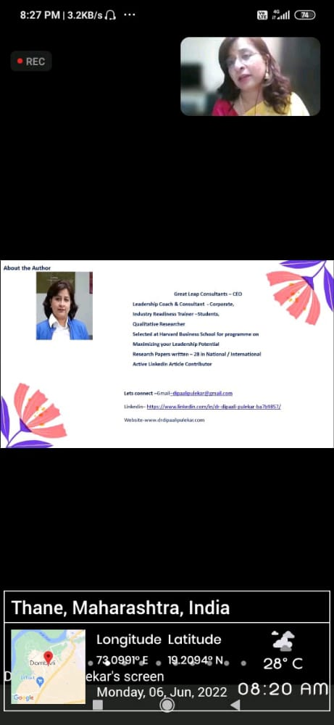
The South Indian Association’s
The S.I.A. College of Higher Education
Affiliated to University of Mumbai
Re-Accredited B+ by NAAC
P-88, MIDC Residential Area Dombivli Gymkhana Road,
Near Balaji Mandir, Dombivli (East), 421203.

Slide 7
The South Indian Association’s
The S.I.A. College of Higher Education
Affiliated to University of Mumbai
Re-Accredited B+ by NAAC
P-88, MIDC Residential Area Dombivli Gymkhana Road,
Near Balaji Mandir, Dombivli (East), 421203.
Activity: Shiv Rajya Abhishek Din through Powada
Date: 06th June 2022
Reflection
2022-23

Slide 8
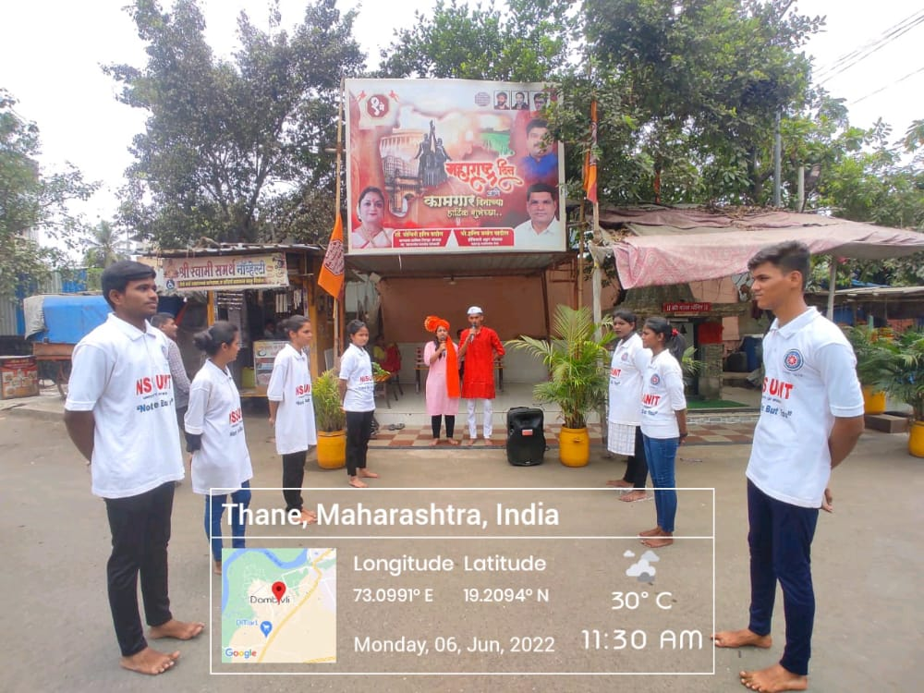
The South Indian Association’s
The S.I.A. College of Higher Education
Affiliated to University of Mumbai
Re-Accredited B+ by NAAC
P-88, MIDC Residential Area Dombivli Gymkhana Road,
Near Balaji Mandir, Dombivli (East), 421203.

Slide 9
The South Indian Association’s
The S.I.A. College of Higher Education
Affiliated to University of Mumbai
Re-Accredited B+ by NAAC
P-88, MIDC Residential Area Dombivli Gymkhana Road,
Near Balaji Mandir, Dombivli (East), 421203.
Activity: Inauguration of MHRD program Paryavaran Janjagruti and Swachhta Week and Cleanliness Drive at Tilak Nagar Police Station.
Date: 07th June 2022
Reflection
2022-23

Slide 10
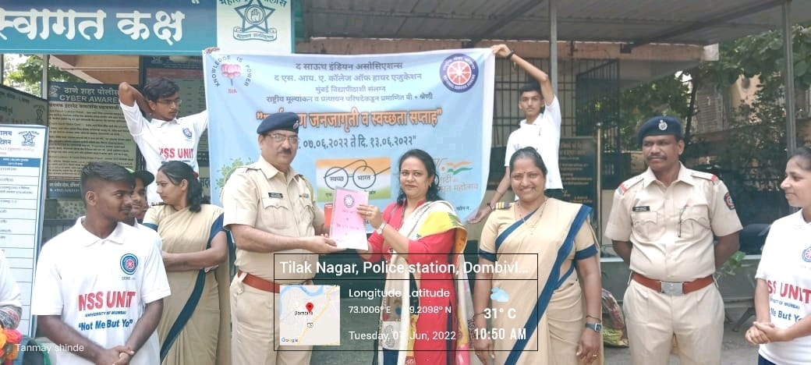
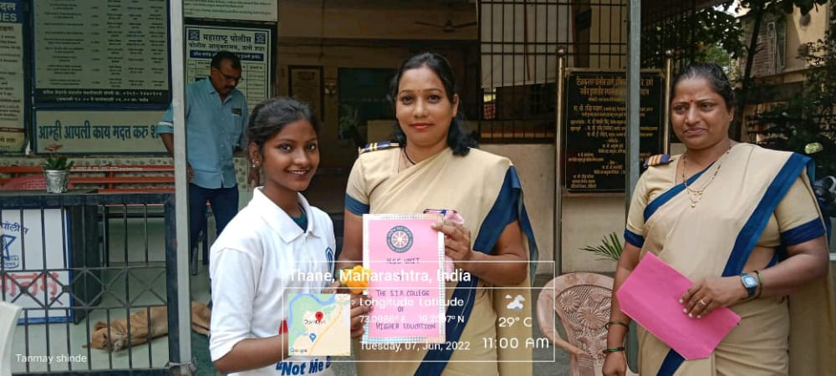
The South Indian Association’s
The S.I.A. College of Higher Education
Affiliated to University of Mumbai
Re-Accredited B+ by NAAC
P-88, MIDC Residential Area Dombivli Gymkhana Road,
Near Balaji Mandir, Dombivli (East), 421203.

Slide 11
The South Indian Association’s
The S.I.A. College of Higher Education
Affiliated to University of Mumbai
Re-Accredited B+ by NAAC
P-88, MIDC Residential Area Dombivli Gymkhana Road,
Near Balaji Mandir, Dombivli (East), 421203.
Activity: Cleanliness Drive under the banner of Paryavaran Janjagruti and Swachhta Week at Dombivli Bus Depo.
Date: 08th June 2022
Reflection
2022-23

Slide 12
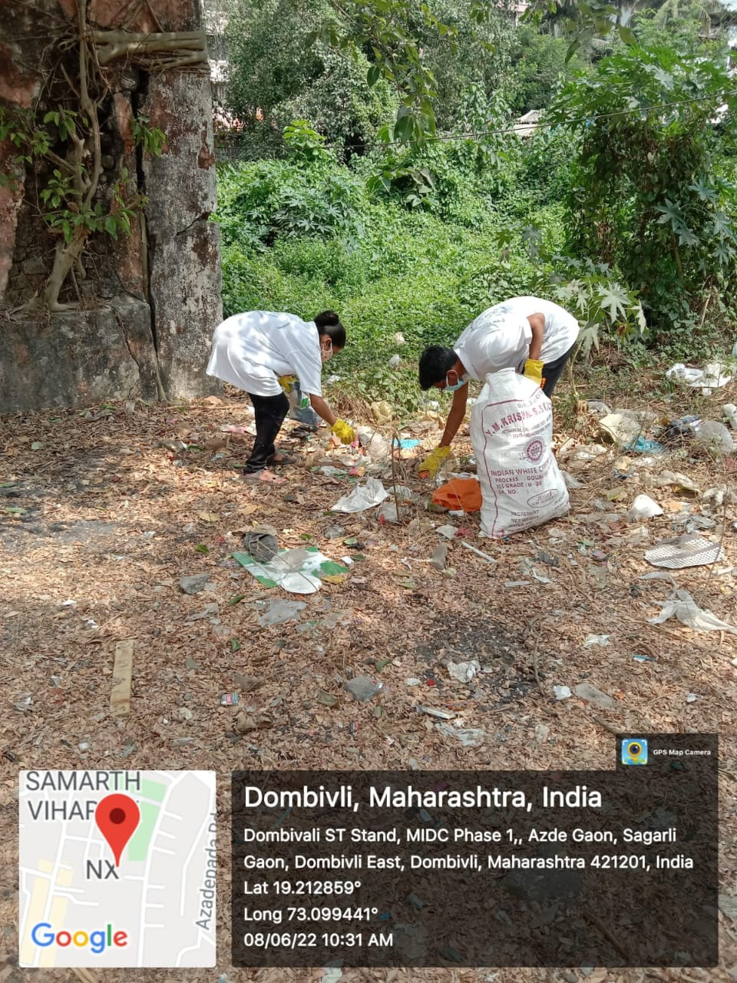
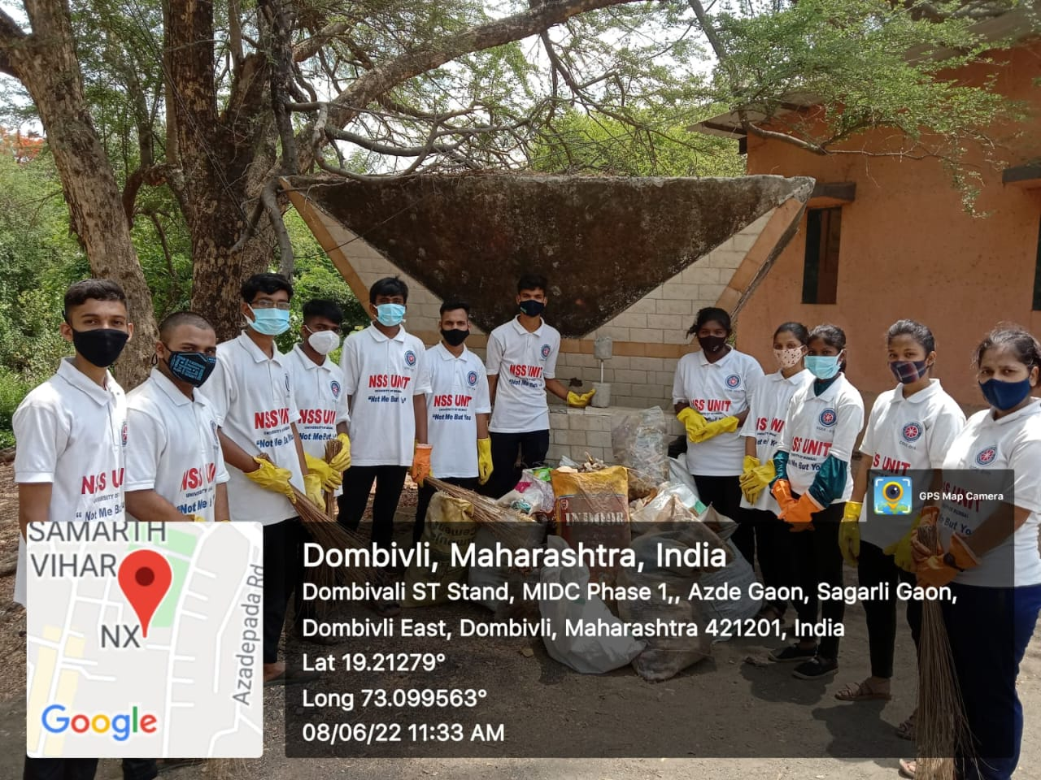
The South Indian Association’s
The S.I.A. College of Higher Education
Affiliated to University of Mumbai
Re-Accredited B+ by NAAC
P-88, MIDC Residential Area Dombivli Gymkhana Road,
Near Balaji Mandir, Dombivli (East), 421203.

Slide 13
The South Indian Association’s
The S.I.A. College of Higher Education
Affiliated to University of Mumbai
Re-Accredited B+ by NAAC
P-88, MIDC Residential Area Dombivli Gymkhana Road,
Near Balaji Mandir, Dombivli (East), 421203.
Activity: Cleanliness Drive at Dombivli Railway Station under the banner of Paryaavaran Janjagruti and Swachhta Week.
Date: 09th June 2022
Reflection
2022-23

Slide 14
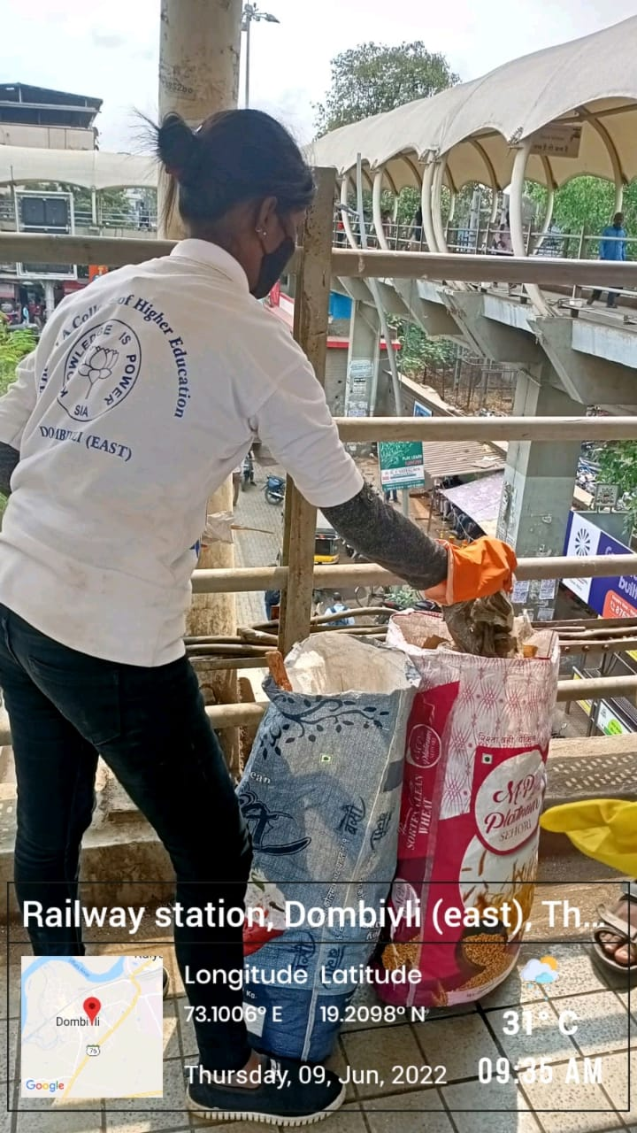
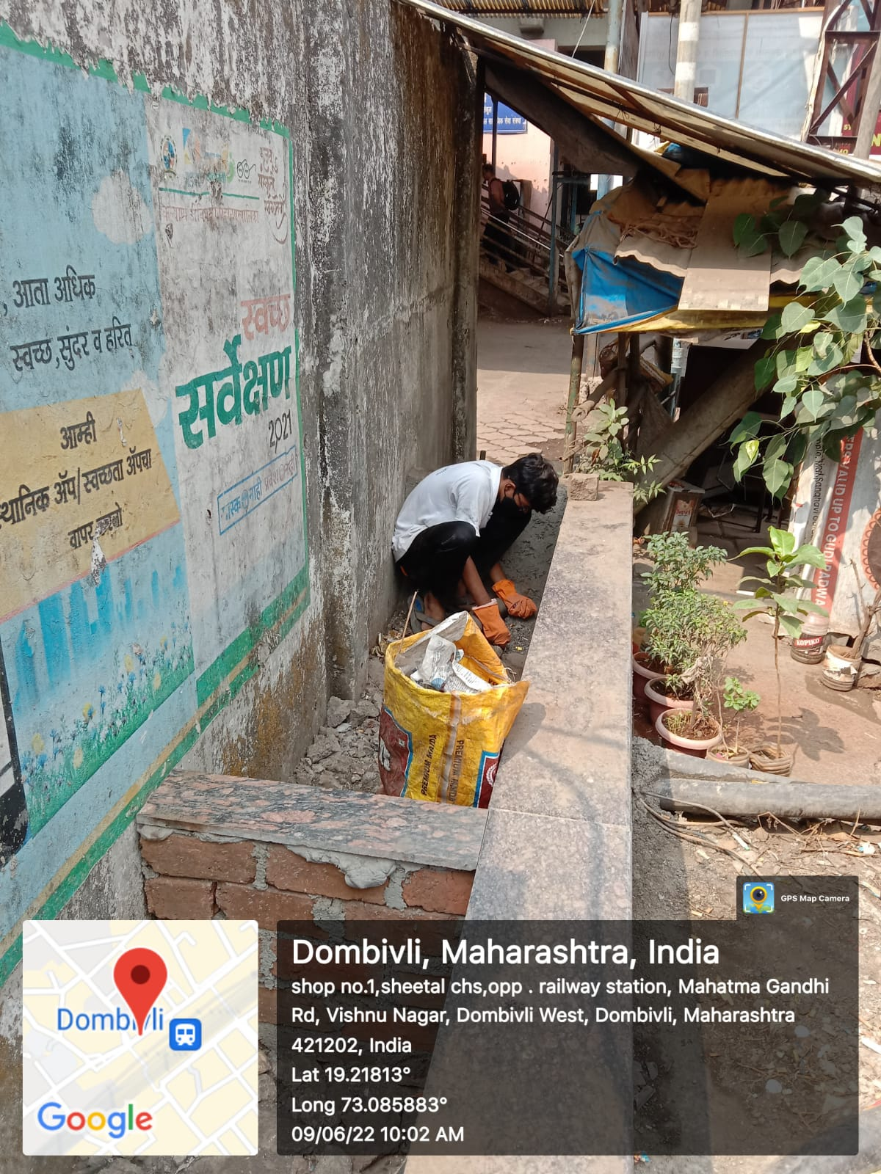
The South Indian Association’s
The S.I.A. College of Higher Education
Affiliated to University of Mumbai
Re-Accredited B+ by NAAC
P-88, MIDC Residential Area Dombivli Gymkhana Road,
Near Balaji Mandir, Dombivli (East), 421203.

Slide 15
The South Indian Association’s
The S.I.A. College of Higher Education
Affiliated to University of Mumbai
Re-Accredited B+ by NAAC
P-88, MIDC Residential Area Dombivli Gymkhana Road,
Near Balaji Mandir, Dombivli (East), 421203.
Activity: Cleanliness Drive at Shastri Nagar Municipal Hospital under banner of Paryavaran Janjagruti and Swachhta Week.
Date: 10th June 2022
Reflection
2022-23

Slide 16
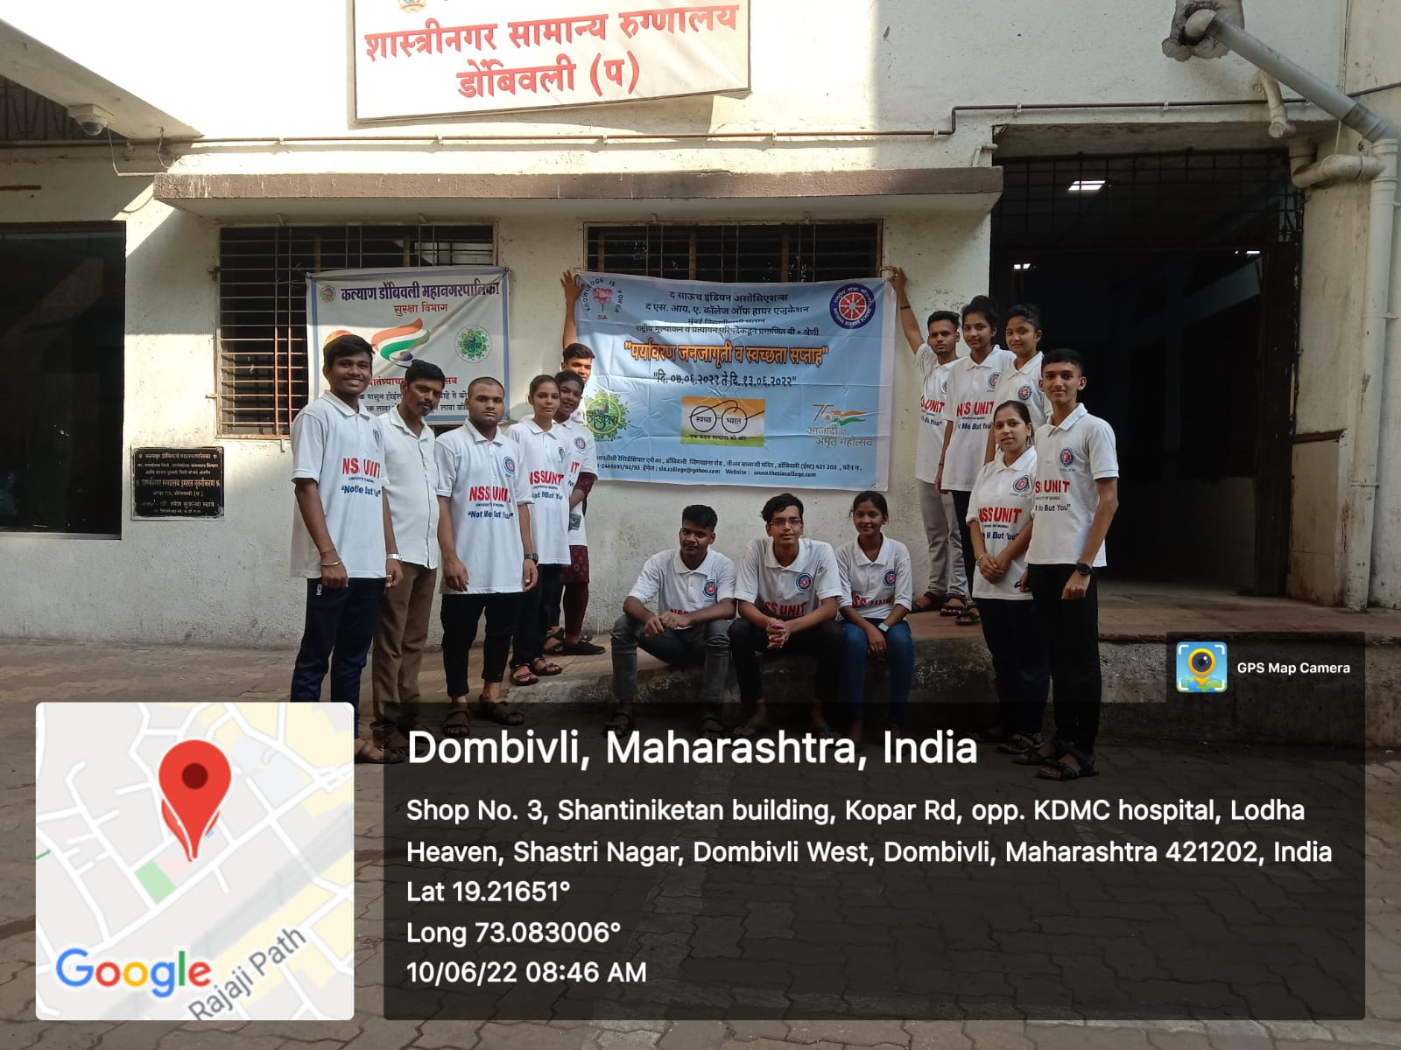
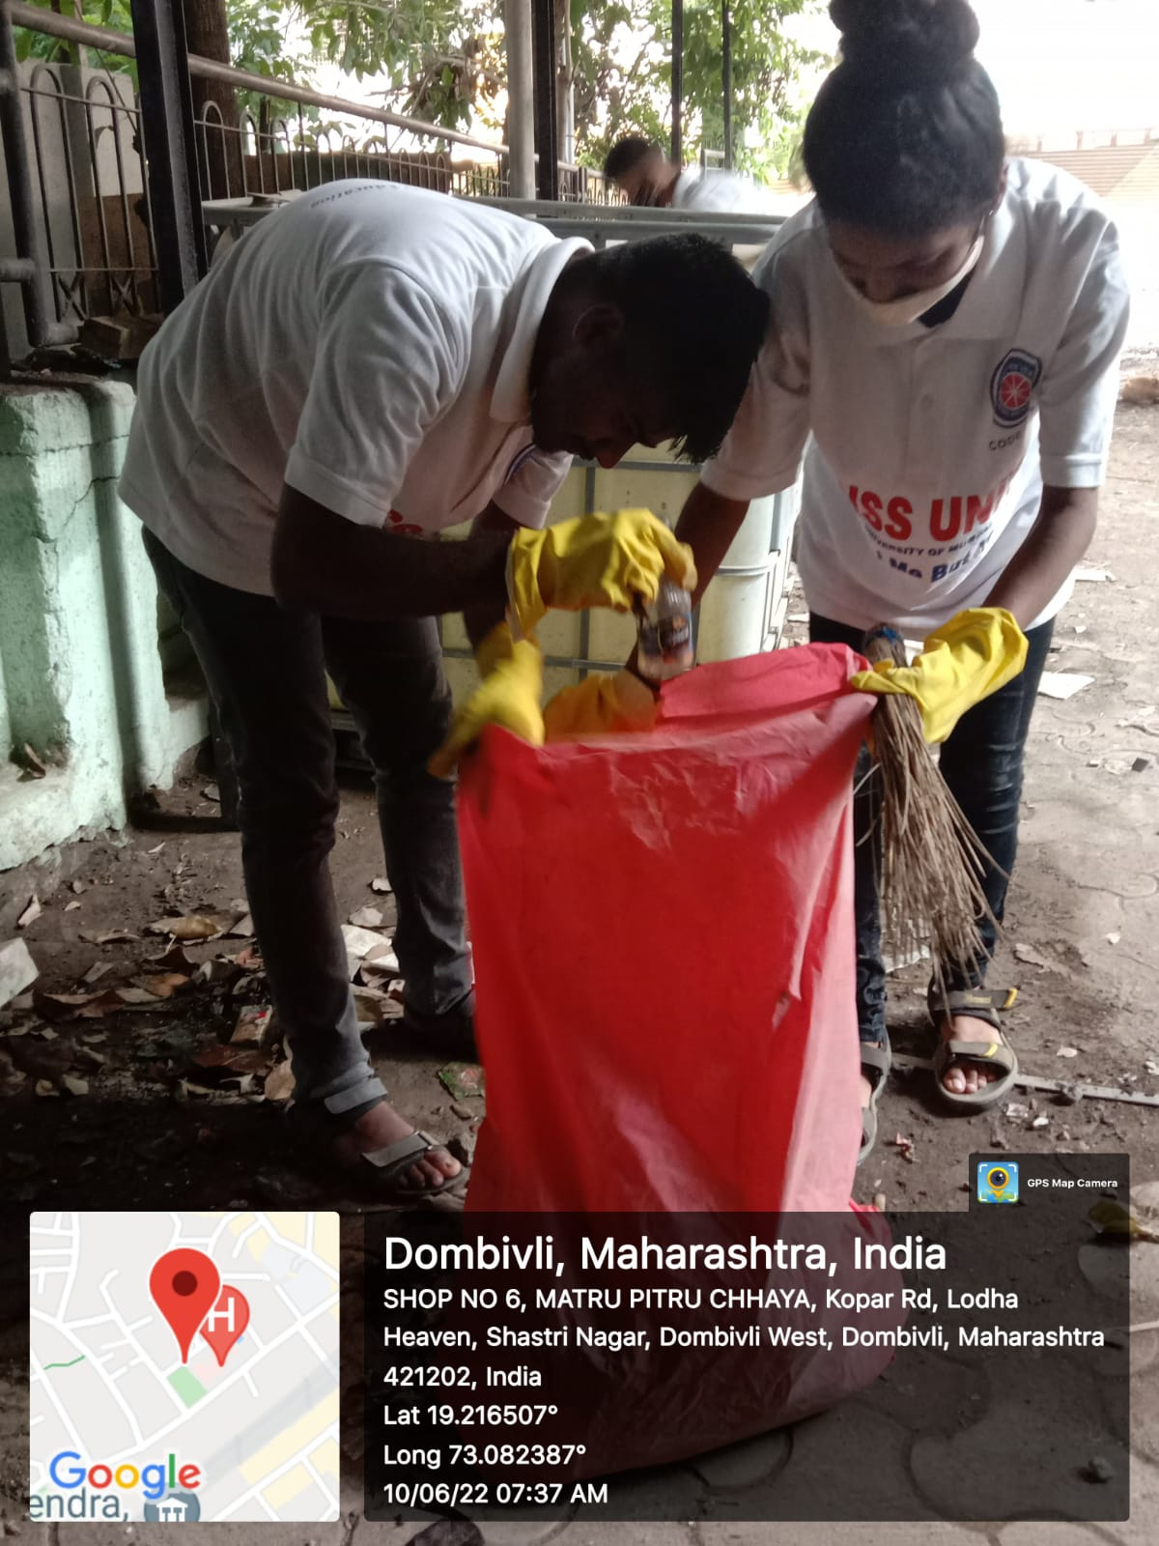
The South Indian Association’s
The S.I.A. College of Higher Education
Affiliated to University of Mumbai
Re-Accredited B+ by NAAC
P-88, MIDC Residential Area Dombivli Gymkhana Road,
Near Balaji Mandir, Dombivli (East), 421203.

Slide 17
The South Indian Association’s
The S.I.A. College of Higher Education
Affiliated to University of Mumbai
Re-Accredited B+ by NAAC
P-88, MIDC Residential Area Dombivli Gymkhana Road,
Near Balaji Mandir, Dombivli (East), 421203.
Activity: Cycle Rally under the banner of Paryavaran Janjagruti and Swachhta Week from The S.I.A College of Higher Education to 90 Feet Road, Khambalpada, Dombivli (E).
Date: 11th June 2022
Reflection
2022-23

Slide 18
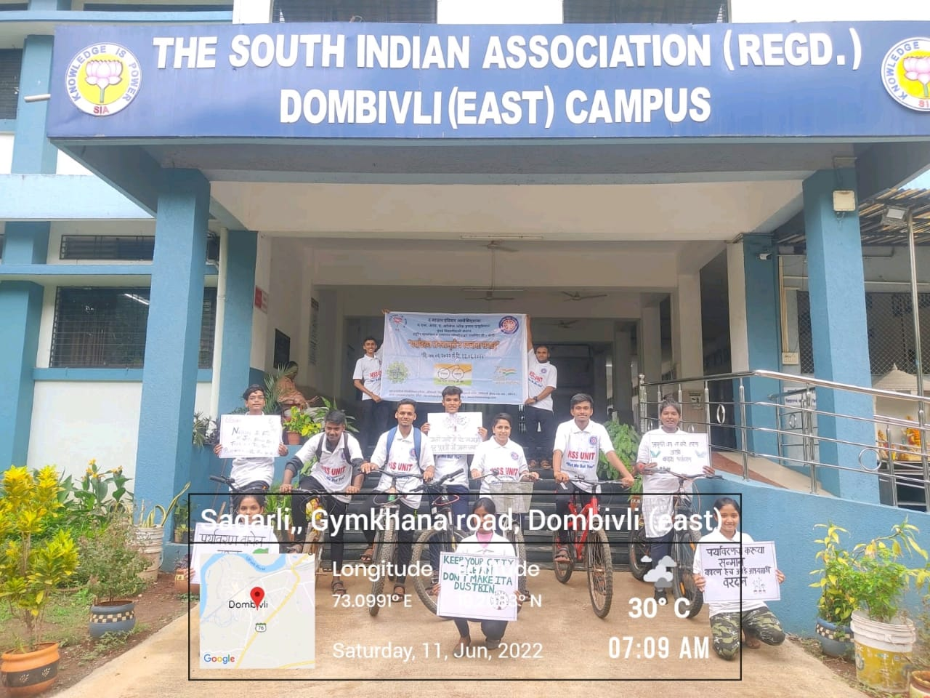
The South Indian Association’s
The S.I.A. College of Higher Education
Affiliated to University of Mumbai
Re-Accredited B+ by NAAC
P-88, MIDC Residential Area Dombivli Gymkhana Road,
Near Balaji Mandir, Dombivli (East), 421203.

Slide 19
The South Indian Association’s
The S.I.A. College of Higher Education
Affiliated to University of Mumbai
Re-Accredited B+ by NAAC
P-88, MIDC Residential Area Dombivli Gymkhana Road,
Near Balaji Mandir, Dombivli (East), 421203.
Activity: Cleanliness Drive at NSS adopted Area, Sagarli Goan under the banner of Paryavaran Janjagruti and Swachhta Week
Date: 12th June 2022
Reflection
2022-23

Slide 20
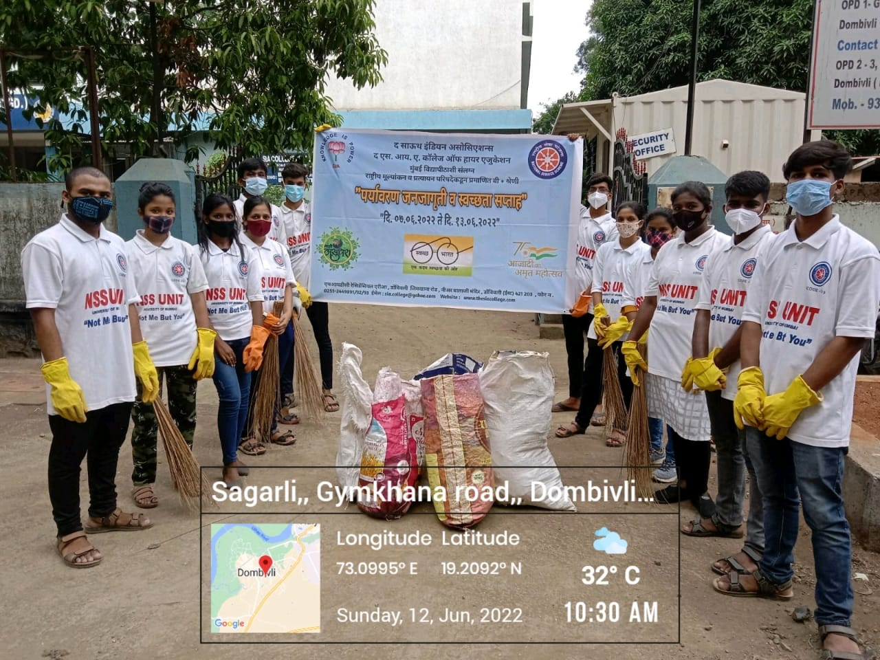
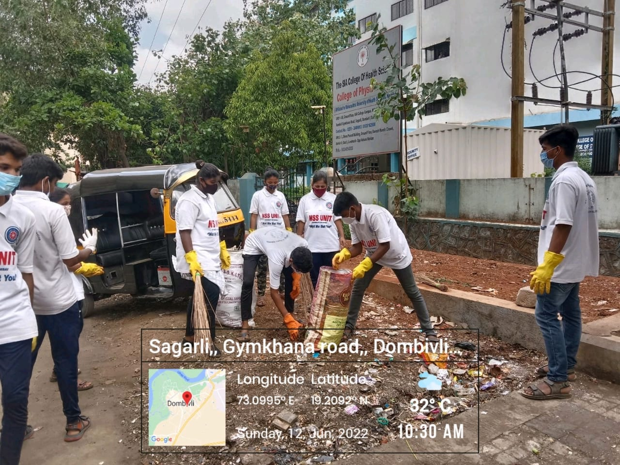
The South Indian Association’s
The S.I.A. College of Higher Education
Affiliated to University of Mumbai
Re-Accredited B+ by NAAC
P-88, MIDC Residential Area Dombivli Gymkhana Road,
Near Balaji Mandir, Dombivli (East), 421203.

Slide 21
The South Indian Association’s
The S.I.A. College of Higher Education
Affiliated to University of Mumbai
Re-Accredited B+ by NAAC
P-88, MIDC Residential Area Dombivli Gymkhana Road,
Near Balaji Mandir, Dombivli (East), 421203.
Activity: Street play on Save the Earth in Community.
Date: 13th June 2022
Reflection
2022-23

Slide 22
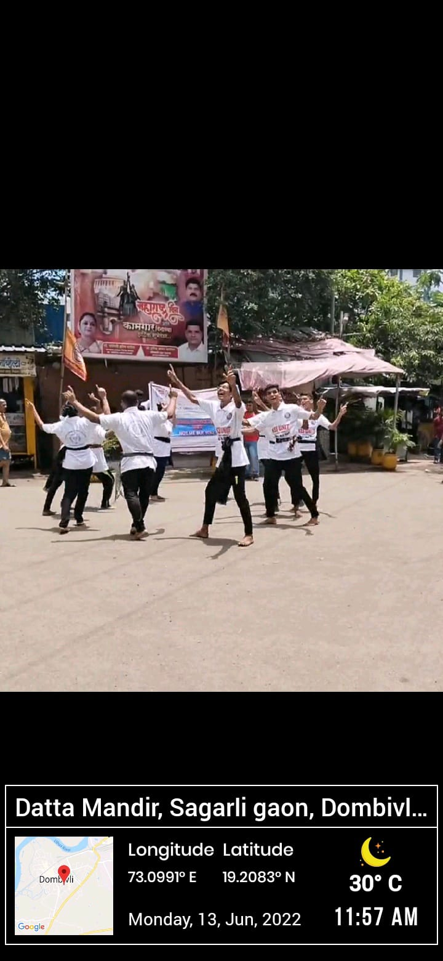
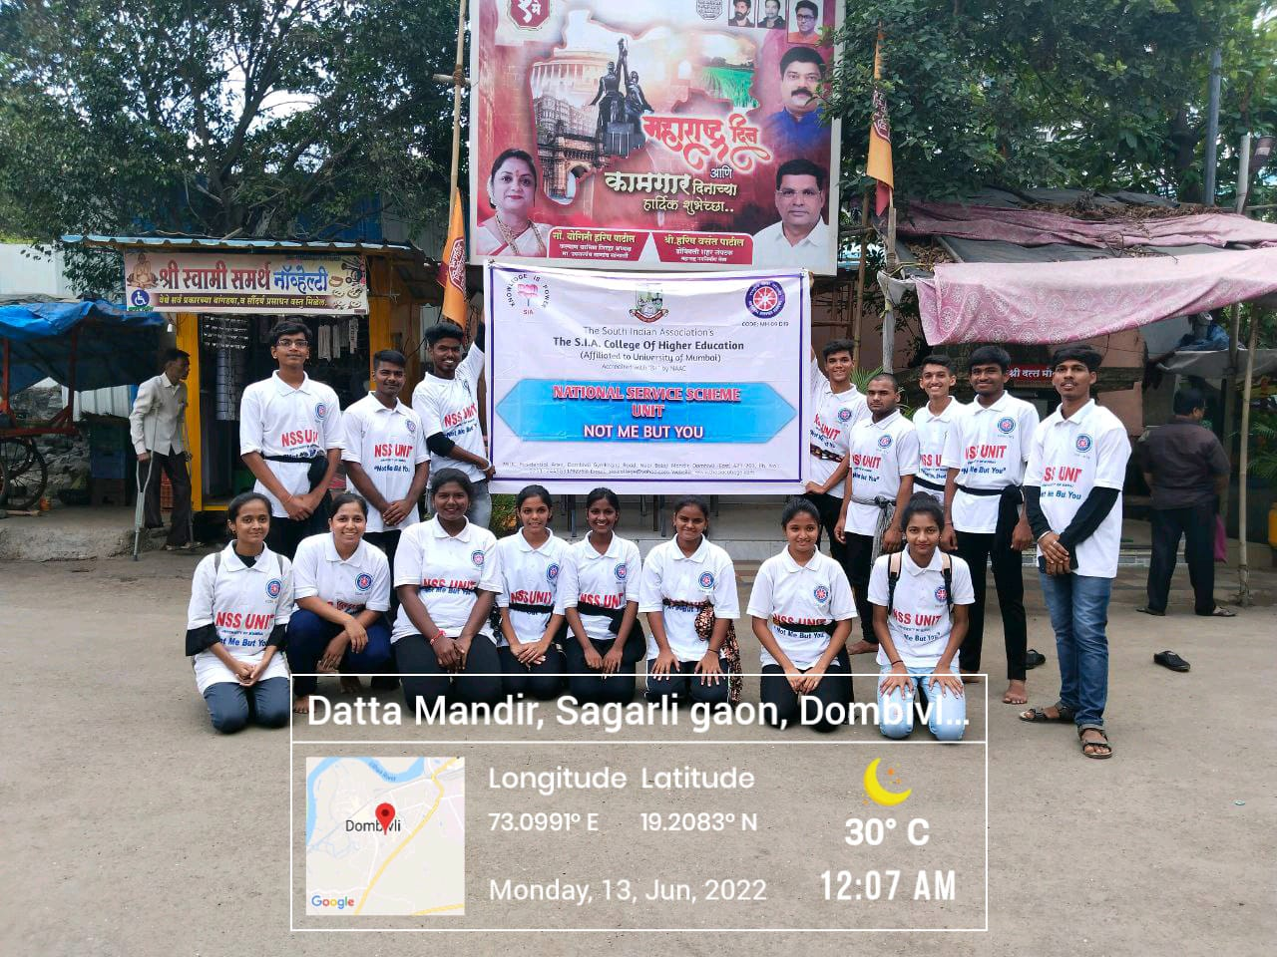
The South Indian Association’s
The S.I.A. College of Higher Education
Affiliated to University of Mumbai
Re-Accredited B+ by NAAC
P-88, MIDC Residential Area Dombivli Gymkhana Road,
Near Balaji Mandir, Dombivli (East), 421203.

Slide 23
The South Indian Association’s
The S.I.A. College of Higher Education
Affiliated to University of Mumbai
Re-Accredited B+ by NAAC
P-88, MIDC Residential Area Dombivli Gymkhana Road,
Near Balaji Mandir, Dombivli (East), 421203.
Activity: Happy Street at 90 Feet Road, Khambalpada, Dombivli (E)
Date: 19th June 2022
Reflection
2022-23

Slide 24
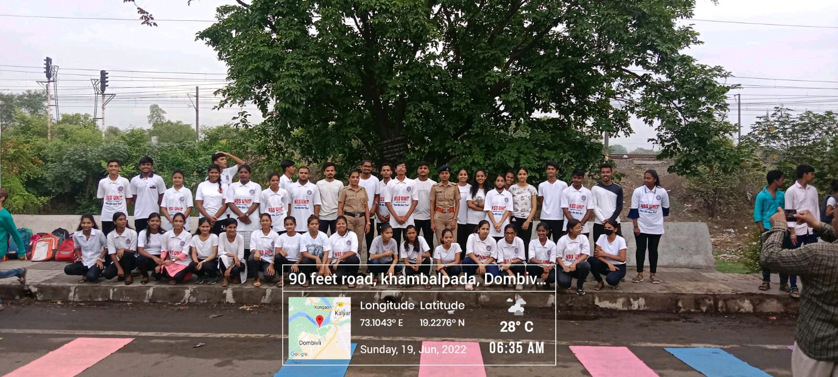
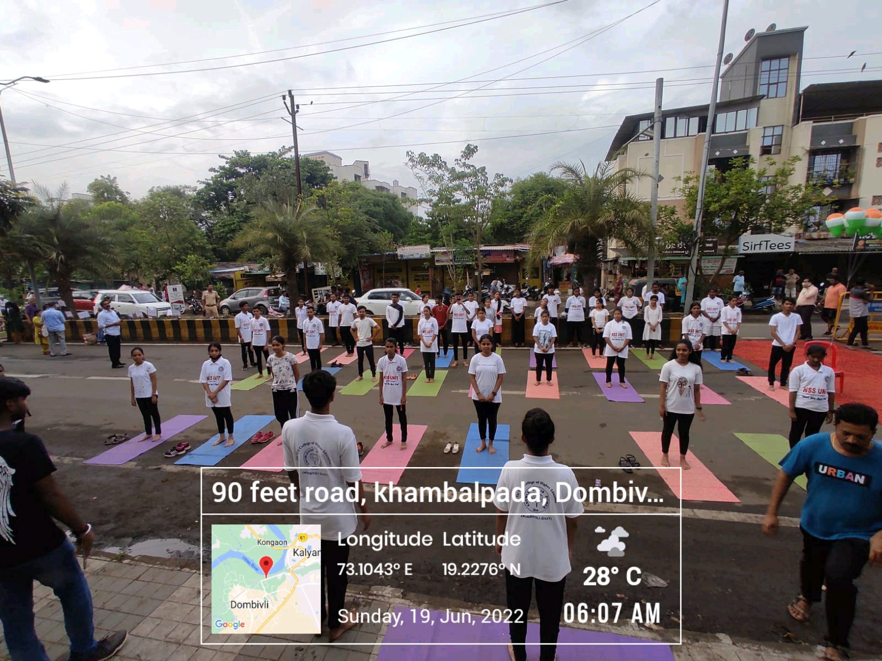
The South Indian Association’s
The S.I.A. College of Higher Education
Affiliated to University of Mumbai
Re-Accredited B+ by NAAC
P-88, MIDC Residential Area Dombivli Gymkhana Road,
Near Balaji Mandir, Dombivli (East), 421203.

Slide 25
The South Indian Association’s
The S.I.A. College of Higher Education
Affiliated to University of Mumbai
Re-Accredited B+ by NAAC
P-88, MIDC Residential Area Dombivli Gymkhana Road,
Near Balaji Mandir, Dombivli (East), 421203.
Activity: Pulse Polio Drive in Community.
Date: 19th June 2022
Reflection
2022-23

Slide 26
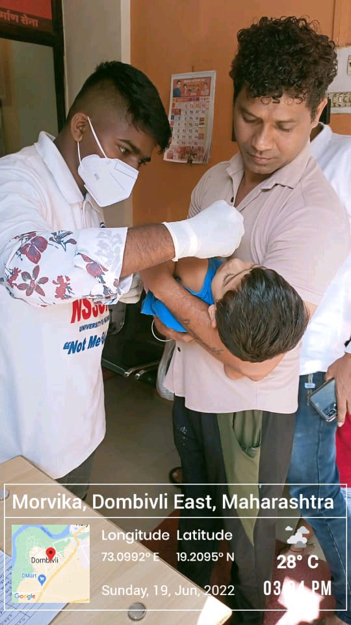
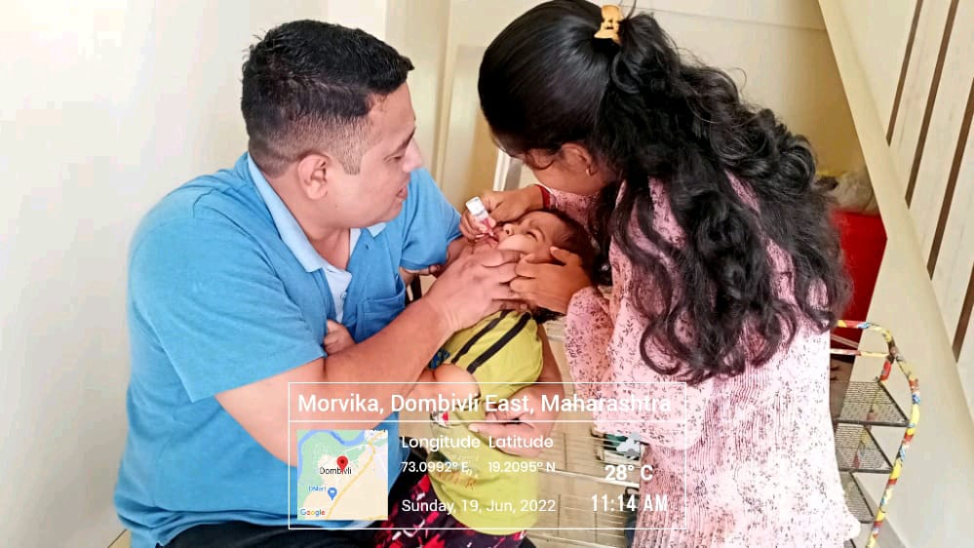
The South Indian Association’s
The S.I.A. College of Higher Education
Affiliated to University of Mumbai
Re-Accredited B+ by NAAC
P-88, MIDC Residential Area Dombivli Gymkhana Road,
Near Balaji Mandir, Dombivli (East), 421203.

Slide 27
The South Indian Association’s
The S.I.A. College of Higher Education
Affiliated to University of Mumbai
Re-Accredited B+ by NAAC
P-88, MIDC Residential Area Dombivli Gymkhana Road,
Near Balaji Mandir, Dombivli (East), 421203.
Activity: Celebrating International Yoga Day at The S.I.A College of Higher Education, Classroom.
Date: 21st June 2022
Reflection
2022-23

Slide 28
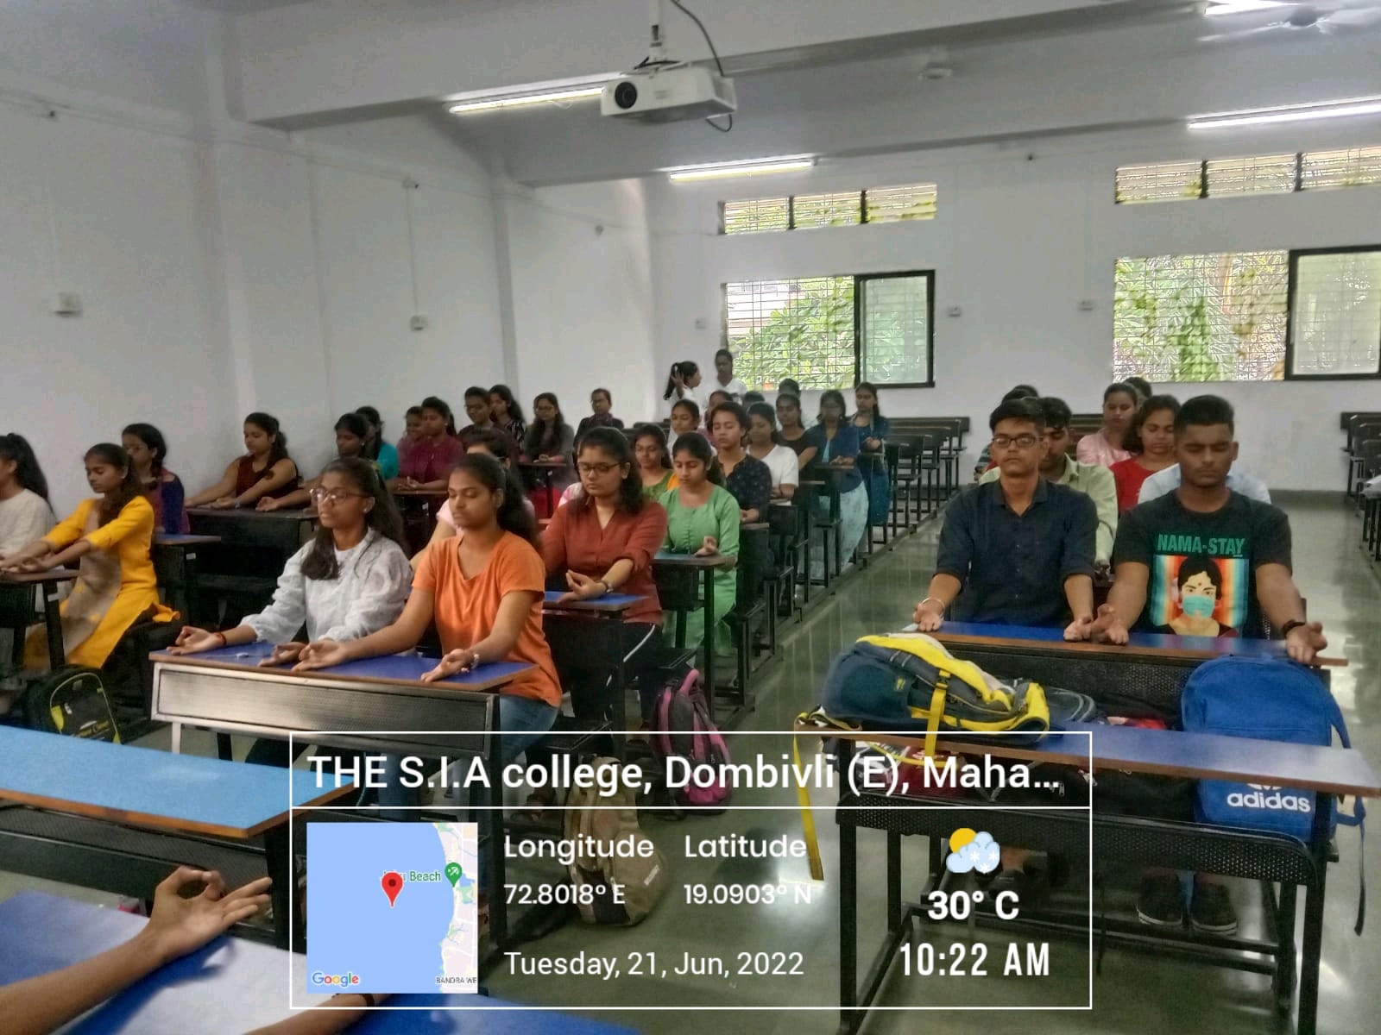
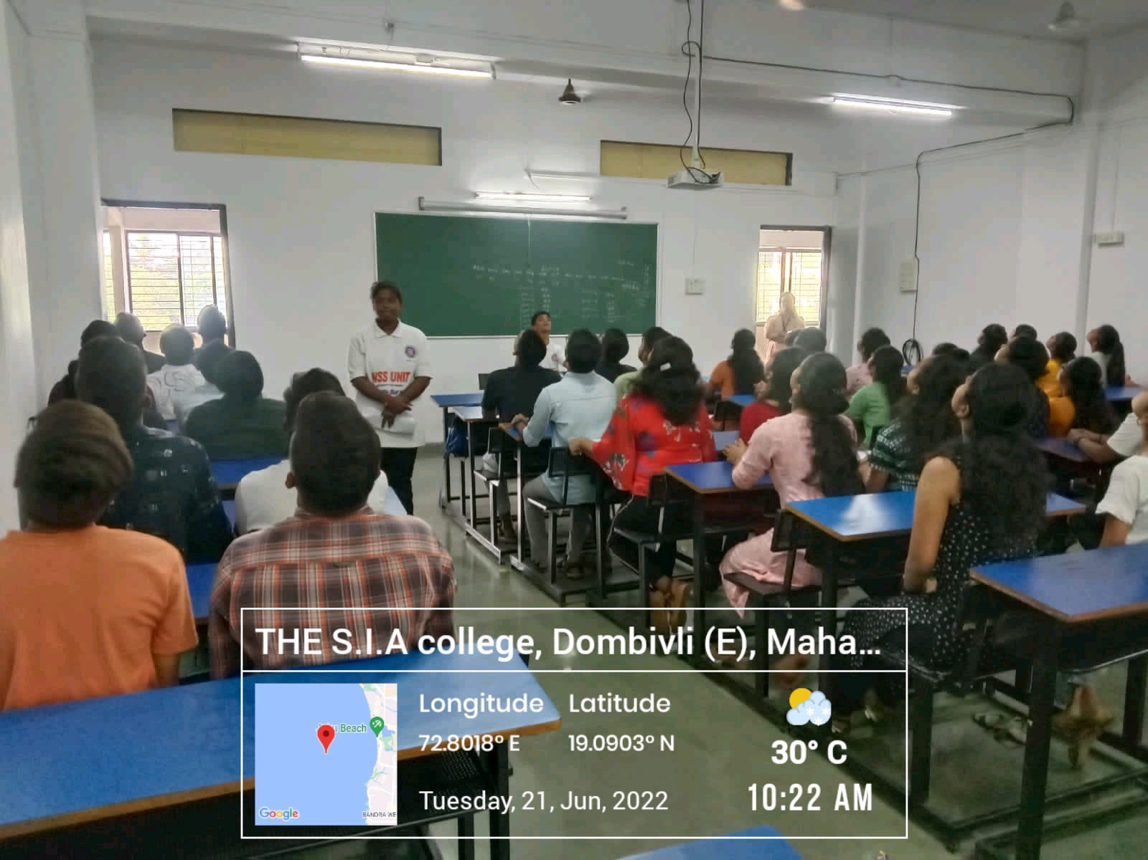
The South Indian Association’s
The S.I.A. College of Higher Education
Affiliated to University of Mumbai
Re-Accredited B+ by NAAC
P-88, MIDC Residential Area Dombivli Gymkhana Road,
Near Balaji Mandir, Dombivli (East), 421203.

Slide 29
The South Indian Association’s
The S.I.A. College of Higher Education
Affiliated to University of Mumbai
Re-Accredited B+ by NAAC
P-88, MIDC Residential Area Dombivli Gymkhana Road,
Near Balaji Mandir, Dombivli (East), 421203.
Activity: Celebrating International Yoga Day in association with Mahila Pantajli Yog Samiti at The S.I.A College of Higher Education, Auditorium.
Date: 21st June 2022
Reflection
2022-23

Slide 30
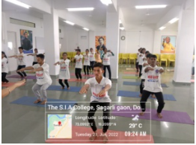
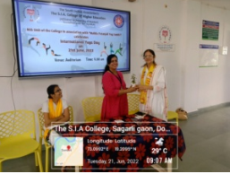
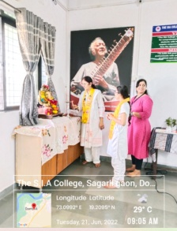
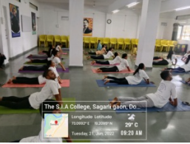
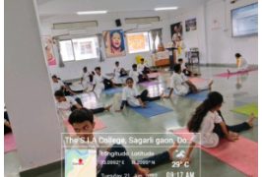
The South Indian Association’s
The S.I.A. College of Higher Education
Affiliated to University of Mumbai
Re-Accredited B+ by NAAC
P-88, MIDC Residential Area Dombivli Gymkhana Road,
Near Balaji Mandir, Dombivli (East), 421203.

Slide 31
The South Indian Association’s
The S.I.A. College of Higher Education
Affiliated to University of Mumbai
Re-Accredited B+ by NAAC
P-88, MIDC Residential Area Dombivli Gymkhana Road,
Near Balaji Mandir, Dombivli (East), 421203.
Activity: Webinar on the theme of “Say No To Drugs, Yes to Life”.
Date: 24th June 2022
Reflection
2022-23

Slide 32


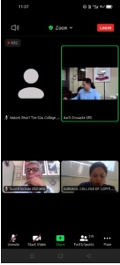
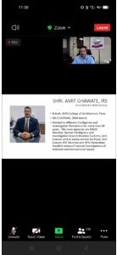
The South Indian Association’s
The S.I.A. College of Higher Education
Affiliated to University of Mumbai
Re-Accredited B+ by NAAC
P-88, MIDC Residential Area Dombivli Gymkhana Road,
Near Balaji Mandir, Dombivli (East), 421203.

Slide 33



The South Indian Association’s
The S.I.A. College of Higher Education
Affiliated to University of Mumbai
Re-Accredited B+ by NAAC
P-88, MIDC Residential Area Dombivli Gymkhana Road,
Near Balaji Mandir, Dombivli (East), 421203.
JULY 2022

Slide 34
The South Indian Association’s
The S.I.A. College of Higher Education
Affiliated to University of Mumbai
Re-Accredited B+ by NAAC
P-88, MIDC Residential Area Dombivli Gymkhana Road,
Near Balaji Mandir, Dombivli (East), 421203.
Activity: Street Play on “World Population Day” in Community.
Date: 11th July 2022
Reflection
2022-23

Slide 35
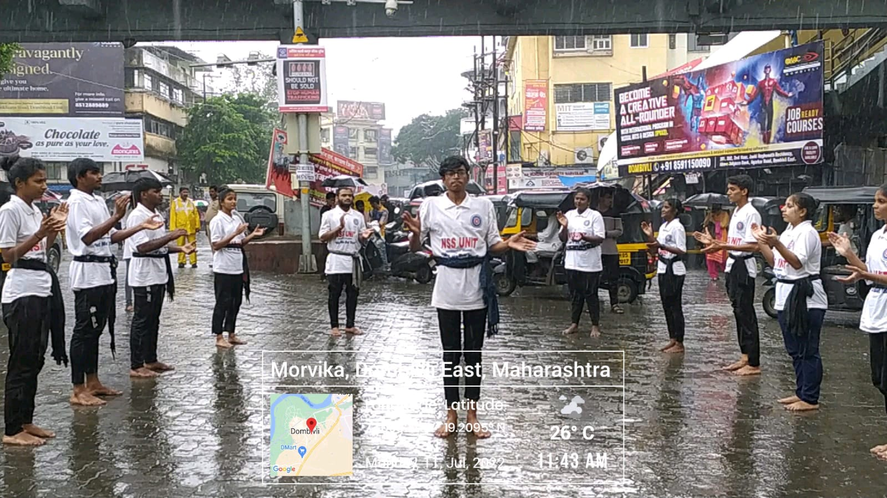
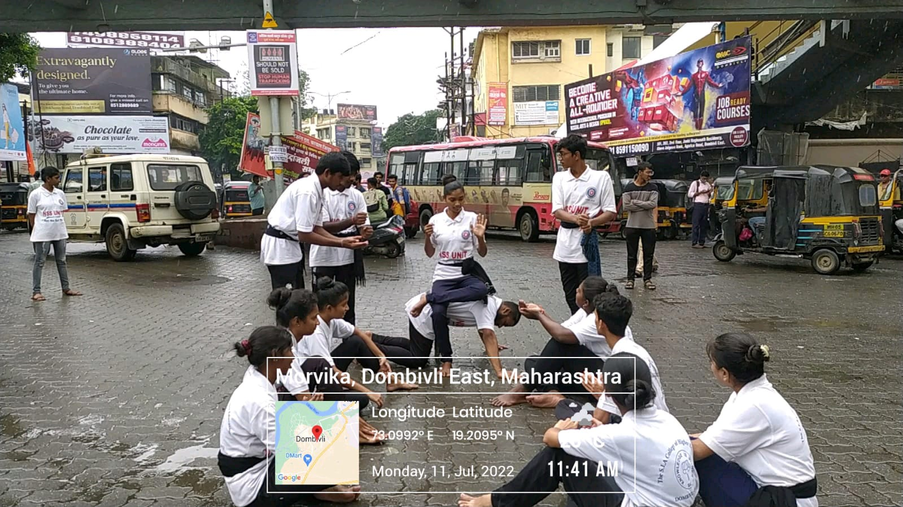
The South Indian Association’s
The S.I.A. College of Higher Education
Affiliated to University of Mumbai
Re-Accredited B+ by NAAC
P-88, MIDC Residential Area Dombivli Gymkhana Road,
Near Balaji Mandir, Dombivli (East), 421203.

Slide 36
The South Indian Association’s
The S.I.A. College of Higher Education
Affiliated to University of Mumbai
Re-Accredited B+ by NAAC
P-88, MIDC Residential Area Dombivli Gymkhana Road,
Near Balaji Mandir, Dombivli (East), 421203.
Activity: First Year NSS Orientation Program at The S.I.A College of Higher Education, Classroom.
Date: 16th July 2022
Reflection
2022-23

Slide 37
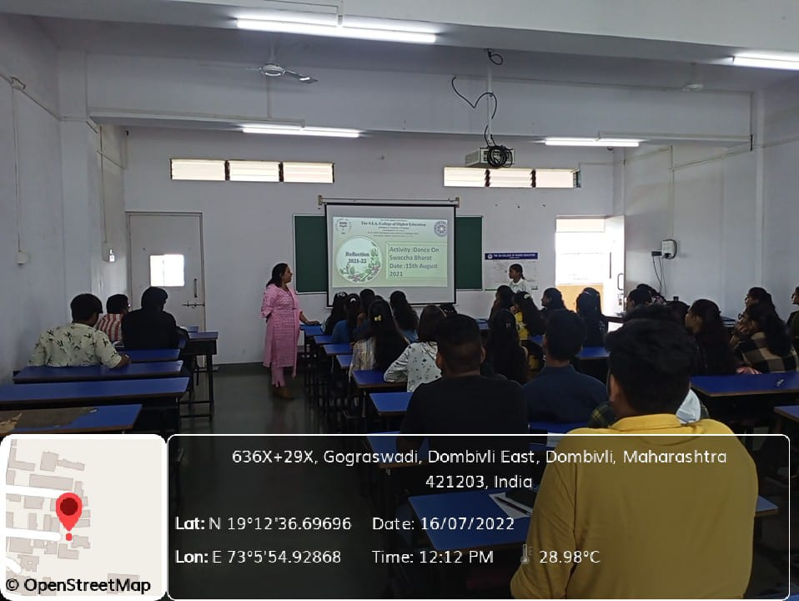
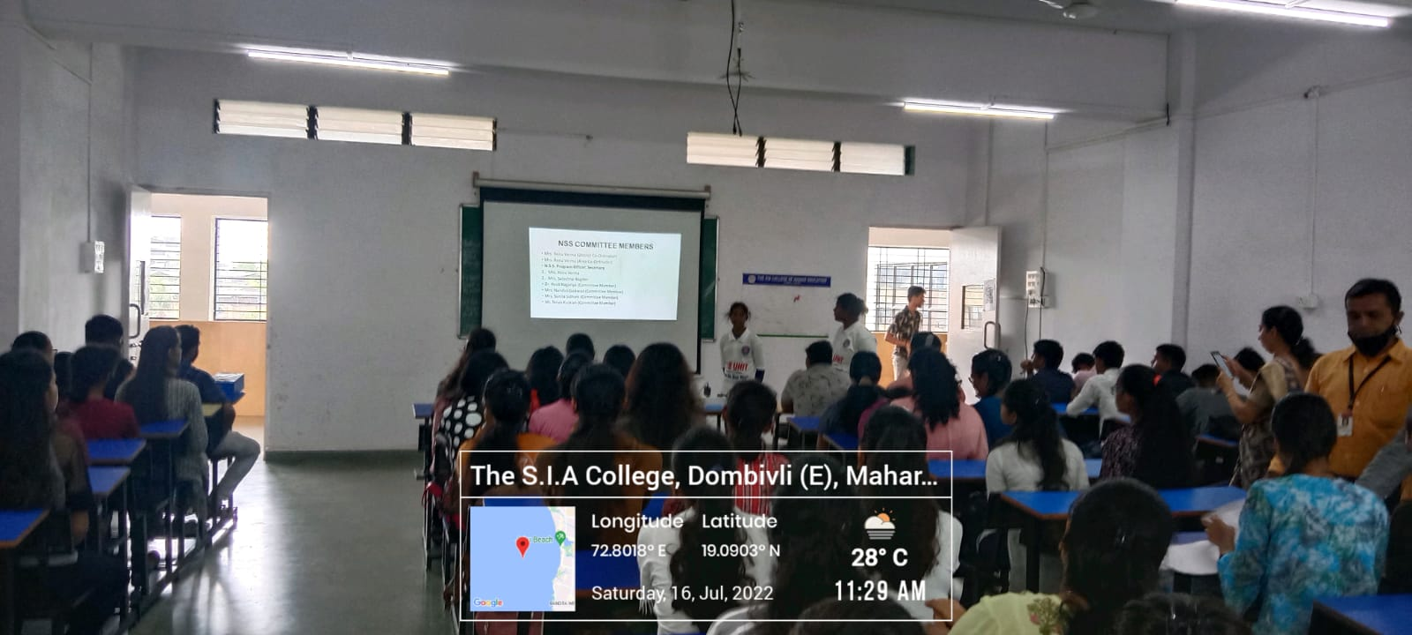
The South Indian Association’s
The S.I.A. College of Higher Education
Affiliated to University of Mumbai
Re-Accredited B+ by NAAC
P-88, MIDC Residential Area Dombivli Gymkhana Road,
Near Balaji Mandir, Dombivli (East), 421203.

Slide 38
The South Indian Association’s
The S.I.A. College of Higher Education
Affiliated to University of Mumbai
Re-Accredited B+ by NAAC
P-88, MIDC Residential Area Dombivli Gymkhana Road,
Near Balaji Mandir, Dombivli (East), 421203.
Activity: Documentary Screening on Kargil Vijay Diwas at The S.I.A College of Higher Education, Classroom.
Date: 26th July 2022
Reflection
2022-23

Slide 39
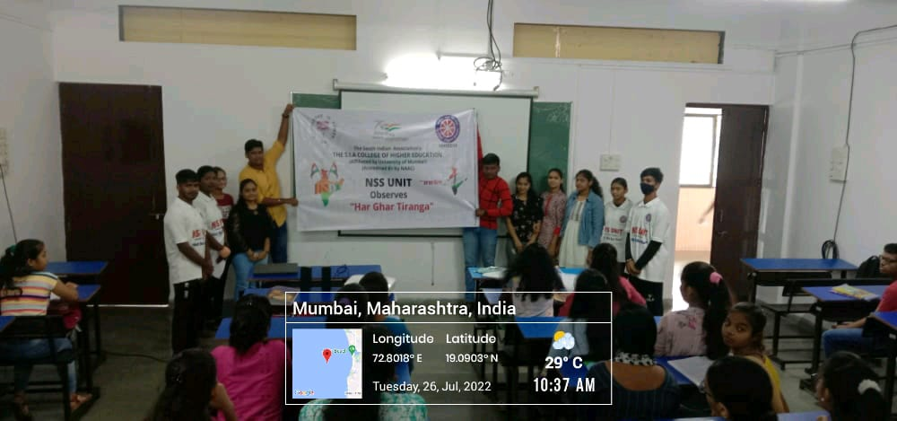
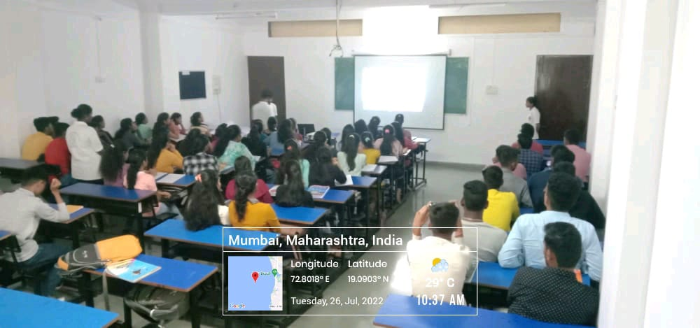
The South Indian Association’s
The S.I.A. College of Higher Education
Affiliated to University of Mumbai
Re-Accredited B+ by NAAC
P-88, MIDC Residential Area Dombivli Gymkhana Road,
Near Balaji Mandir, Dombivli (East), 421203.

Slide 40
The South Indian Association’s
The S.I.A. College of Higher Education
Affiliated to University of Mumbai
Re-Accredited B+ by NAAC
P-88, MIDC Residential Area Dombivli Gymkhana Road,
Near Balaji Mandir, Dombivli (East), 421203.
Activity: Documentary Screening on Kargil Vijay Diwas at Zilla Parishad School.
Date: 26th July 2022
Reflection
2022-23

Slide 41
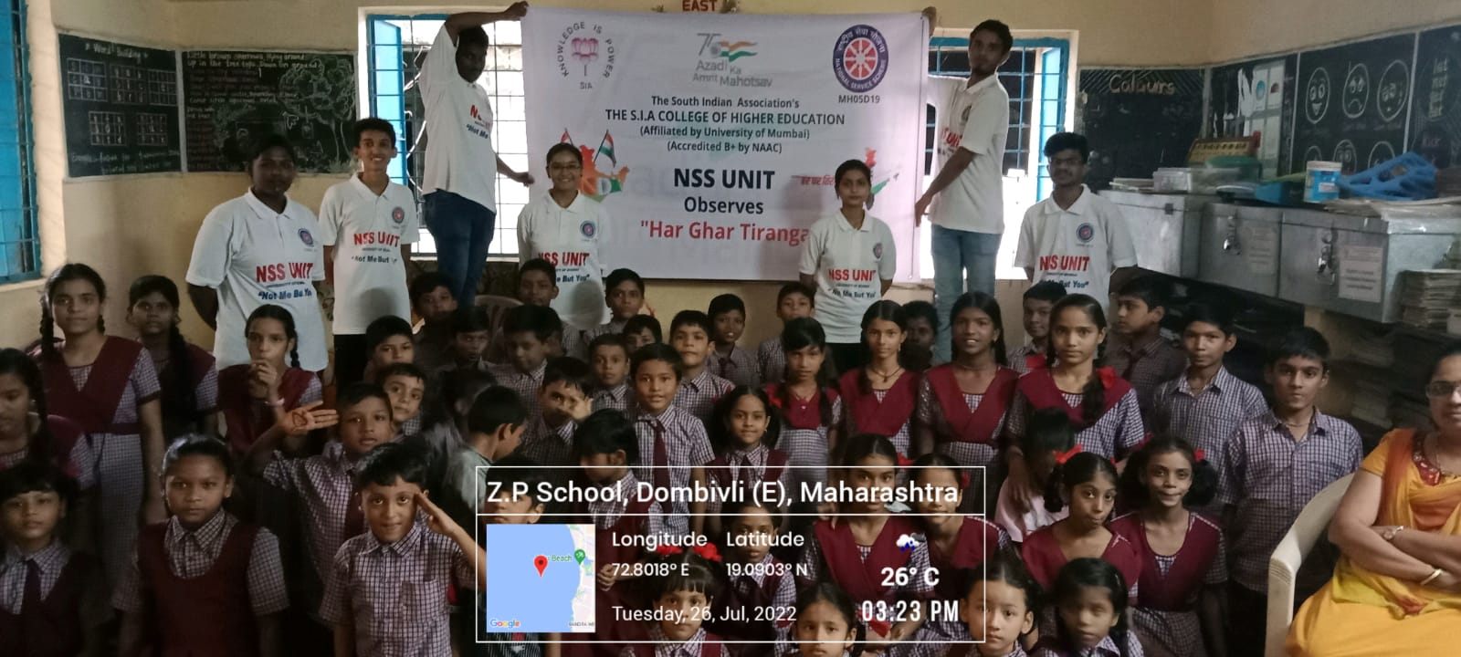
The South Indian Association’s
The S.I.A. College of Higher Education
Affiliated to University of Mumbai
Re-Accredited B+ by NAAC
P-88, MIDC Residential Area Dombivli Gymkhana Road,
Near Balaji Mandir, Dombivli (East), 421203.

Slide 42
The South Indian Association’s
The S.I.A. College of Higher Education
Affiliated to University of Mumbai
Re-Accredited B+ by NAAC
P-88, MIDC Residential Area Dombivli Gymkhana Road,
Near Balaji Mandir, Dombivli (East), 421203.
Activity: Flashmob on Kargil Vijay Diwas in Community.
Date: 26th July 2022
Reflection
2022-23

Slide 43
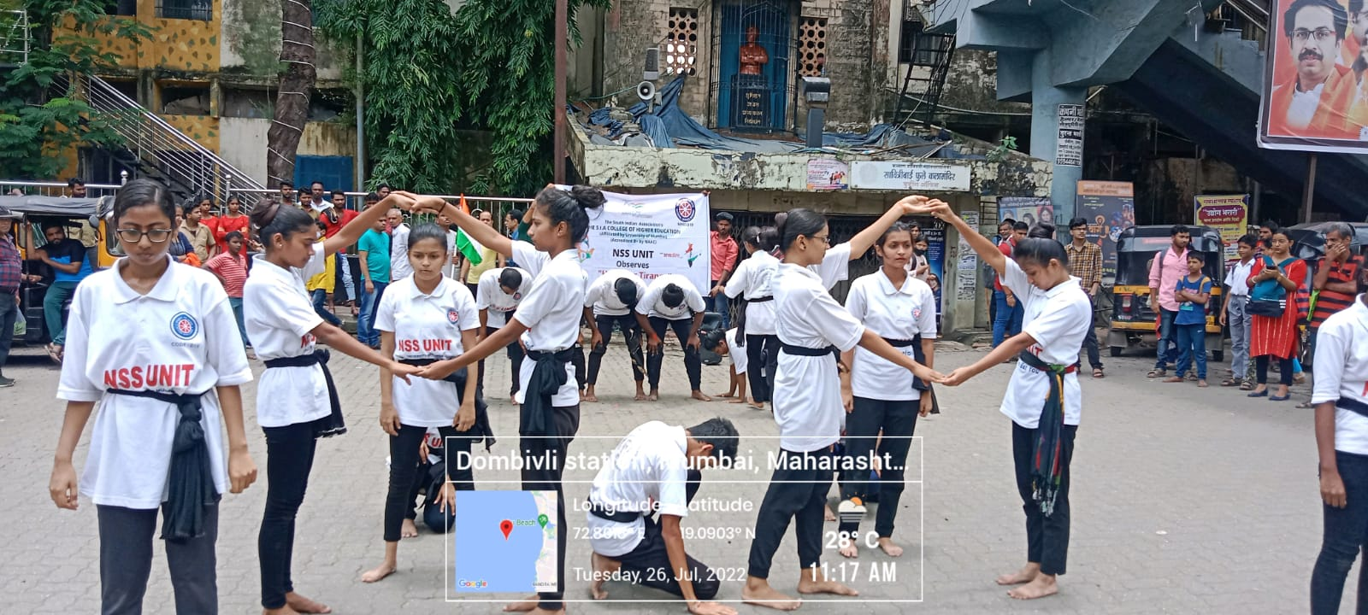
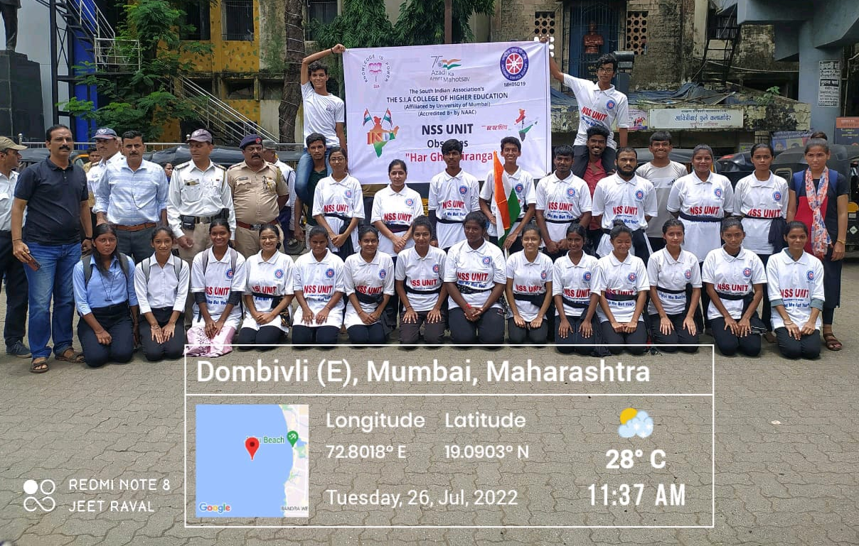
The South Indian Association’s
The S.I.A. College of Higher Education
Affiliated to University of Mumbai
Re-Accredited B+ by NAAC
P-88, MIDC Residential Area Dombivli Gymkhana Road,
Near Balaji Mandir, Dombivli (East), 421203.

Slide 44







The South Indian Association’s
The S.I.A. College of Higher Education
Affiliated to University of Mumbai
Re-Accredited B+ by NAAC
P-88, MIDC Residential Area Dombivli Gymkhana Road,
Near Balaji Mandir, Dombivli (East), 421203.
AUGUST 2022
PLEDGE

Slide 45
The South Indian Association’s
The S.I.A. College of Higher Education
Affiliated to University of Mumbai
Re-Accredited B+ by NAAC
P-88, MIDC Residential Area Dombivli Gymkhana Road,
Near Balaji Mandir, Dombivli (East), 421203.
Activity: Bamboo Selling Drive.
Date: 01st – 10th August 2022.
Reflection
2022-23

Slide 46
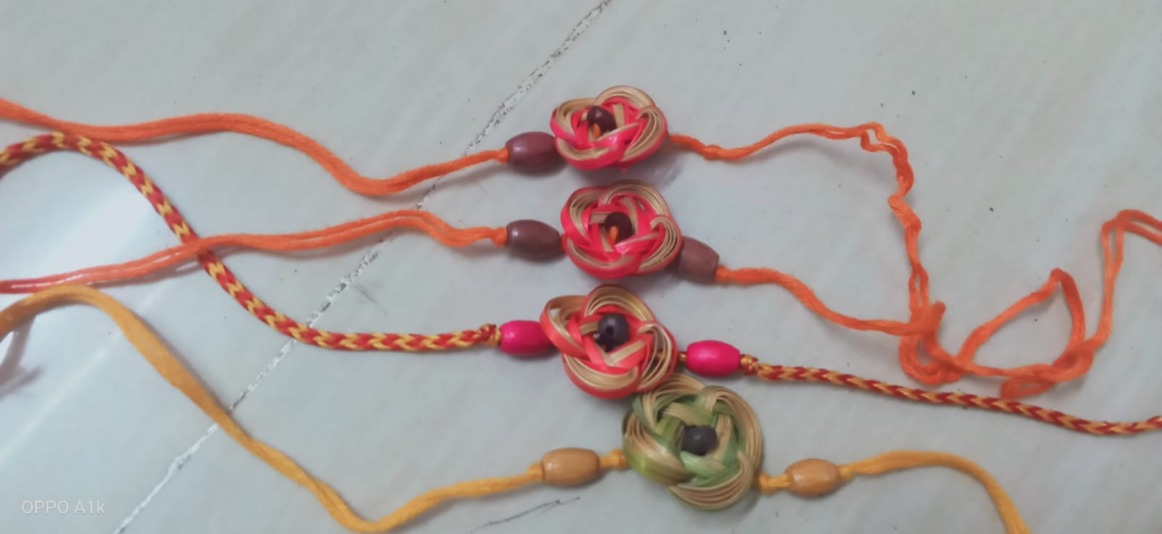
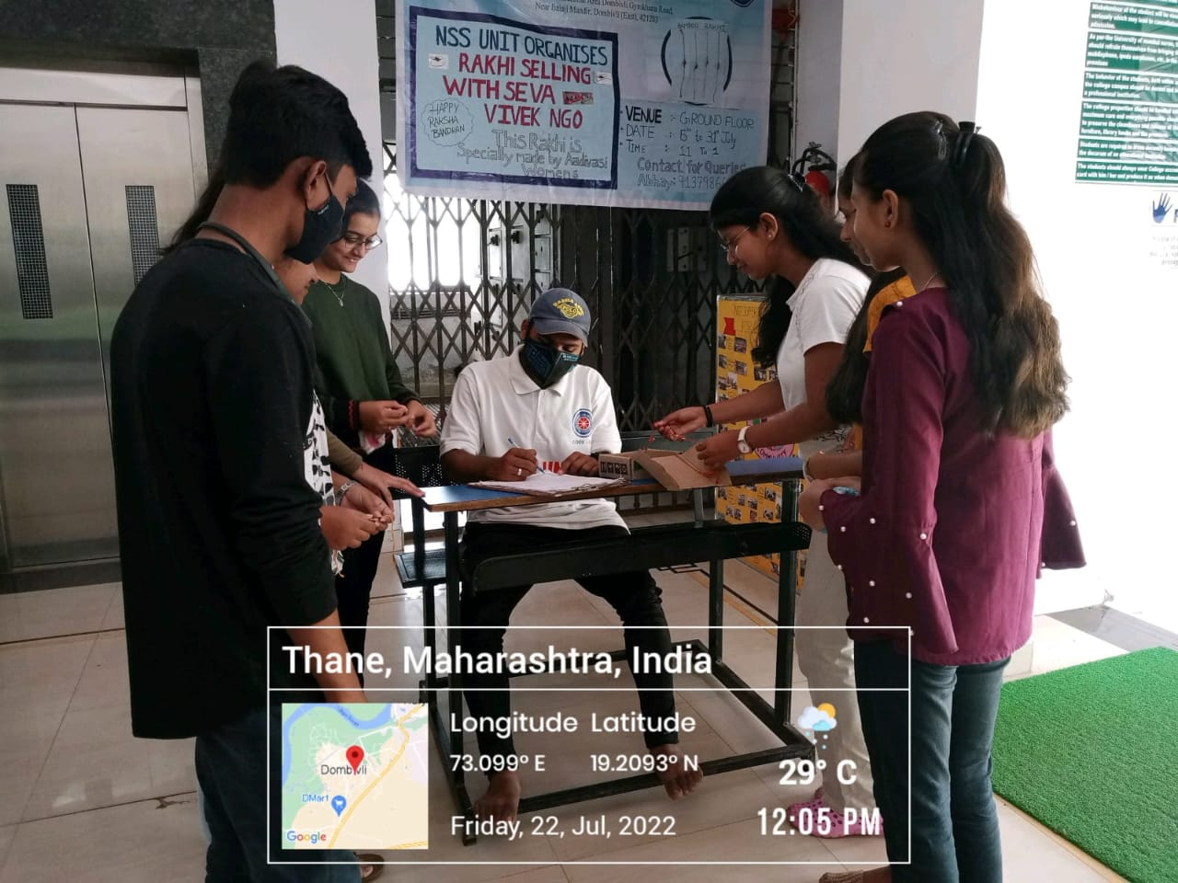
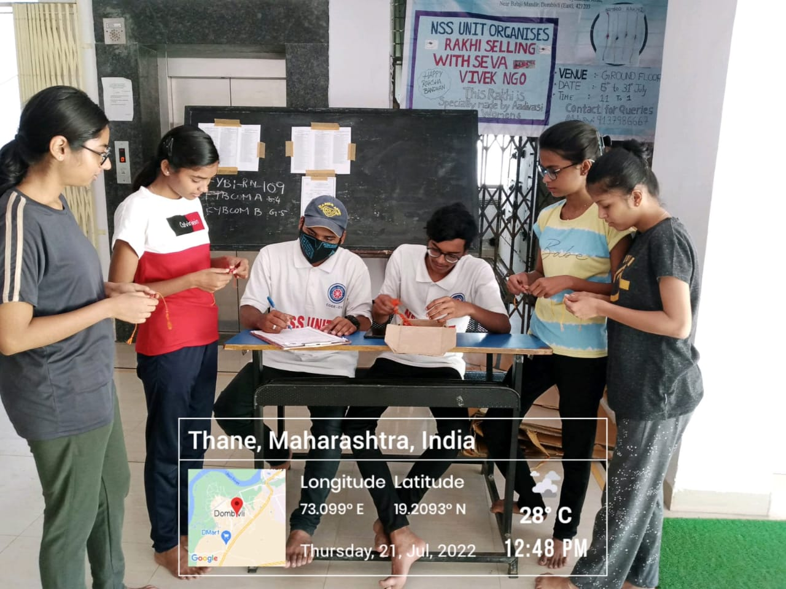
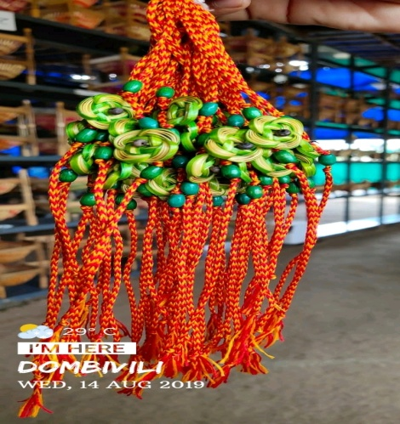
The South Indian Association’s
The S.I.A. College of Higher Education
Affiliated to University of Mumbai
Re-Accredited B+ by NAAC
P-88, MIDC Residential Area Dombivli Gymkhana Road,
Near Balaji Mandir, Dombivli (East), 421203.

Slide 47
The South Indian Association’s
The S.I.A. College of Higher Education
Affiliated to University of Mumbai
Re-Accredited B+ by NAAC
P-88, MIDC Residential Area Dombivli Gymkhana Road,
Near Balaji Mandir, Dombivli (East), 421203.
Activity: Online Pledge on Swachh Bharat under Swachhta Pakhwada.
Date: 01st August 2022
Reflection
2022-23

Slide 48


The South Indian Association’s
The S.I.A. College of Higher Education
Affiliated to University of Mumbai
Re-Accredited B+ by NAAC
P-88, MIDC Residential Area Dombivli Gymkhana Road,
Near Balaji Mandir, Dombivli (East), 421203.

Slide 49
The South Indian Association’s
The S.I.A. College of Higher Education
Affiliated to University of Mumbai
Re-Accredited B+ by NAAC
P-88, MIDC Residential Area Dombivli Gymkhana Road,
Near Balaji Mandir, Dombivli (East), 421203.
Activity: Cleanliness Drive - Outside College under Swachhta Pakhwada.
Date: 02st August 2022
Reflection
2022-23

Slide 50
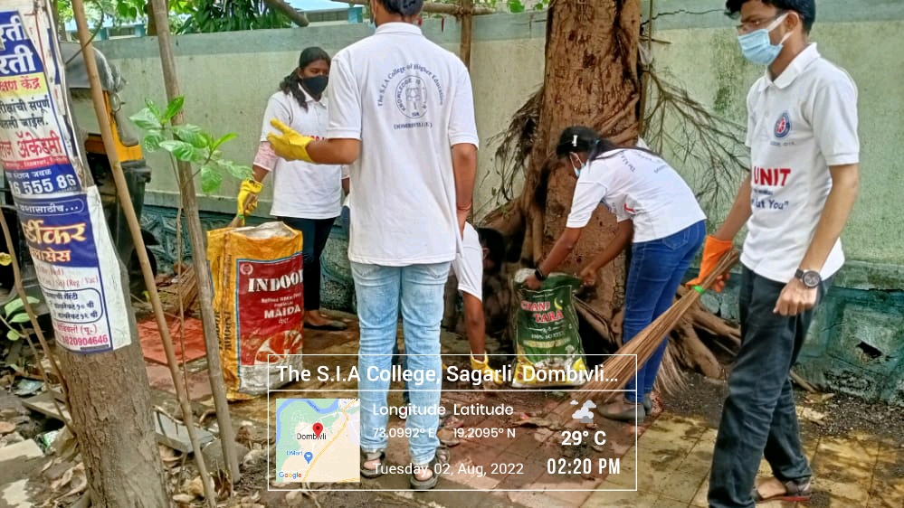
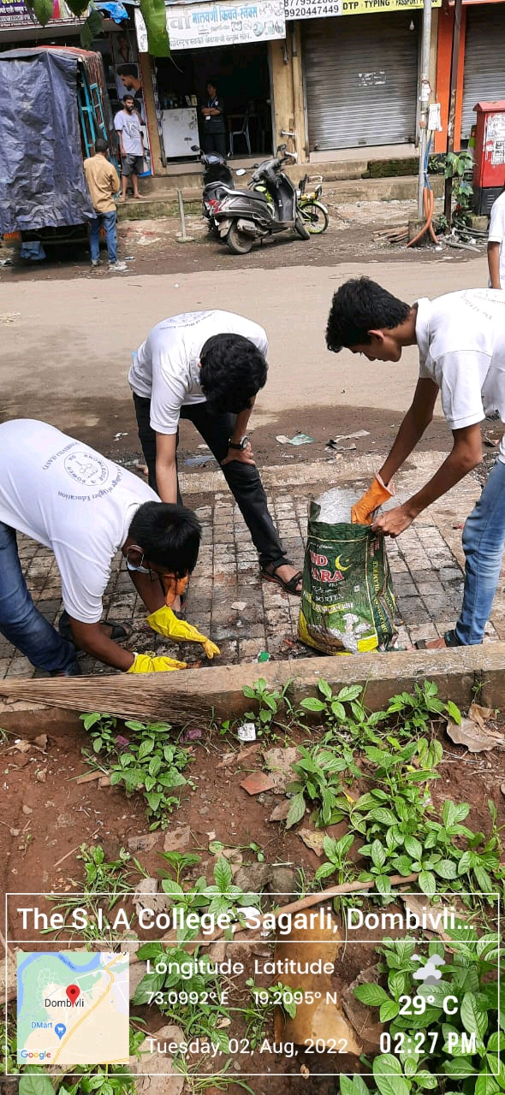
The South Indian Association’s
The S.I.A. College of Higher Education
Affiliated to University of Mumbai
Re-Accredited B+ by NAAC
P-88, MIDC Residential Area Dombivli Gymkhana Road,
Near Balaji Mandir, Dombivli (East), 421203.

Slide 51
The South Indian Association’s
The S.I.A. College of Higher Education
Affiliated to University of Mumbai
Re-Accredited B+ by NAAC
P-88, MIDC Residential Area Dombivli Gymkhana Road,
Near Balaji Mandir, Dombivli (East), 421203.
Activity: Cleanliness Drive at NSS Adopted Area, Sagarli Gaon under Swachhta Pakhwada.
Date: 03rd August 2022
Reflection
2022-23

Slide 52
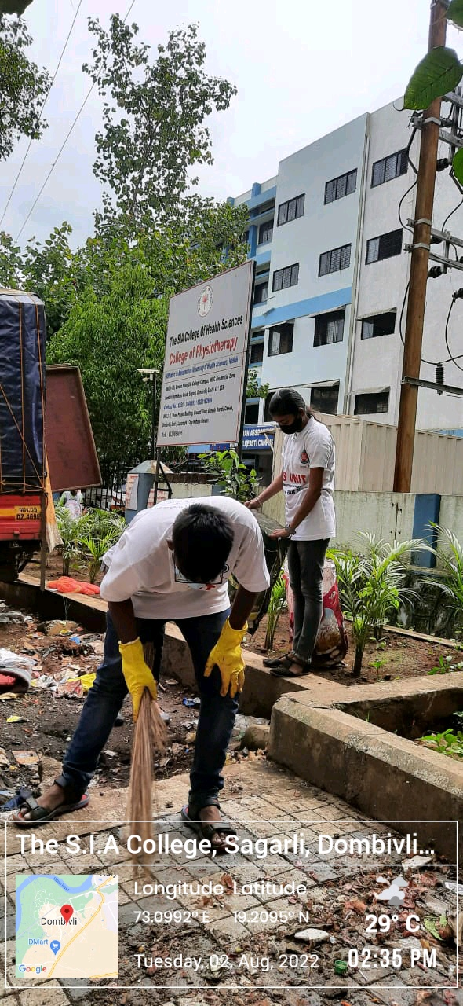
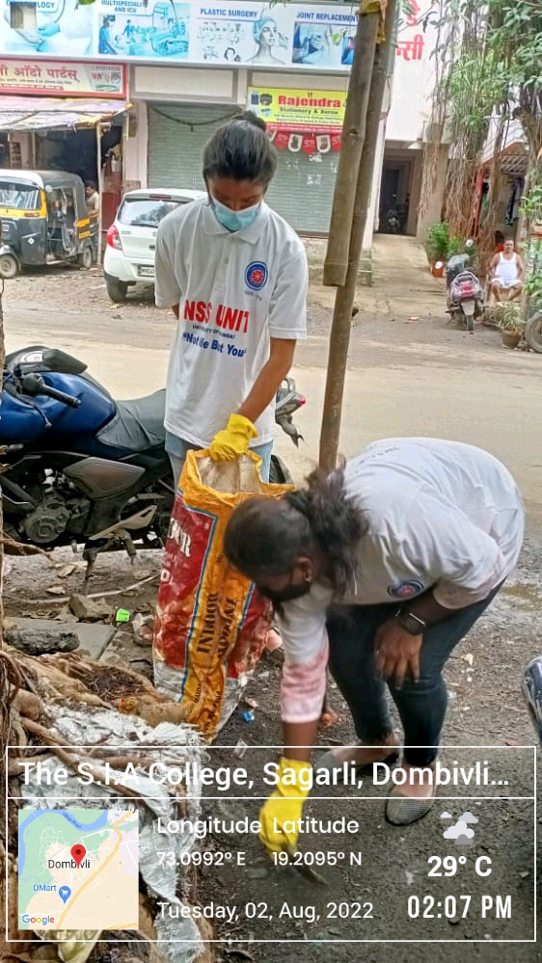
The South Indian Association’s
The S.I.A. College of Higher Education
Affiliated to University of Mumbai
Re-Accredited B+ by NAAC
P-88, MIDC Residential Area Dombivli Gymkhana Road,
Near Balaji Mandir, Dombivli (East), 421203.

Slide 53
The South Indian Association’s
The S.I.A. College of Higher Education
Affiliated to University of Mumbai
Re-Accredited B+ by NAAC
P-88, MIDC Residential Area Dombivli Gymkhana Road,
Near Balaji Mandir, Dombivli (East), 421203.
Activity: Cleanliness Drive at Shastri Nagar Hospital under Swachhta Pakhwada.
Date: 04th August 2022
Reflection
2022-23

Slide 54
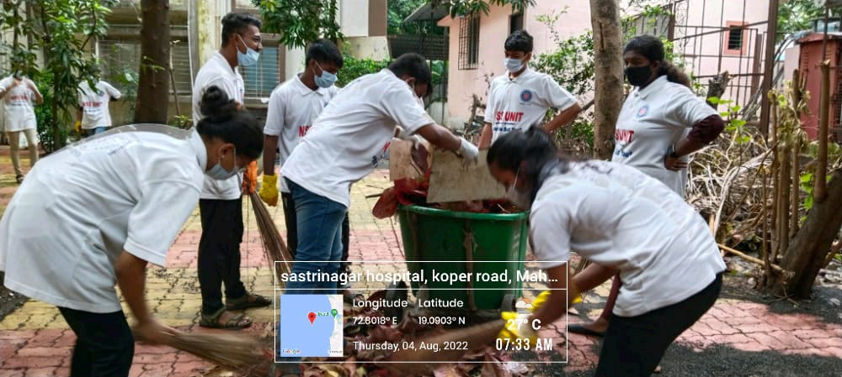
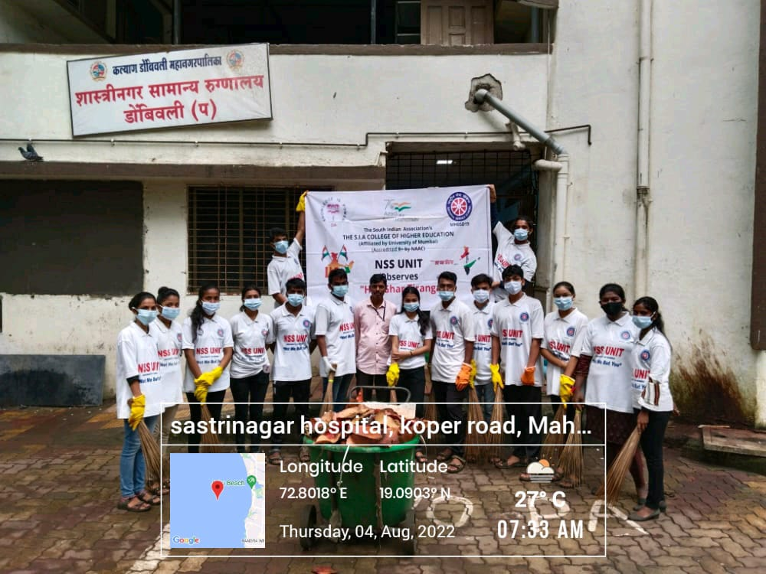
The South Indian Association’s
The S.I.A. College of Higher Education
Affiliated to University of Mumbai
Re-Accredited B+ by NAAC
P-88, MIDC Residential Area Dombivli Gymkhana Road,
Near Balaji Mandir, Dombivli (East), 421203.

Slide 55
The South Indian Association’s
The S.I.A. College of Higher Education
Affiliated to University of Mumbai
Re-Accredited B+ by NAAC
P-88, MIDC Residential Area Dombivli Gymkhana Road,
Near Balaji Mandir, Dombivli (East), 421203.
Activity: Cleanliness Drive at Maitri Charitable Trust under Swachhta Pakhwada.
Date: 05th August 2022
Reflection
2022-23

Slide 56


The South Indian Association’s
The S.I.A. College of Higher Education
Affiliated to University of Mumbai
Re-Accredited B+ by NAAC
P-88, MIDC Residential Area Dombivli Gymkhana Road,
Near Balaji Mandir, Dombivli (East), 421203.

Slide 57
The South Indian Association’s
The S.I.A. College of Higher Education
Affiliated to University of Mumbai
Re-Accredited B+ by NAAC
P-88, MIDC Residential Area Dombivli Gymkhana Road,
Near Balaji Mandir, Dombivli (East), 421203.
Activity: Cleanliness Drive at Zilla Parishad School under Swachhta Pakhwada.
Date: 06th August 2022
Reflection
2022-23

Slide 58


The South Indian Association’s
The S.I.A. College of Higher Education
Affiliated to University of Mumbai
Re-Accredited B+ by NAAC
P-88, MIDC Residential Area Dombivli Gymkhana Road,
Near Balaji Mandir, Dombivli (East), 421203.

Slide 59
The South Indian Association’s
The S.I.A. College of Higher Education
Affiliated to University of Mumbai
Re-Accredited B+ by NAAC
P-88, MIDC Residential Area Dombivli Gymkhana Road,
Near Balaji Mandir, Dombivli (East), 421203.
Activity: Cotton Bag Distribution in Community under Swachhta Pakhwada.
Date: 07th August 2022
Reflection
2022-23

Slide 60


The South Indian Association’s
The S.I.A. College of Higher Education
Affiliated to University of Mumbai
Re-Accredited B+ by NAAC
P-88, MIDC Residential Area Dombivli Gymkhana Road,
Near Balaji Mandir, Dombivli (East), 421203.

Slide 61
The South Indian Association’s
The S.I.A. College of Higher Education
Affiliated to University of Mumbai
Re-Accredited B+ by NAAC
P-88, MIDC Residential Area Dombivli Gymkhana Road,
Near Balaji Mandir, Dombivli (East), 421203.
Activity: Cleanliness Drive at Dombivli Bus Depo under Swachhta Pakhwada.
Date: 07th August 2022
Reflection
2022-23

Slide 62


The South Indian Association’s
The S.I.A. College of Higher Education
Affiliated to University of Mumbai
Re-Accredited B+ by NAAC
P-88, MIDC Residential Area Dombivli Gymkhana Road,
Near Balaji Mandir, Dombivli (East), 421203.

Slide 63
The South Indian Association’s
The S.I.A. College of Higher Education
Affiliated to University of Mumbai
Re-Accredited B+ by NAAC
P-88, MIDC Residential Area Dombivli Gymkhana Road,
Near Balaji Mandir, Dombivli (East), 421203.
Activity: Documentary Screening at Zilla Parishad under Swachhta Pakhwada.
Date: 08th August 2022
Reflection
2022-23

Slide 64


The South Indian Association’s
The S.I.A. College of Higher Education
Affiliated to University of Mumbai
Re-Accredited B+ by NAAC
P-88, MIDC Residential Area Dombivli Gymkhana Road,
Near Balaji Mandir, Dombivli (East), 421203.

Slide 65
The South Indian Association’s
The S.I.A. College of Higher Education
Affiliated to University of Mumbai
Re-Accredited B+ by NAAC
P-88, MIDC Residential Area Dombivli Gymkhana Road,
Near Balaji Mandir, Dombivli (East), 421203.
Activity: Street Play on Swachh Bharat in Community under Swachhta Pakhwada.
Date: 10th August 2022
Reflection
2022-23

Slide 66


The South Indian Association’s
The S.I.A. College of Higher Education
Affiliated to University of Mumbai
Re-Accredited B+ by NAAC
P-88, MIDC Residential Area Dombivli Gymkhana Road,
Near Balaji Mandir, Dombivli (East), 421203.

Slide 67
The South Indian Association’s
The S.I.A. College of Higher Education
Affiliated to University of Mumbai
Re-Accredited B+ by NAAC
P-88, MIDC Residential Area Dombivli Gymkhana Road,
Near Balaji Mandir, Dombivli (East), 421203.
Activity: Rally from S.I.A College of Higher Education to Garda Circle under Azadi Ka Amrit Mahotsav.
Date: 10th August 2022
Reflection
2022-23

Slide 68


The South Indian Association’s
The S.I.A. College of Higher Education
Affiliated to University of Mumbai
Re-Accredited B+ by NAAC
P-88, MIDC Residential Area Dombivli Gymkhana Road,
Near Balaji Mandir, Dombivli (East), 421203.

Slide 69
The South Indian Association’s
The S.I.A. College of Higher Education
Affiliated to University of Mumbai
Re-Accredited B+ by NAAC
P-88, MIDC Residential Area Dombivli Gymkhana Road,
Near Balaji Mandir, Dombivli (East), 421203.
Activity: Best Out of Waste Competition at The S.I.A College of Higher Education under Swachhta Pakhwada.
Date: 12th August 2022
Reflection
2022-23

Slide 70


The South Indian Association’s
The S.I.A. College of Higher Education
Affiliated to University of Mumbai
Re-Accredited B+ by NAAC
P-88, MIDC Residential Area Dombivli Gymkhana Road,
Near Balaji Mandir, Dombivli (East), 421203.

Slide 71
The South Indian Association’s
The S.I.A. College of Higher Education
Affiliated to University of Mumbai
Re-Accredited B+ by NAAC
P-88, MIDC Residential Area Dombivli Gymkhana Road,
Near Balaji Mandir, Dombivli (East), 421203.
Activity: Online Quiz Competition on Swachh Bharat under Swachhta Pakhwada.
Date: 12th August 2022
Reflection
2022-23

Slide 72


The South Indian Association’s
The S.I.A. College of Higher Education
Affiliated to University of Mumbai
Re-Accredited B+ by NAAC
P-88, MIDC Residential Area Dombivli Gymkhana Road,
Near Balaji Mandir, Dombivli (East), 421203.

Slide 73
The South Indian Association’s
The S.I.A. College of Higher Education
Affiliated to University of Mumbai
Re-Accredited B+ by NAAC
P-88, MIDC Residential Area Dombivli Gymkhana Road,
Near Balaji Mandir, Dombivli (East), 421203.
Activity: Rangoli Competition at The S.I.A College of Higher Education under Swachhta Pakhwada.
Date: 13th August 2022
Reflection
2022-23

Slide 74


The South Indian Association’s
The S.I.A. College of Higher Education
Affiliated to University of Mumbai
Re-Accredited B+ by NAAC
P-88, MIDC Residential Area Dombivli Gymkhana Road,
Near Balaji Mandir, Dombivli (East), 421203.

Slide 75
The South Indian Association’s
The S.I.A. College of Higher Education
Affiliated to University of Mumbai
Re-Accredited B+ by NAAC
P-88, MIDC Residential Area Dombivli Gymkhana Road,
Near Balaji Mandir, Dombivli (East), 421203.
Activity: Rally at The S.I.A School under Azadi Ka Amrit Mahotsav.
Date: 13th August 2022
Reflection
2022-23

Slide 76


The South Indian Association’s
The S.I.A. College of Higher Education
Affiliated to University of Mumbai
Re-Accredited B+ by NAAC
P-88, MIDC Residential Area Dombivli Gymkhana Road,
Near Balaji Mandir, Dombivli (East), 421203.

Slide 77
The South Indian Association’s
The S.I.A. College of Higher Education
Affiliated to University of Mumbai
Re-Accredited B+ by NAAC
P-88, MIDC Residential Area Dombivli Gymkhana Road,
Near Balaji Mandir, Dombivli (East), 421203.
Activity: Rally at Kalina University under Azadi Ka Amrit Mahotsav.
Date: 13th August 2022
Reflection
2022-23

Slide 78


The South Indian Association’s
The S.I.A. College of Higher Education
Affiliated to University of Mumbai
Re-Accredited B+ by NAAC
P-88, MIDC Residential Area Dombivli Gymkhana Road,
Near Balaji Mandir, Dombivli (East), 421203.

Slide 79
The South Indian Association’s
The S.I.A. College of Higher Education
Affiliated to University of Mumbai
Re-Accredited B+ by NAAC
P-88, MIDC Residential Area Dombivli Gymkhana Road,
Near Balaji Mandir, Dombivli (East), 421203.
Activity: Flashmob at 90 Feet Road, Khambalpada, under Azadi ka Amrit Mahotsav.
Date: 14th August 2022
Reflection
2022-23

Slide 80

The South Indian Association’s
The S.I.A. College of Higher Education
Affiliated to University of Mumbai
Re-Accredited B+ by NAAC
P-88, MIDC Residential Area Dombivli Gymkhana Road,
Near Balaji Mandir, Dombivli (East), 421203.

Slide 81
The South Indian Association’s
The S.I.A. College of Higher Education
Affiliated to University of Mumbai
Re-Accredited B+ by NAAC
P-88, MIDC Residential Area Dombivli Gymkhana Road,
Near Balaji Mandir, Dombivli (East), 421203.
Activity: Flag Distribution at NSS Adopted Area, Sagarli Gaon, under Azadi Ka Amrit Mahotsav.
Date: 14th August 2022
Reflection
2022-23

Slide 82


The South Indian Association’s
The S.I.A. College of Higher Education
Affiliated to University of Mumbai
Re-Accredited B+ by NAAC
P-88, MIDC Residential Area Dombivli Gymkhana Road,
Near Balaji Mandir, Dombivli (East), 421203.

Slide 83
The South Indian Association’s
The S.I.A. College of Higher Education
Affiliated to University of Mumbai
Re-Accredited B+ by NAAC
P-88, MIDC Residential Area Dombivli Gymkhana Road,
Near Balaji Mandir, Dombivli (East), 421203.
Activity: Street Play at 90 Feet Road, Khambalpada, Dombivli (E).
Date: 14th August 2022
Reflection
2022-23

Slide 84
The South Indian Association’s
The S.I.A. College of Higher Education
Affiliated to University of Mumbai
Re-Accredited B+ by NAAC
P-88, MIDC Residential Area Dombivli Gymkhana Road,
Near Balaji Mandir, Dombivli (East), 421203.
Activity: Greeting Card Distribution at NSS Adopted Area, Sagarli Gaon under Azadi Ka Amrit Mahotsav.
Date: 15th August 2022
Reflection
2022-23

Slide 85


The South Indian Association’s
The S.I.A. College of Higher Education
Affiliated to University of Mumbai
Re-Accredited B+ by NAAC
P-88, MIDC Residential Area Dombivli Gymkhana Road,
Near Balaji Mandir, Dombivli (East), 421203.

Slide 86




The South Indian Association’s
The S.I.A. College of Higher Education
Affiliated to University of Mumbai
Re-Accredited B+ by NAAC
P-88, MIDC Residential Area Dombivli Gymkhana Road,
Near Balaji Mandir, Dombivli (East), 421203.
SEPTEMBER 2022

Slide 87
The South Indian Association’s
The S.I.A. College of Higher Education
Affiliated to University of Mumbai
Re-Accredited B+ by NAAC
P-88, MIDC Residential Area Dombivli Gymkhana Road,
Near Balaji Mandir, Dombivli (East), 421203.
Activity: Nirmalya Collection
Date: 1st,4th,5th & 9th September 2022
Reflection
2022-23

Slide 88


The South Indian Association’s
The S.I.A. College of Higher Education
Affiliated to University of Mumbai
Re-Accredited B+ by NAAC
P-88, MIDC Residential Area Dombivli Gymkhana Road,
Near Balaji Mandir, Dombivli (East), 421203.

Slide 89
The South Indian Association’s
The S.I.A. College of Higher Education
Affiliated to University of Mumbai
Re-Accredited B+ by NAAC
P-88, MIDC Residential Area Dombivli Gymkhana Road,
Near Balaji Mandir, Dombivli (East), 421203.
Activity: CPR Training.
Date: 15th September 2022.
Reflection
2022-23

Slide 90


The South Indian Association’s
The S.I.A. College of Higher Education
Affiliated to University of Mumbai
Re-Accredited B+ by NAAC
P-88, MIDC Residential Area Dombivli Gymkhana Road,
Near Balaji Mandir, Dombivli (East), 421203.

Slide 91
The South Indian Association’s
The S.I.A. College of Higher Education
Affiliated to University of Mumbai
Re-Accredited B+ by NAAC
P-88, MIDC Residential Area Dombivli Gymkhana Road,
Near Balaji Mandir, Dombivli (East), 421203.
Activity: Blood Donation Drive at Dombivli Station.
Date: 17th September 2022.
Reflection
2022-23

Slide 92


The South Indian Association’s
The S.I.A. College of Higher Education
Affiliated to University of Mumbai
Re-Accredited B+ by NAAC
P-88, MIDC Residential Area Dombivli Gymkhana Road,
Near Balaji Mandir, Dombivli (East), 421203.

Slide 93
The South Indian Association’s
The S.I.A. College of Higher Education
Affiliated to University of Mumbai
Re-Accredited B+ by NAAC
P-88, MIDC Residential Area Dombivli Gymkhana Road,
Near Balaji Mandir, Dombivli (East), 421203.
Activity: Pulse Polio Drive at Tilak Nagar.
Date: 18th September 2022.
Reflection
2022-23

Slide 94


The South Indian Association’s
The S.I.A. College of Higher Education
Affiliated to University of Mumbai
Re-Accredited B+ by NAAC
P-88, MIDC Residential Area Dombivli Gymkhana Road,
Near Balaji Mandir, Dombivli (East), 421203.

Slide 95
The South Indian Association’s
The S.I.A. College of Higher Education
Affiliated to University of Mumbai
Re-Accredited B+ by NAAC
P-88, MIDC Residential Area Dombivli Gymkhana Road,
Near Balaji Mandir, Dombivli (East), 421203.
Activity: Celebrating NSS Day at The S.I.A College of Higher Education, Ground.
Date: 24th September 2022.
Reflection
2022-23

Slide 96


The South Indian Association’s
The S.I.A. College of Higher Education
Affiliated to University of Mumbai
Re-Accredited B+ by NAAC
P-88, MIDC Residential Area Dombivli Gymkhana Road,
Near Balaji Mandir, Dombivli (East), 421203.

Slide 97
The South Indian Association’s
The S.I.A. College of Higher Education
Affiliated to University of Mumbai
Re-Accredited B+ by NAAC
P-88, MIDC Residential Area Dombivli Gymkhana Road,
Near Balaji Mandir, Dombivli (East), 421203.
Activity: Cotton Bag Distribution in Community.
Date: 24th September 2022.
Reflection
2022-23

Slide 98


The South Indian Association’s
The S.I.A. College of Higher Education
Affiliated to University of Mumbai
Re-Accredited B+ by NAAC
P-88, MIDC Residential Area Dombivli Gymkhana Road,
Near Balaji Mandir, Dombivli (East), 421203.

Slide 99



The South Indian Association’s
The S.I.A. College of Higher Education
Affiliated to University of Mumbai
Re-Accredited B+ by NAAC
P-88, MIDC Residential Area Dombivli Gymkhana Road,
Near Balaji Mandir, Dombivli (East), 421203.
OCTOBER 2022

Slide 100
The South Indian Association’s
The S.I.A. College of Higher Education
Affiliated to University of Mumbai
Re-Accredited B+ by NAAC
P-88, MIDC Residential Area Dombivli Gymkhana Road,
Near Balaji Mandir, Dombivli (East), 421203.
Activity: Bhajan Sandhya at Gate Way of India, CSMT.
Date: 02nd October 2022.
Reflection
2022-23

Slide 101


The South Indian Association’s
The S.I.A. College of Higher Education
Affiliated to University of Mumbai
Re-Accredited B+ by NAAC
P-88, MIDC Residential Area Dombivli Gymkhana Road,
Near Balaji Mandir, Dombivli (East), 421203.

Slide 102
The South Indian Association’s
The S.I.A. College of Higher Education
Affiliated to University of Mumbai
Re-Accredited B+ by NAAC
P-88, MIDC Residential Area Dombivli Gymkhana Road,
Near Balaji Mandir, Dombivli (East), 421203.
Activity: Collection of Donation at Sagarli Gaon.
Date: 19th, 20th & 21st October 2022.
Reflection
2022-23

Slide 103



The South Indian Association’s
The S.I.A. College of Higher Education
Affiliated to University of Mumbai
Re-Accredited B+ by NAAC
P-88, MIDC Residential Area Dombivli Gymkhana Road,
Near Balaji Mandir, Dombivli (East), 421203.

Slide 104
The South Indian Association’s
The S.I.A. College of Higher Education
Affiliated to University of Mumbai
Re-Accredited B+ by NAAC
P-88, MIDC Residential Area Dombivli Gymkhana Road,
Near Balaji Mandir, Dombivli (East), 421203.
Activity: Donation Drive at Ayregaon Slum Area, Kopar (E).
Date: 22nd October 2022.
Reflection
2022-23

Slide 105


The South Indian Association’s
The S.I.A. College of Higher Education
Affiliated to University of Mumbai
Re-Accredited B+ by NAAC
P-88, MIDC Residential Area Dombivli Gymkhana Road,
Near Balaji Mandir, Dombivli (East), 421203.

Slide 106
The South Indian Association’s
The S.I.A. College of Higher Education
Affiliated to University of Mumbai
Re-Accredited B+ by NAAC
P-88, MIDC Residential Area Dombivli Gymkhana Road,
Near Balaji Mandir, Dombivli (East), 421203.
Activity: Donation Drive at Maitri Old Age Home.
Date: 24th October 2022.
Reflection
2022-23

Slide 107


The South Indian Association’s
The S.I.A. College of Higher Education
Affiliated to University of Mumbai
Re-Accredited B+ by NAAC
P-88, MIDC Residential Area Dombivli Gymkhana Road,
Near Balaji Mandir, Dombivli (East), 421203.

Slide 108
The South Indian Association’s
The S.I.A. College of Higher Education
Affiliated to University of Mumbai
Re-Accredited B+ by NAAC
P-88, MIDC Residential Area Dombivli Gymkhana Road,
Near Balaji Mandir, Dombivli (East), 421203.
Activity: Donation Drive at Janani Ashish.
Date: 24th October 2022.
Reflection
2022-23

Slide 109

The South Indian Association’s
The S.I.A. College of Higher Education
Affiliated to University of Mumbai
Re-Accredited B+ by NAAC
P-88, MIDC Residential Area Dombivli Gymkhana Road,
Near Balaji Mandir, Dombivli (East), 421203.

Slide 110
The South Indian Association’s
The S.I.A. College of Higher Education
Affiliated to University of Mumbai
Re-Accredited B+ by NAAC
P-88, MIDC Residential Area Dombivli Gymkhana Road,
Near Balaji Mandir, Dombivli (East), 421203.
Activity: Street Play on National Unity Day at NSS Adopted Area, Sagarli Gaon.
Date: 31st October 2022.
Reflection
2022-23

Slide 111


The South Indian Association’s
The S.I.A. College of Higher Education
Affiliated to University of Mumbai
Re-Accredited B+ by NAAC
P-88, MIDC Residential Area Dombivli Gymkhana Road,
Near Balaji Mandir, Dombivli (East), 421203.

Slide 112



The South Indian Association’s
The S.I.A. College of Higher Education
Affiliated to University of Mumbai
Re-Accredited B+ by NAAC
P-88, MIDC Residential Area Dombivli Gymkhana Road,
Near Balaji Mandir, Dombivli (East), 421203.
NOVEMBER 2022

Slide 113
The South Indian Association’s
The S.I.A. College of Higher Education
Affiliated to University of Mumbai
Re-Accredited B+ by NAAC
P-88, MIDC Residential Area Dombivli Gymkhana Road,
Near Balaji Mandir, Dombivli (East), 421203.
Activity: Online Session on Anti – Corruption.
Date: 04th November 2022.
Reflection
2022-23

Slide 114


The South Indian Association’s
The S.I.A. College of Higher Education
Affiliated to University of Mumbai
Re-Accredited B+ by NAAC
P-88, MIDC Residential Area Dombivli Gymkhana Road,
Near Balaji Mandir, Dombivli (East), 421203.

Slide 115
The South Indian Association’s
The S.I.A. College of Higher Education
Affiliated to University of Mumbai
Re-Accredited B+ by NAAC
P-88, MIDC Residential Area Dombivli Gymkhana Road,
Near Balaji Mandir, Dombivli (East), 421203.
Activity: Online Session on importance of Vigilance Awareness Week.
Date: 06th November 2022.
Reflection
2022-23

Slide 116

The South Indian Association’s
The S.I.A. College of Higher Education
Affiliated to University of Mumbai
Re-Accredited B+ by NAAC
P-88, MIDC Residential Area Dombivli Gymkhana Road,
Near Balaji Mandir, Dombivli (East), 421203.

Slide 117
The South Indian Association’s
The S.I.A. College of Higher Education
Affiliated to University of Mumbai
Re-Accredited B+ by NAAC
P-88, MIDC Residential Area Dombivli Gymkhana Road,
Near Balaji Mandir, Dombivli (East), 421203.
Activity: Cancer Awareness Day at Ayregaon, Kopar (E).
Date: 07th November 2022.
Reflection
2022-23

Slide 118


The South Indian Association’s
The S.I.A. College of Higher Education
Affiliated to University of Mumbai
Re-Accredited B+ by NAAC
P-88, MIDC Residential Area Dombivli Gymkhana Road,
Near Balaji Mandir, Dombivli (East), 421203.

Slide 119
The South Indian Association’s
The S.I.A. College of Higher Education
Affiliated to University of Mumbai
Re-Accredited B+ by NAAC
P-88, MIDC Residential Area Dombivli Gymkhana Road,
Near Balaji Mandir, Dombivli (East), 421203.
Activity: Documentary Screening on National Education Day at Zilla Parishad School.
Date: 11th November 2022.
Reflection
2022-23

Slide 120
The South Indian Association’s
The S.I.A. College of Higher Education
Affiliated to University of Mumbai
Re-Accredited B+ by NAAC
P-88, MIDC Residential Area Dombivli Gymkhana Road,
Near Balaji Mandir, Dombivli (East), 421203.

Slide 121
The South Indian Association’s
The S.I.A. College of Higher Education
Affiliated to University of Mumbai
Re-Accredited B+ by NAAC
P-88, MIDC Residential Area Dombivli Gymkhana Road,
Near Balaji Mandir, Dombivli (East), 421203.
Activity: Children’s Day Celebration.
Date: 14th November 2022.
Reflection
2022-23

Slide 122



The South Indian Association’s
The S.I.A. College of Higher Education
Affiliated to University of Mumbai
Re-Accredited B+ by NAAC
P-88, MIDC Residential Area Dombivli Gymkhana Road,
Near Balaji Mandir, Dombivli (East), 421203.

Slide 123
The South Indian Association’s
The S.I.A. College of Higher Education
Affiliated to University of Mumbai
Re-Accredited B+ by NAAC
P-88, MIDC Residential Area Dombivli Gymkhana Road,
Near Balaji Mandir, Dombivli (East), 421203.
Activity: 5 Days Leadership Training Program.
Date: 29th November - 03rd December 2022.
Reflection
2022-23

Slide 124




The South Indian Association’s
The S.I.A. College of Higher Education
Affiliated to University of Mumbai
Re-Accredited B+ by NAAC
P-88, MIDC Residential Area Dombivli Gymkhana Road,
Near Balaji Mandir, Dombivli (East), 421203.

Slide 125


The South Indian Association’s
The S.I.A. College of Higher Education
Affiliated to University of Mumbai
Re-Accredited B+ by NAAC
P-88, MIDC Residential Area Dombivli Gymkhana Road,
Near Balaji Mandir, Dombivli (East), 421203.
DECEMBER 2022

Slide 126
The South Indian Association’s
The S.I.A. College of Higher Education
Affiliated to University of Mumbai
Re-Accredited B+ by NAAC
P-88, MIDC Residential Area Dombivli Gymkhana Road,
Near Balaji Mandir, Dombivli (East), 421203.
Activity: Celebrating World Aids Day at Dombivli Station .
Date: 01st December 2022.
Reflection
2022-23

Slide 127


The South Indian Association’s
The S.I.A. College of Higher Education
Affiliated to University of Mumbai
Re-Accredited B+ by NAAC
P-88, MIDC Residential Area Dombivli Gymkhana Road,
Near Balaji Mandir, Dombivli (East), 421203.

Slide 128
The South Indian Association’s
The S.I.A. College of Higher Education
Affiliated to University of Mumbai
Re-Accredited B+ by NAAC
P-88, MIDC Residential Area Dombivli Gymkhana Road,
Near Balaji Mandir, Dombivli (East), 421203.
Activity: 7 Days Residential Camp.
Date: 22nd December – 28th December 2022.
Reflection
2022-23

Slide 129


The South Indian Association’s
The S.I.A. College of Higher Education
Affiliated to University of Mumbai
Re-Accredited B+ by NAAC
P-88, MIDC Residential Area Dombivli Gymkhana Road,
Near Balaji Mandir, Dombivli (East), 421203.

Slide 130

The South Indian Association’s
The S.I.A. College of Higher Education
Affiliated to University of Mumbai
Accredited B+ by NAAC
P-88, MIDC Residential Area Dombivli Gymkhana Road,
Near Balaji Mandir, Dombivli (East), 421203.

Slide 131


The South Indian Association’s
The S.I.A. College of Higher Education
Affiliated to University of Mumbai
Re-Accredited B+ by NAAC
P-88, MIDC Residential Area Dombivli Gymkhana Road,
Near Balaji Mandir, Dombivli (East), 421203.
JANUARY 2023
IG POSTER MAKING COMPETITION

Slide 132
The South Indian Association’s
The S.I.A. College of Higher Education
Affiliated to University of Mumbai
Re-Accredited B+ by NAAC
P-88, MIDC Residential Area Dombivli Gymkhana Road,
Near Balaji Mandir, Dombivli (East), 421203.
Activity: Street Play on Road Safety at Morvika, Dombivli (E).
Date: 06th January 2023.
Reflection
2022-23

Slide 133


The South Indian Association’s
The S.I.A. College of Higher Education
Affiliated to University of Mumbai
Re-Accredited B+ by NAAC
P-88, MIDC Residential Area Dombivli Gymkhana Road,
Near Balaji Mandir, Dombivli (East), 421203.

Slide 134
The South Indian Association’s
The S.I.A. College of Higher Education
Affiliated to University of Mumbai
Re-Accredited B+ by NAAC
P-88, MIDC Residential Area Dombivli Gymkhana Road,
Near Balaji Mandir, Dombivli (East), 421203.
Activity: Street Play on Cyber Crime at NSS Adopted Area, Sagarli Gaon.
Date: 06th January 2023.
Reflection
2022-23

Slide 135


The South Indian Association’s
The S.I.A. College of Higher Education
Affiliated to University of Mumbai
Re-Accredited B+ by NAAC
P-88, MIDC Residential Area Dombivli Gymkhana Road,
Near Balaji Mandir, Dombivli (East), 421203.

Slide 136
The South Indian Association’s
The S.I.A. College of Higher Education
Affiliated to University of Mumbai
Re-Accredited B+ by NAAC
P-88, MIDC Residential Area Dombivli Gymkhana Road,
Near Balaji Mandir, Dombivli (East), 421203.
Activity: Blood Donation Awareness Campaign at NSS Adopted Area, Sagarli Gaon.
Date: 10th, 11th & 12th January 2023.
Reflection
2022-23

Slide 137


The South Indian Association’s
The S.I.A. College of Higher Education
Affiliated to University of Mumbai
Re-Accredited B+ by NAAC
P-88, MIDC Residential Area Dombivli Gymkhana Road,
Near Balaji Mandir, Dombivli (East), 421203.

Slide 138
The South Indian Association’s
The S.I.A. College of Higher Education
Affiliated to University of Mumbai
Re-Accredited B+ by NAAC
P-88, MIDC Residential Area Dombivli Gymkhana Road,
Near Balaji Mandir, Dombivli (East), 421203.
Activity: Blood Donation Drive at The S.I.A College of Higher Education, Auditorium.
Date: 13th January 2023.
Reflection
2022-23

Slide 139


The South Indian Association’s
The S.I.A. College of Higher Education
Affiliated to University of Mumbai
Re-Accredited B+ by NAAC
P-88, MIDC Residential Area Dombivli Gymkhana Road,
Near Balaji Mandir, Dombivli (East), 421203.

Slide 140
The South Indian Association’s
The S.I.A. College of Higher Education
Affiliated to University of Mumbai
Re-Accredited B+ by NAAC
P-88, MIDC Residential Area Dombivli Gymkhana Road,
Near Balaji Mandir, Dombivli (East), 421203.
Activity: Flashmob on Republic Day at The S.I.A College of Higher Education, Ground.
Date: 26th January 2023.
Reflection
2022-23

Slide 141


The South Indian Association’s
The S.I.A. College of Higher Education
Affiliated to University of Mumbai
Re-Accredited B+ by NAAC
P-88, MIDC Residential Area Dombivli Gymkhana Road,
Near Balaji Mandir, Dombivli (East), 421203.

Slide 142
The South Indian Association’s
The S.I.A. College of Higher Education
Affiliated to University of Mumbai
Re-Accredited B+ by NAAC
P-88, MIDC Residential Area Dombivli Gymkhana Road,
Near Balaji Mandir, Dombivli (East), 421203.
Activity: Human Pyramid Formation on Republic Day at The S.I.A College of Higher Education, Ground.
Date: 26th January 2023.
Reflection
2022-23

Slide 143


The South Indian Association’s
The S.I.A. College of Higher Education
Affiliated to University of Mumbai
Re-Accredited B+ by NAAC
P-88, MIDC Residential Area Dombivli Gymkhana Road,
Near Balaji Mandir, Dombivli (East), 421203.

Slide 144
The South Indian Association’s
The S.I.A. College of Higher Education
Affiliated to University of Mumbai
Re-Accredited B+ by NAAC
P-88, MIDC Residential Area Dombivli Gymkhana Road,
Near Balaji Mandir, Dombivli (East), 421203.
Activity: National Voters Day – IG Poster Making Competition.
Date: 30th January 2023.
Reflection
2022-23

Slide 145




The South Indian Association’s
The S.I.A. College of Higher Education
Affiliated to University of Mumbai
Re-Accredited B+ by NAAC
P-88, MIDC Residential Area Dombivli Gymkhana Road,
Near Balaji Mandir, Dombivli (East), 421203.

Slide 146

The South Indian Association’s
The S.I.A. College of Higher Education
Affiliated to University of Mumbai
Re-Accredited B+ by NAAC
P-88, MIDC Residential Area Dombivli Gymkhana Road,
Near Balaji Mandir, Dombivli (East), 421203.
FEBUARY 2023

Slide 147
The South Indian Association’s
The S.I.A. College of Higher Education
Affiliated to University of Mumbai
Re-Accredited B+ by NAAC
P-88, MIDC Residential Area Dombivli Gymkhana Road,
Near Balaji Mandir, Dombivli (East), 421203.
Activity: FIT India Campaign.
Date: 09th February 2022.
Reflection
2022-23

Slide 148



The South Indian Association’s
The S.I.A. College of Higher Education
Affiliated to University of Mumbai
Re-Accredited B+ by NAAC
P-88, MIDC Residential Area Dombivli Gymkhana Road,
Near Balaji Mandir, Dombivli (East), 421203.

Slide 149


The South Indian Association’s
The S.I.A. College of Higher Education
Affiliated to University of Mumbai
Re-Accredited B+ by NAAC
P-88, MIDC Residential Area Dombivli Gymkhana Road,
Near Balaji Mandir, Dombivli (East), 421203.
MARCH 2023

Slide 150
The South Indian Association’s
The S.I.A. College of Higher Education
Affiliated to University of Mumbai
Re-Accredited B+ by NAAC
P-88, MIDC Residential Area Dombivli Gymkhana Road,
Near Balaji Mandir, Dombivli (East), 421203.
Activity: International Women’s Day.
Date: 08th March 2023.
Reflection
2022-23

Slide 151



The South Indian Association’s
The S.I.A. College of Higher Education
Affiliated to University of Mumbai
Re-Accredited B+ by NAAC
P-88, MIDC Residential Area Dombivli Gymkhana Road,
Near Balaji Mandir, Dombivli (East), 421203.

Slide 152
The South Indian Association’s
The S.I.A. College of Higher Education
Affiliated to University of Mumbai
Re-Accredited B+ by NAAC
P-88, MIDC Residential Area Dombivli Gymkhana Road,
Near Balaji Mandir, Dombivli (East), 421203.
Activity: Donation Drive in Community.
Date: 15th March 2023.
Reflection
2022-23

Slide 153



The South Indian Association’s
The S.I.A. College of Higher Education
Affiliated to University of Mumbai
Re-Accredited B+ by NAAC
P-88, MIDC Residential Area Dombivli Gymkhana Road,
Near Balaji Mandir, Dombivli (East), 421203.

Slide 154
The South Indian Association’s
The S.I.A. College of Higher Education
Affiliated to University of Mumbai
Re-Accredited B+ by NAAC
P-88, MIDC Residential Area Dombivli Gymkhana Road,
Near Balaji Mandir, Dombivli (East), 421203.
Activity: Rally on Save Environment.
Date: 22nd March 2023.
Reflection
2022-23

Slide 155



The South Indian Association’s
The S.I.A. College of Higher Education
Affiliated to University of Mumbai
Re-Accredited B+ by NAAC
P-88, MIDC Residential Area Dombivli Gymkhana Road,
Near Balaji Mandir, Dombivli (East), 421203.

Slide 156
The South Indian Association’s
The S.I.A. College of Higher Education
Affiliated to University of Mumbai
Re-Accredited B+ by NAAC
P-88, MIDC Residential Area Dombivli Gymkhana Road,
Near Balaji Mandir, Dombivli (East), 421203.
Activity: Pulse Polio Drive.
Date: 28th May 2023.
Reflection
2022-23

Slide 157




The South Indian Association’s
The S.I.A. College of Higher Education
Affiliated to University of Mumbai
Re-Accredited B+ by NAAC
P-88, MIDC Residential Area Dombivli Gymkhana Road,
Near Balaji Mandir, Dombivli (East), 421203.

Slide 158

The South Indian Association’s
The S.I.A. College of Higher Education
Affiliated to University of Mumbai
Re-Accredited B+ by NAAC
P-88, MIDC Residential Area Dombivli Gymkhana Road,
Near Balaji Mandir, Dombivli (East), 421203.

