Slide 1


The South Indian Association’s
The S.I.A. College of Higher Education
Affiliated to University of Mumbai
Re-Accredited B+ by NAAC
P-88, MIDC Residential Area Dombivli Gymkhana Road,
Near Balaji Mandir, Dombivli (East), 421203.
3.4.3 Number of extension and outreached Programmes conducted by the institution through NSS/ NCC/ Red Cross/ YRC etc., ( including the programmes such as Swachh Bharat, AIDS awareness, Gender issues etc. and/or those organised in collaboration with industry, community and NGOs during the year 2023-24
(15) & 3.4.4 Average percentage of students participating in extension activities at 3.4.3. above for the year 2023-24

Slide 2



The South Indian Association’s
The S.I.A. College of Higher Education
Affiliated to University of Mumbai
Re-Accredited B+ by NAAC
P-88, MIDC Residential Area Dombivli Gymkhana Road,
Near Balaji Mandir, Dombivli (East), 421203.
JUNE 2023-24
PLEDGE

Slide 3

The South Indian Association’s
The S.I.A. College of Higher Education
Affiliated to University of Mumbai
Re-Accredited B+ by NAAC
P-88, MIDC Residential Area Dombivli Gymkhana Road,
Near Balaji Mandir, Dombivli (East), 421203.
Activity: Online Pledge.
Day: Monday.
Date :05th June 2023.
Reflection
2023-24

Slide 4
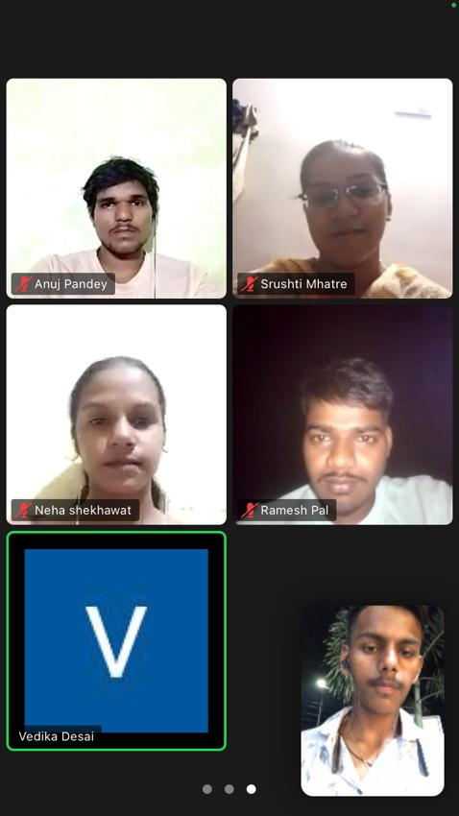
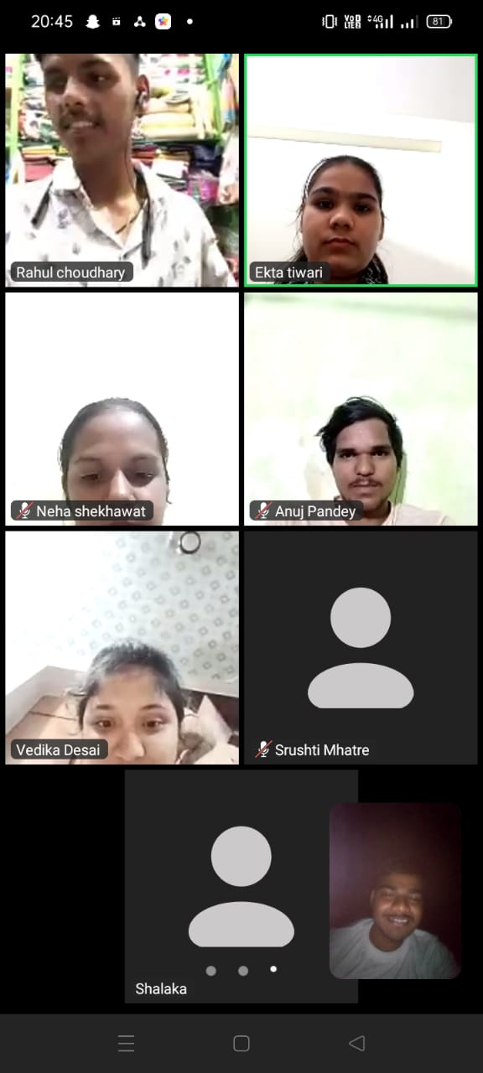
The South Indian Association’s
The S.I.A. College of Higher Education
Affiliated to University of Mumbai
Re-Accredited B+ by NAAC
P-88, MIDC Residential Area Dombivli Gymkhana Road,
Near Balaji Mandir, Dombivli (East), 421203.

Slide 5
The South Indian Association’s
The S.I.A. College of Higher Education
Affiliated to University of Mumbai
Re-Accredited B+ by NAAC
P-88, MIDC Residential Area Dombivli Gymkhana Road,
Near Balaji Mandir, Dombivli (East), 421203.
Activity: Street Play on Environment in Community.
Day: Saturday.
Date :17th June 2023
Reflection
2023-24

Slide 6
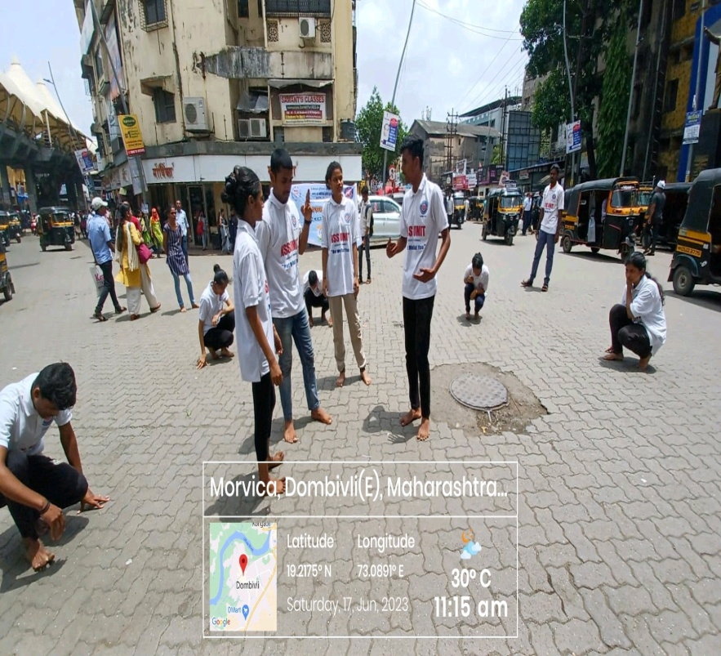
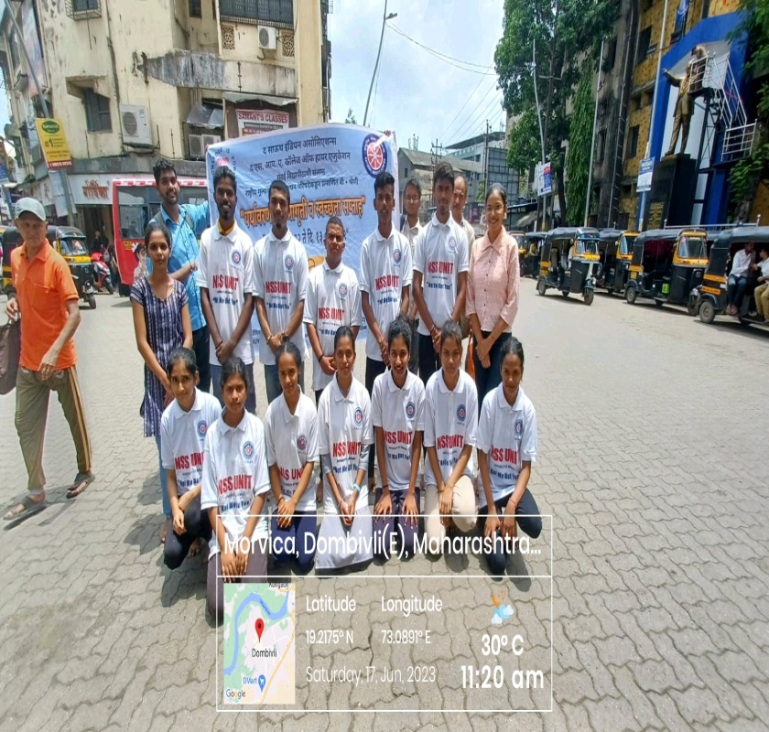
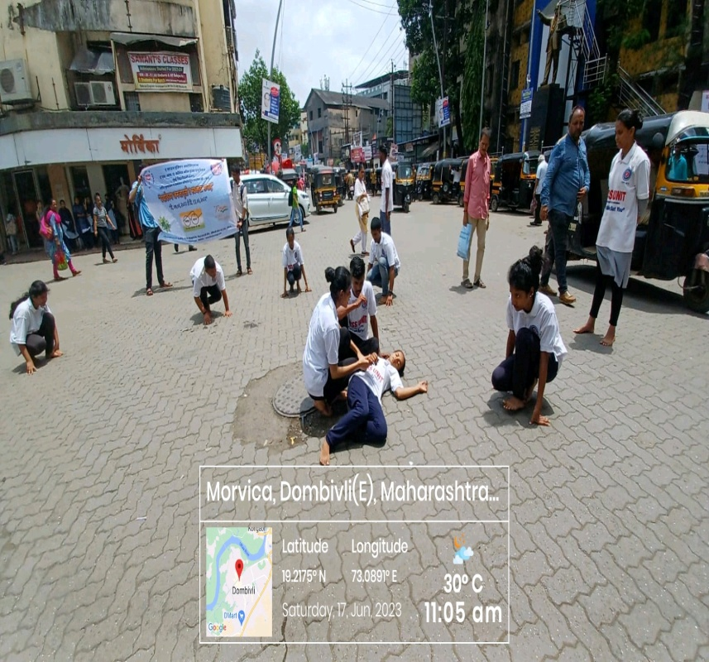
The South Indian Association’s
The S.I.A. College of Higher Education
Affiliated to University of Mumbai
Re-Accredited B+ by NAAC
P-88, MIDC Residential Area Dombivli Gymkhana Road,
Near Balaji Mandir, Dombivli (East), 421203.

Slide 7
The South Indian Association’s
The S.I.A. College of Higher Education
Affiliated to University of Mumbai
Re-Accredited B+ by NAAC
P-88, MIDC Residential Area Dombivli Gymkhana Road,
Near Balaji Mandir, Dombivli (East), 421203.
Activity: Observing International Yoga Day Protocol at Maitri Old Age Home.
Day: Monday
Date :19th June 2023
Reflection
2023-24

Slide 8
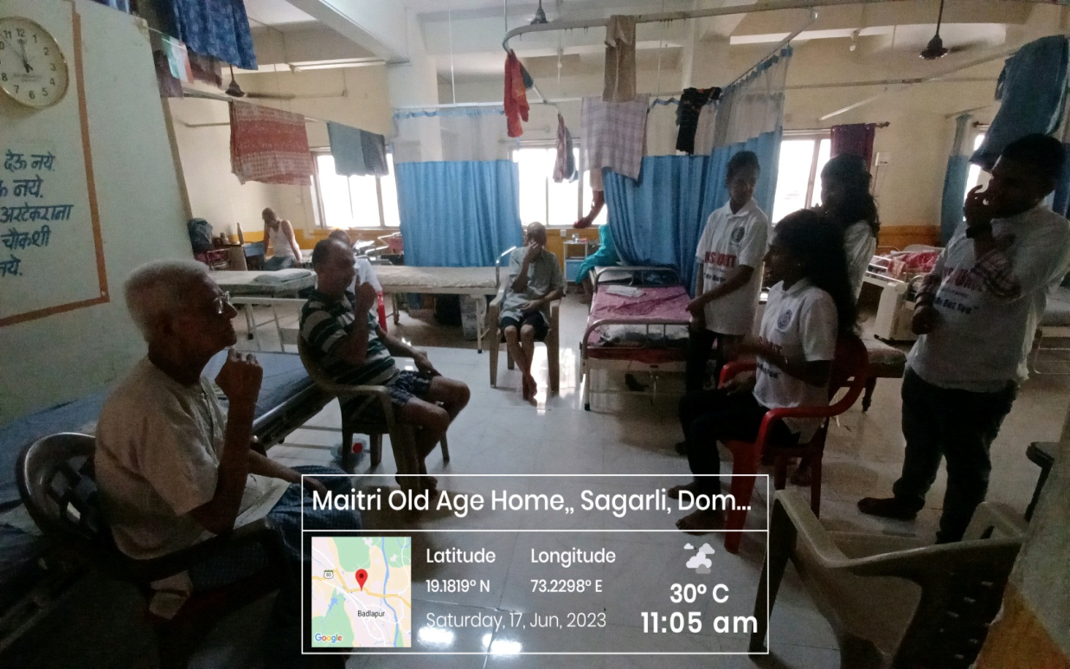
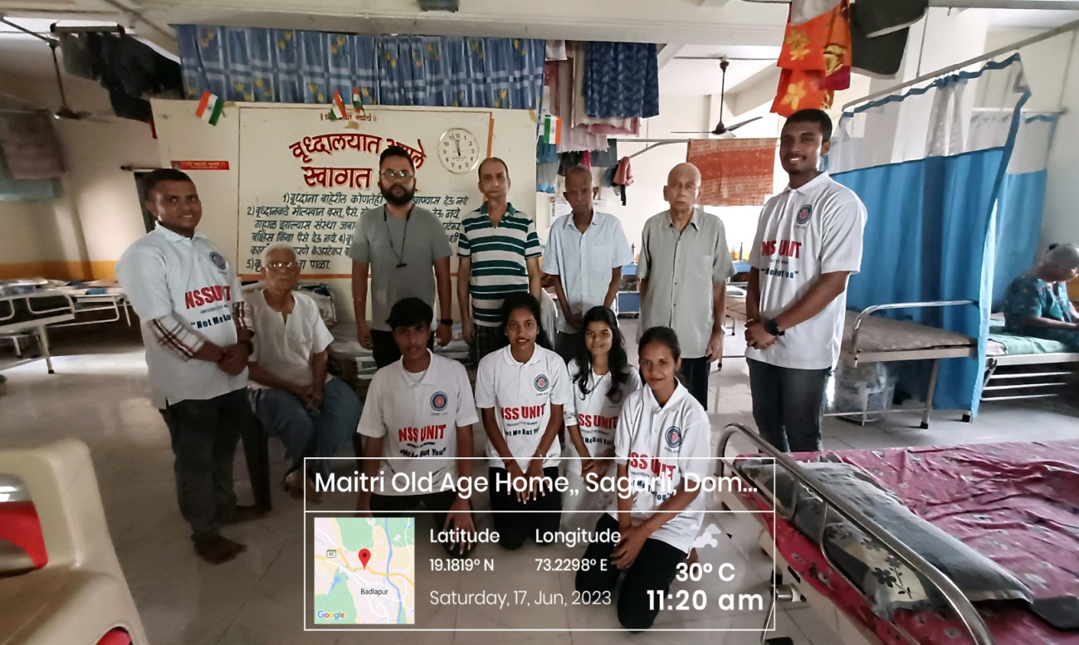
The South Indian Association’s
The S.I.A. College of Higher Education
Affiliated to University of Mumbai
Re-Accredited B+ by NAAC
P-88, MIDC Residential Area Dombivli Gymkhana Road,
Near Balaji Mandir, Dombivli (East), 421203.

Slide 9
The South Indian Association’s
The S.I.A. College of Higher Education
Affiliated to University of Mumbai
Re-Accredited B+ by NAAC
P-88, MIDC Residential Area Dombivli Gymkhana Road,
Near Balaji Mandir, Dombivli (East), 421203.
Activity: Observing International Yoga Day Protocol at The S.I.A College of Higher Education, Classroom.
Day: Mon, Tue & Wednesday
Date :19th-21st June 2023
Reflection
2023-24

Slide 10
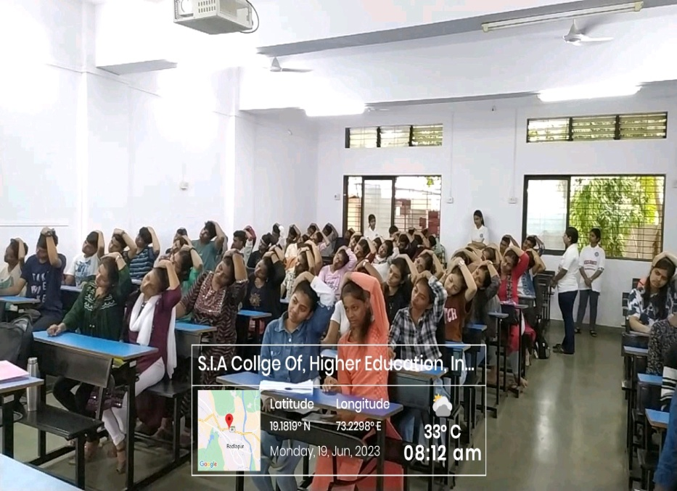
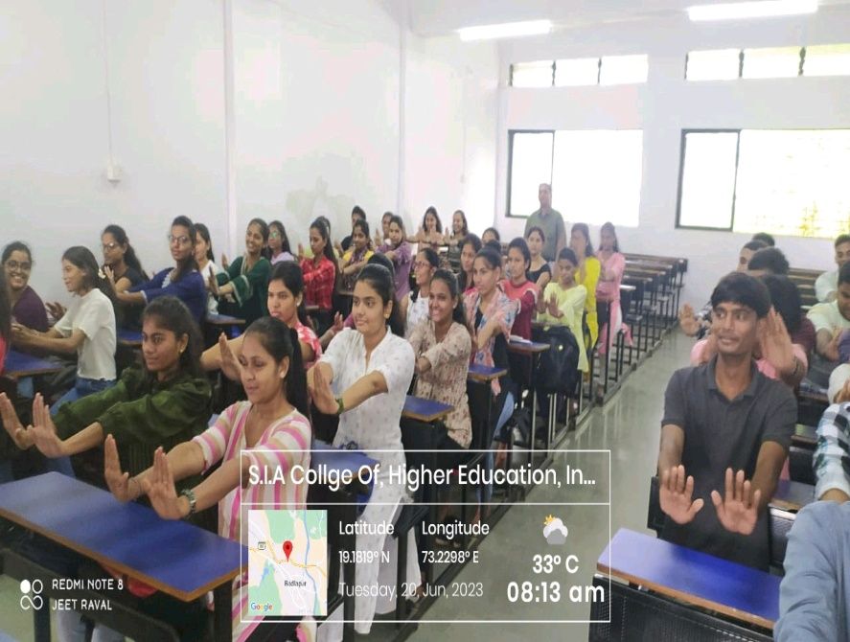
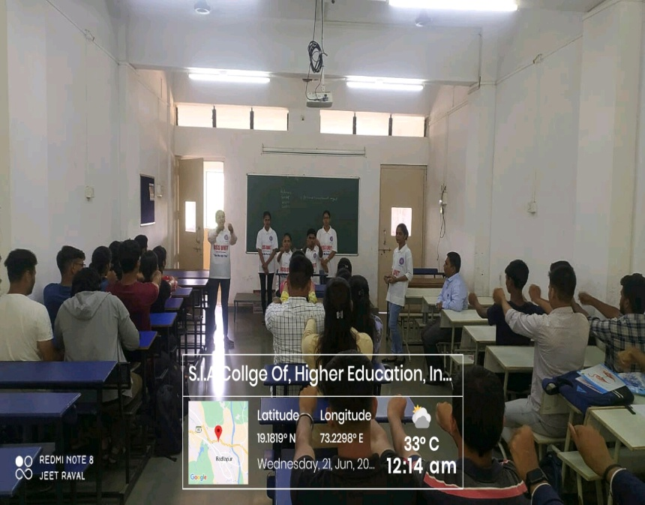
The South Indian Association’s
The S.I.A. College of Higher Education
Affiliated to University of Mumbai
Re-Accredited B+ by NAAC
P-88, MIDC Residential Area Dombivli Gymkhana Road,
Near Balaji Mandir, Dombivli (East), 421203.

Slide 11
The South Indian Association’s
The S.I.A. College of Higher Education
Affiliated to University of Mumbai
Re-Accredited B+ by NAAC
P-88, MIDC Residential Area Dombivli Gymkhana Road,
Near Balaji Mandir, Dombivli (East), 421203.
Activity: Celebrating International Yoga Day at Zilla Parishad School.
Day: Wednesday.
Date: 21st June 2023
Reflection
2023-24

Slide 12
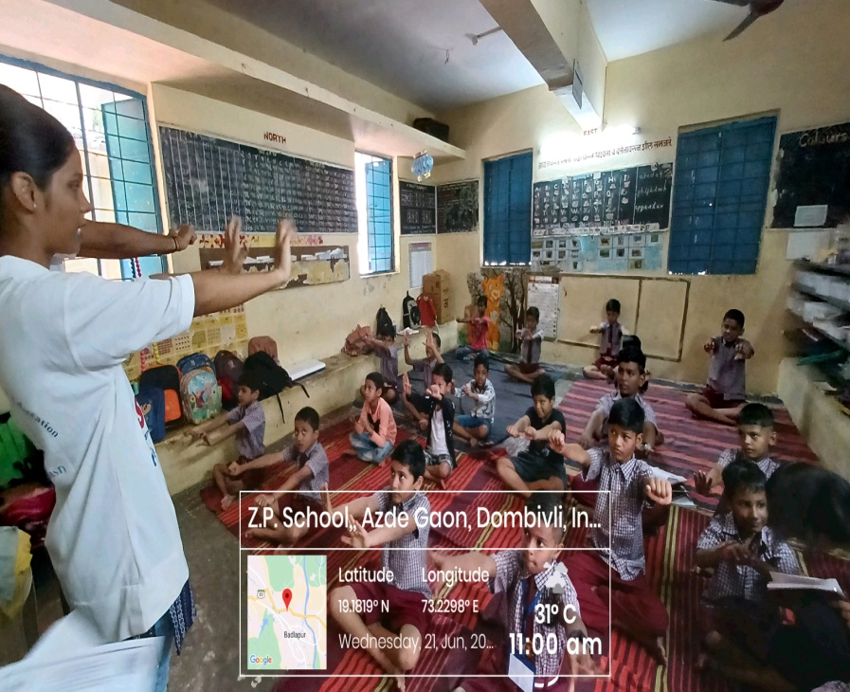
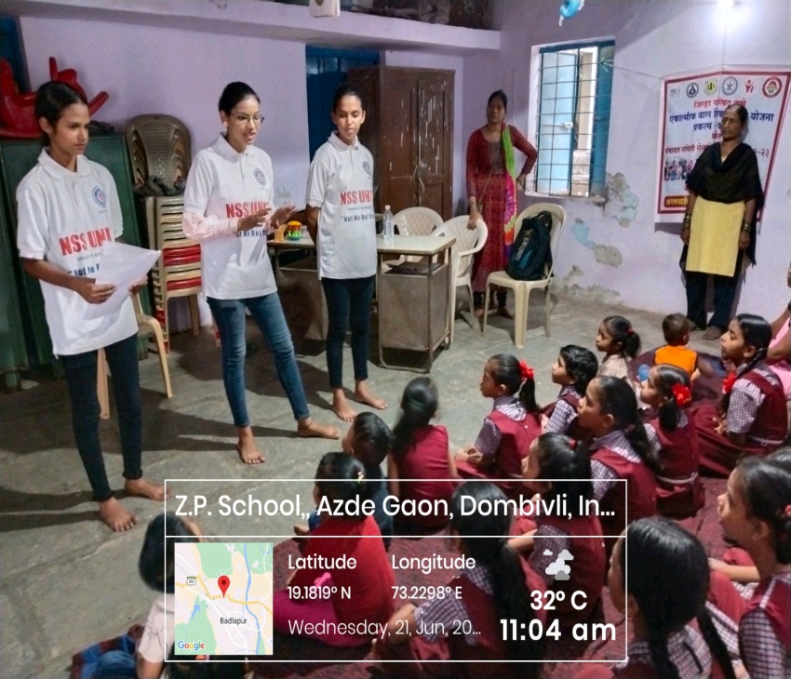
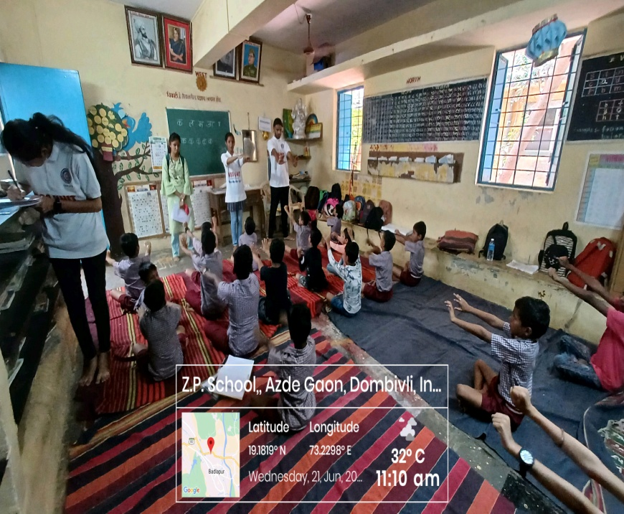
The South Indian Association’s
The S.I.A. College of Higher Education
Affiliated to University of Mumbai
Re-Accredited B+ by NAAC
P-88, MIDC Residential Area Dombivli Gymkhana Road,
Near Balaji Mandir, Dombivli (East), 421203.

Slide 13






The South Indian Association’s
The S.I.A. College of Higher Education
Affiliated to University of Mumbai
Re-Accredited B+ by NAAC
P-88, MIDC Residential Area Dombivli Gymkhana Road,
Near Balaji Mandir, Dombivli (East), 421203.
JULY 2023-24

Slide 14
The South Indian Association’s
The S.I.A. College of Higher Education
Affiliated to University of Mumbai
Re-Accredited B+ by NAAC
P-88, MIDC Residential Area Dombivli Gymkhana Road,
Near Balaji Mandir, Dombivli (East), 421203.
Activity: Blood Donation Camp at The S.I.A College of Higher Education, Auditorium
Day: Saturday.
Date: 01st July 2023
Reflection
2023-24

Slide 15
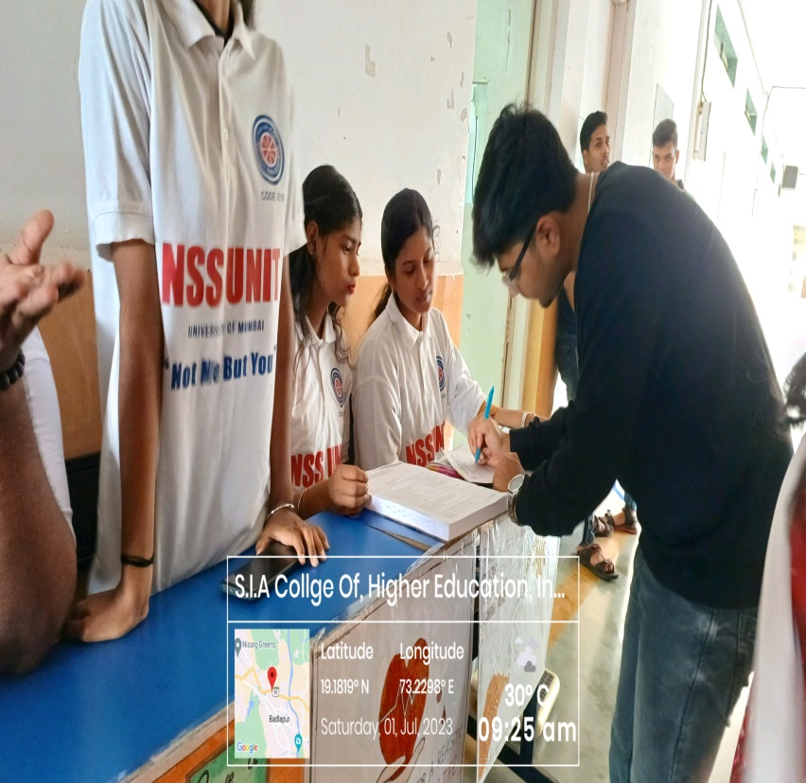
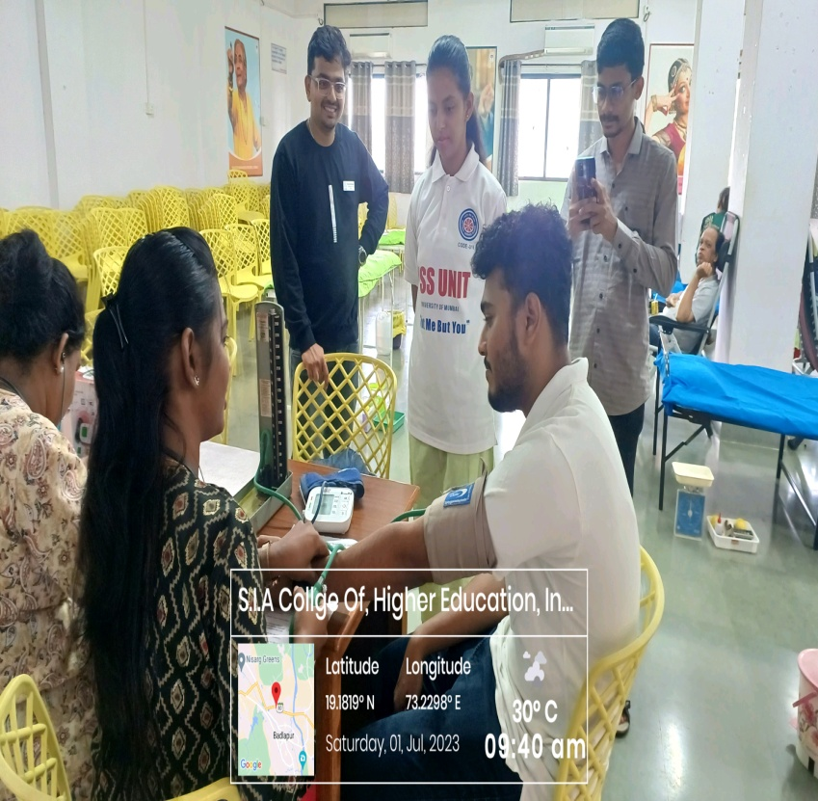
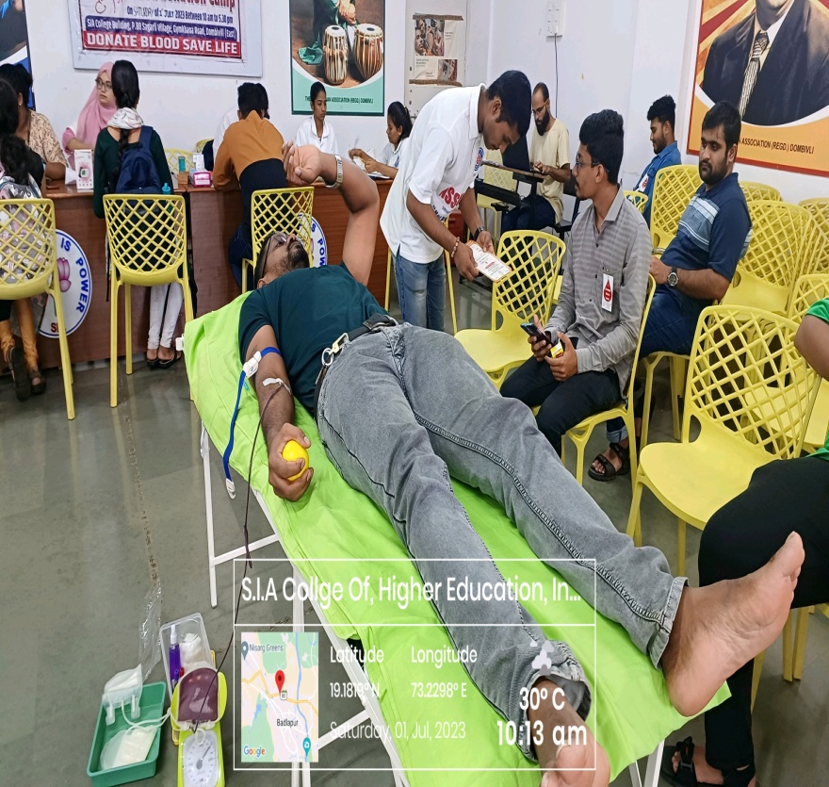
The South Indian Association’s
The S.I.A. College of Higher Education
Affiliated to University of Mumbai
Re-Accredited B+ by NAAC
P-88, MIDC Residential Area Dombivli Gymkhana Road,
Near Balaji Mandir, Dombivli (East), 421203.

Slide 16
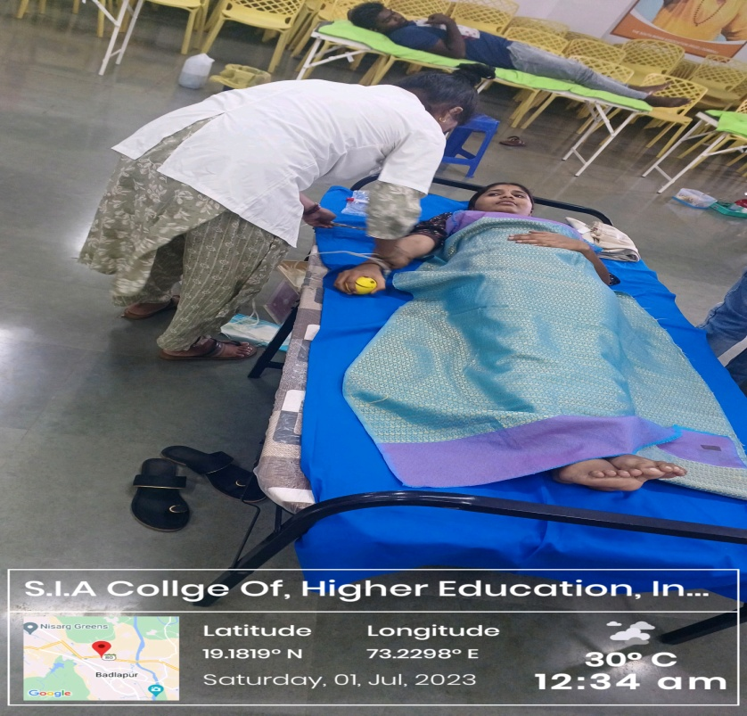
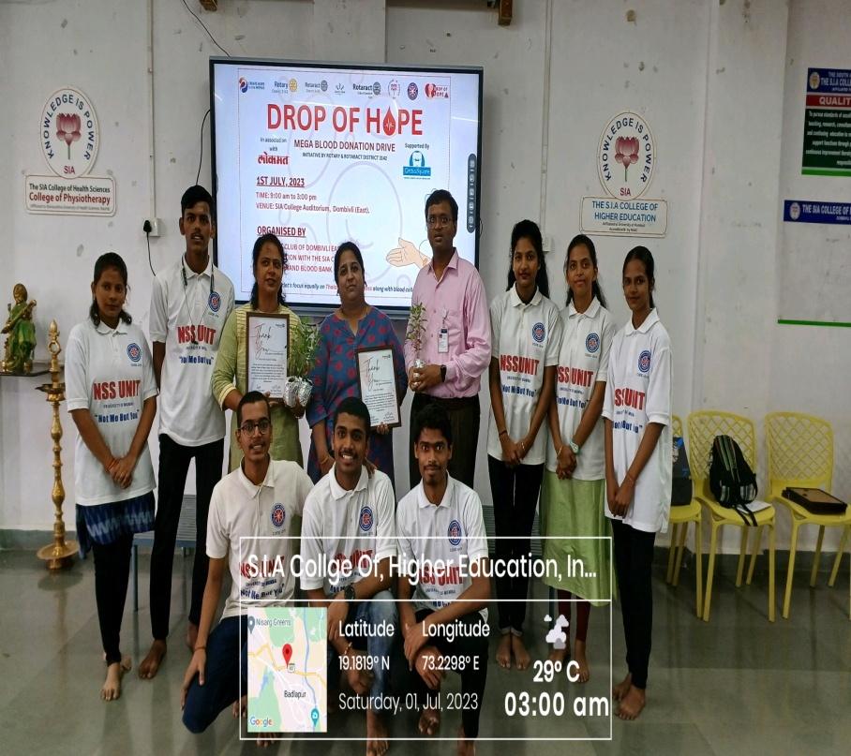
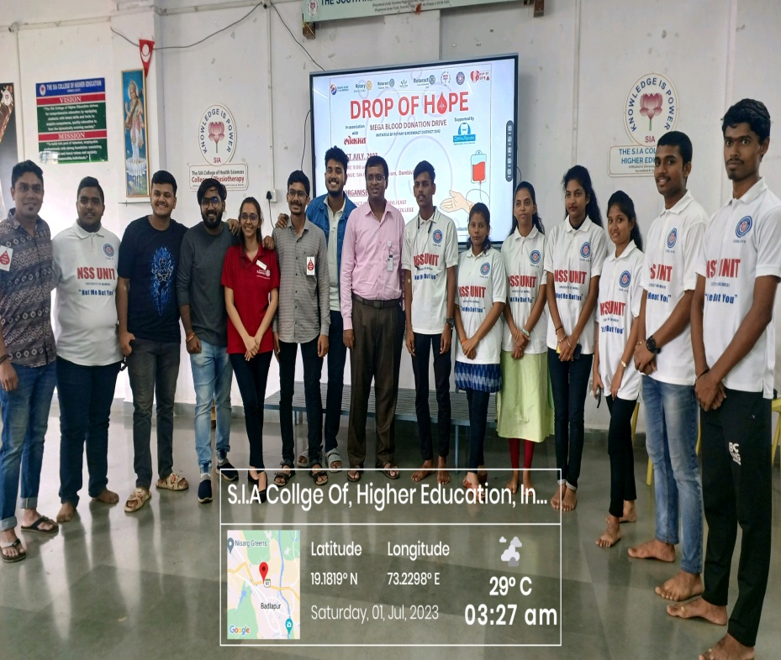
The South Indian Association’s
The S.I.A. College of Higher Education
Affiliated to University of Mumbai
Re-Accredited B+ by NAAC
P-88, MIDC Residential Area Dombivli Gymkhana Road,
Near Balaji Mandir, Dombivli (East), 421203.

Slide 17
The South Indian Association’s
The S.I.A. College of Higher Education
Affiliated to University of Mumbai
Re-Accredited B+ by NAAC
P-88, MIDC Residential Area Dombivli Gymkhana Road,
Near Balaji Mandir, Dombivli (East), 421203.
Activity: Cotton Bag Making Drive at The S.I.A College of Higher Education, NSS Room.
Day: Mon- Monday (3 Weeks)
Date :10th-31stJuly 2023
Reflection
2023-24

Slide 18
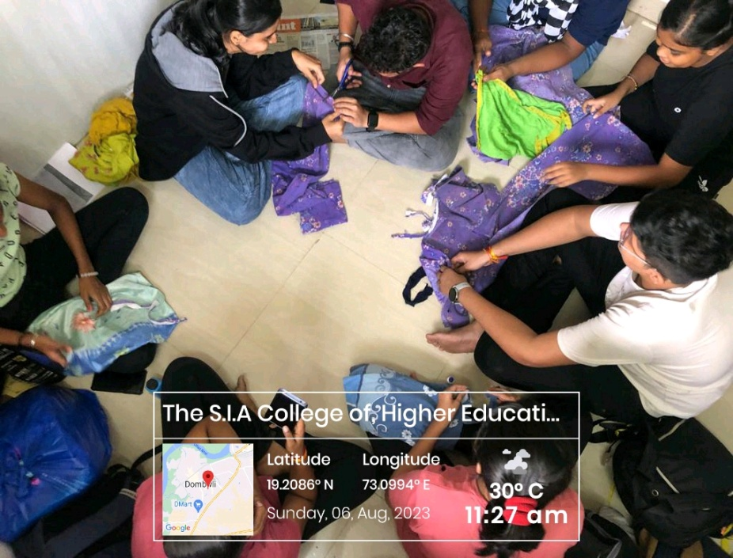
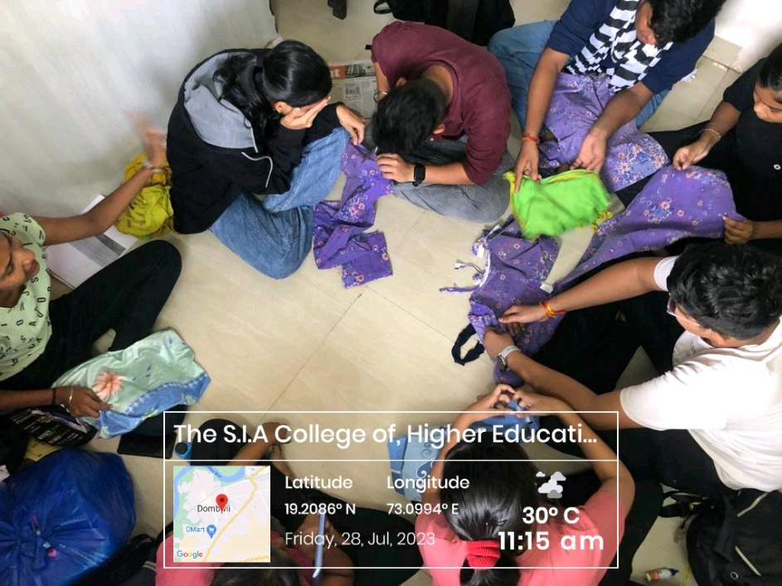
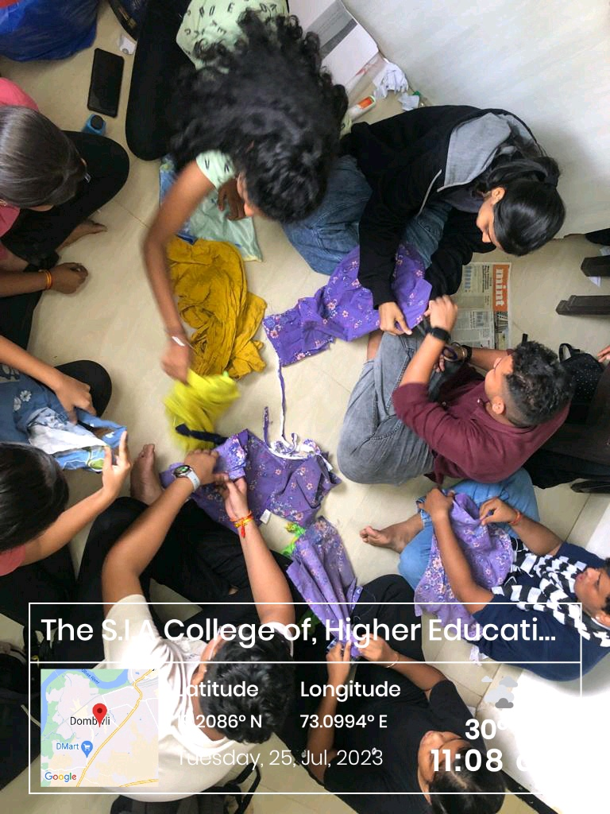
The South Indian Association’s
The S.I.A. College of Higher Education
Affiliated to University of Mumbai
Re-Accredited B+ by NAAC
P-88, MIDC Residential Area Dombivli Gymkhana Road,
Near Balaji Mandir, Dombivli (East), 421203.

Slide 19
The South Indian Association’s
The S.I.A. College of Higher Education
Affiliated to University of Mumbai
Re-Accredited B+ by NAAC
P-88, MIDC Residential Area Dombivli Gymkhana Road,
Near Balaji Mandir, Dombivli (East), 421203.
Activity: Skit Play on “World Population Day” at The S.I.A College of Higher Education, Classroom.
Day: Tuesday.
Date: 11thJuly 2023
Reflection
2023-24

Slide 20
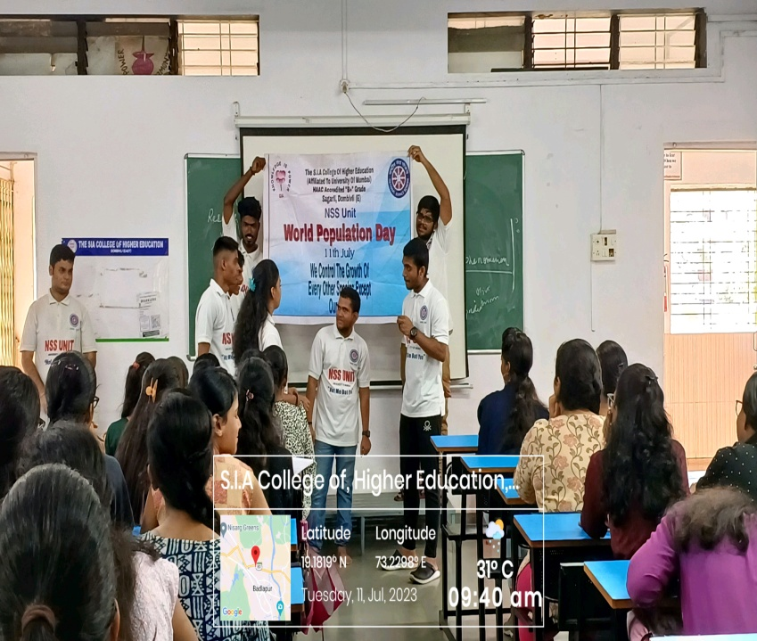
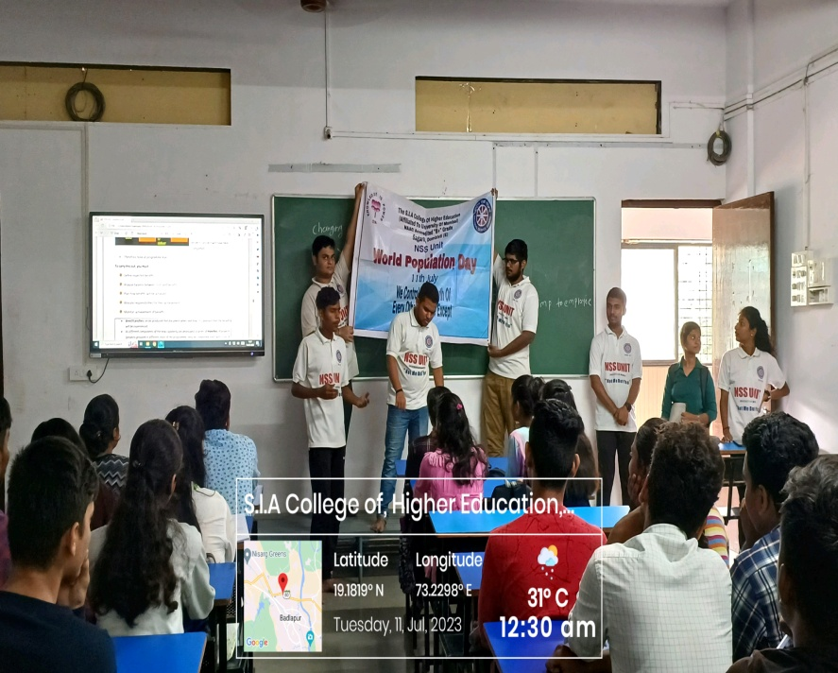
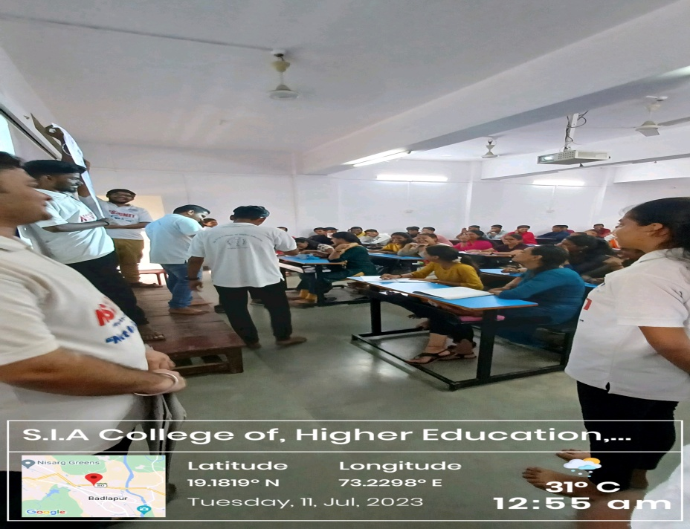
The South Indian Association’s
The S.I.A. College of Higher Education
Affiliated to University of Mumbai
Re-Accredited B+ by NAAC
P-88, MIDC Residential Area Dombivli Gymkhana Road,
Near Balaji Mandir, Dombivli (East), 421203.

Slide 21
The South Indian Association’s
The S.I.A. College of Higher Education
Affiliated to University of Mumbai
Re-Accredited B+ by NAAC
P-88, MIDC Residential Area Dombivli Gymkhana Road,
Near Balaji Mandir, Dombivli (East), 421203.
Activity: Street Play on “World Population Day” in Community.
Day: Tuesday.
Date: 11thJuly 2023
Reflection
2023-24

Slide 22
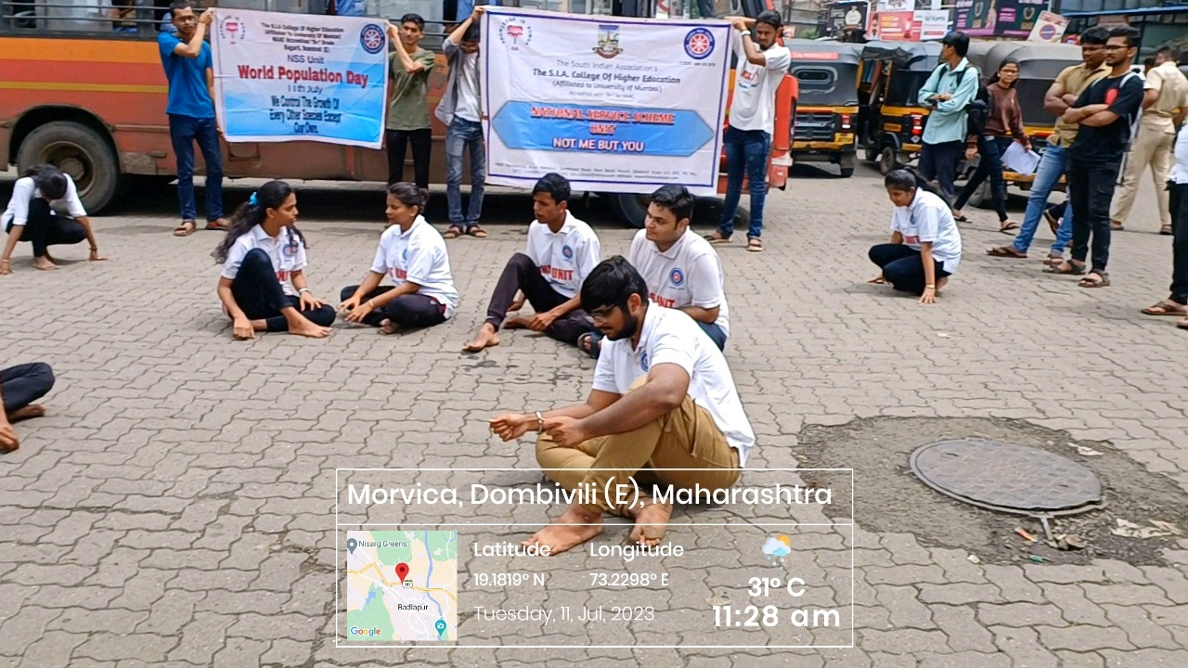
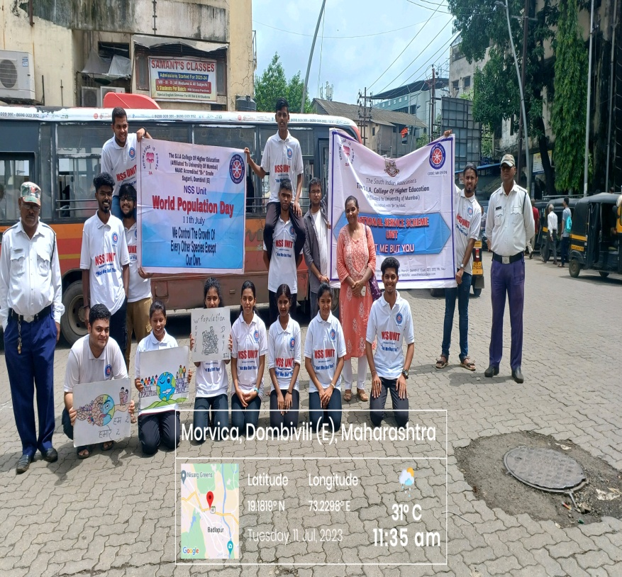
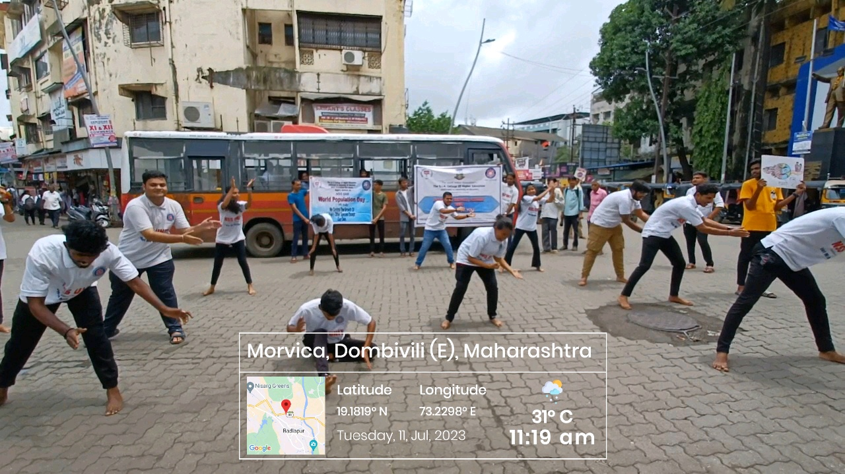
The South Indian Association’s
The S.I.A. College of Higher Education
Affiliated to University of Mumbai
Re-Accredited B+ by NAAC
P-88, MIDC Residential Area Dombivli Gymkhana Road,
Near Balaji Mandir, Dombivli (East), 421203.

Slide 23
The South Indian Association’s
The S.I.A. College of Higher Education
Affiliated to University of Mumbai
Re-Accredited B+ by NAAC
P-88, MIDC Residential Area Dombivli Gymkhana Road,
Near Balaji Mandir, Dombivli (East), 421203.
Activity: Tree Plantation Drive at Sarvoday School, Kolegaon.
Day: Sunday.
Date: 16thJuly 2023
Reflection
2023-24

Slide 24
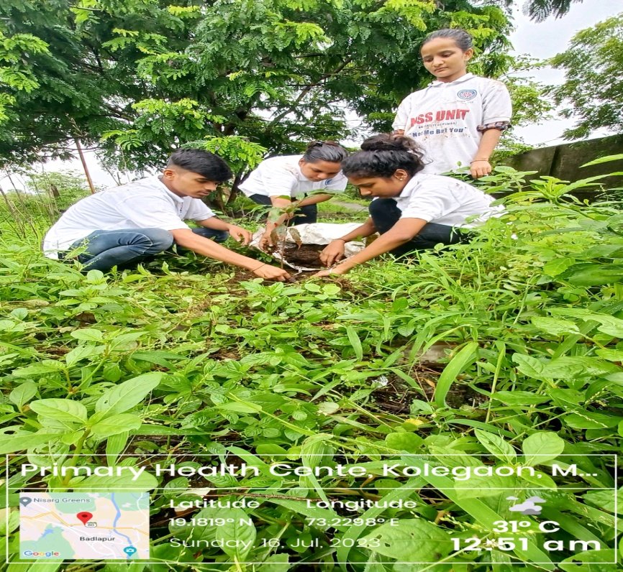
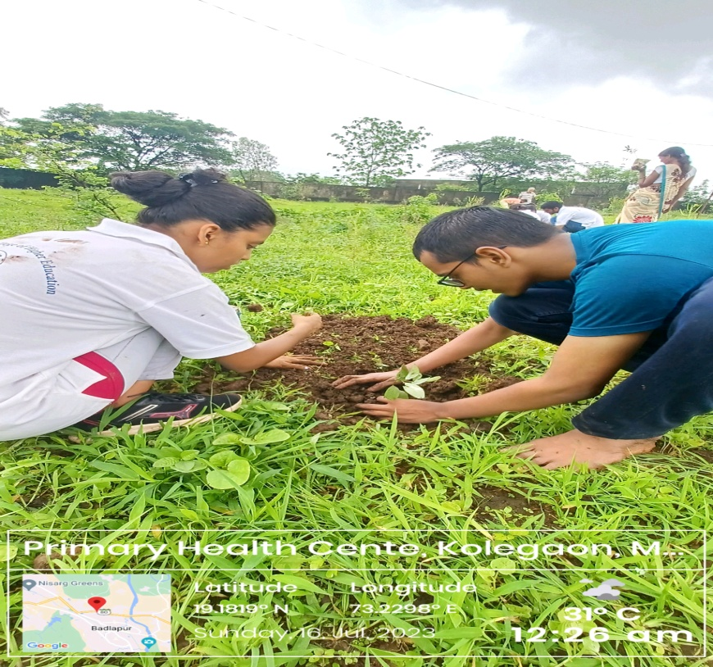
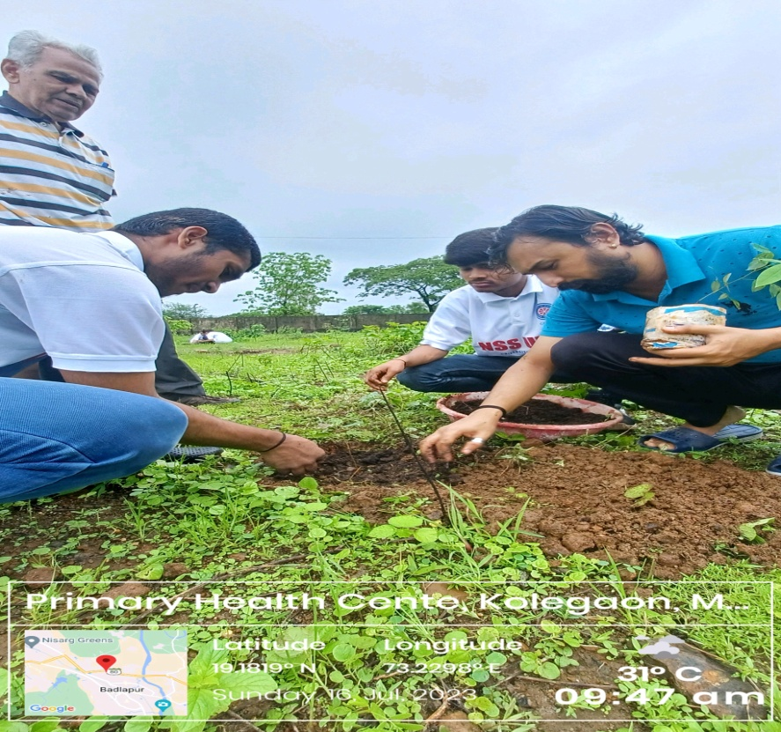
The South Indian Association’s
The S.I.A. College of Higher Education
Affiliated to University of Mumbai
Re-Accredited B+ by NAAC
P-88, MIDC Residential Area Dombivli Gymkhana Road,
Near Balaji Mandir, Dombivli (East), 421203.

Slide 25
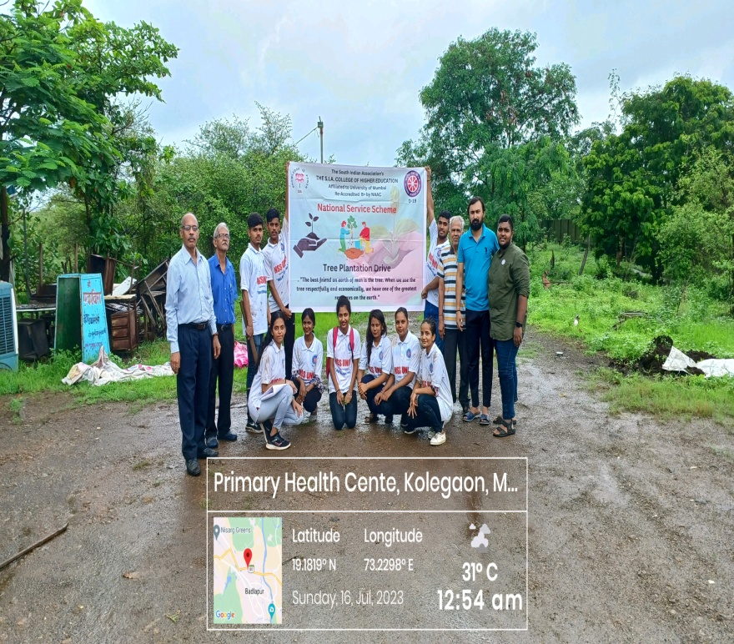
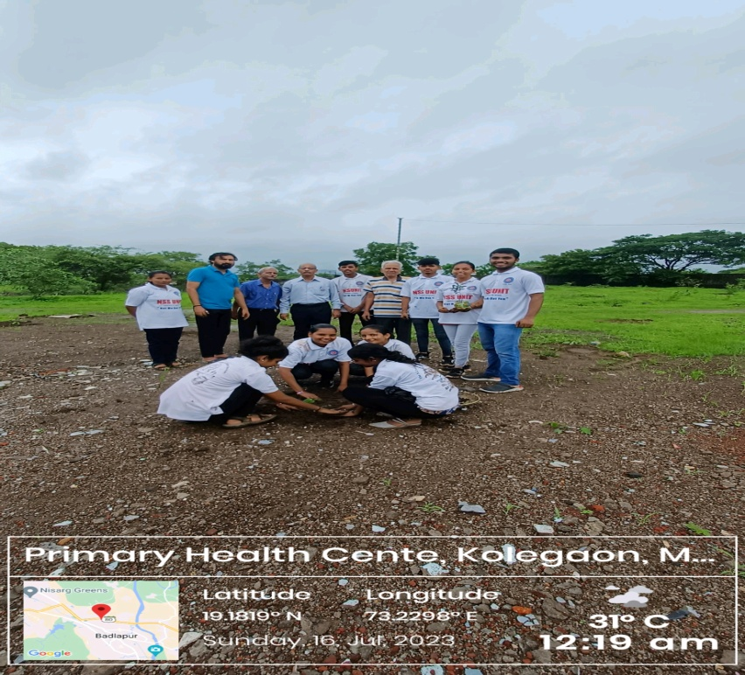
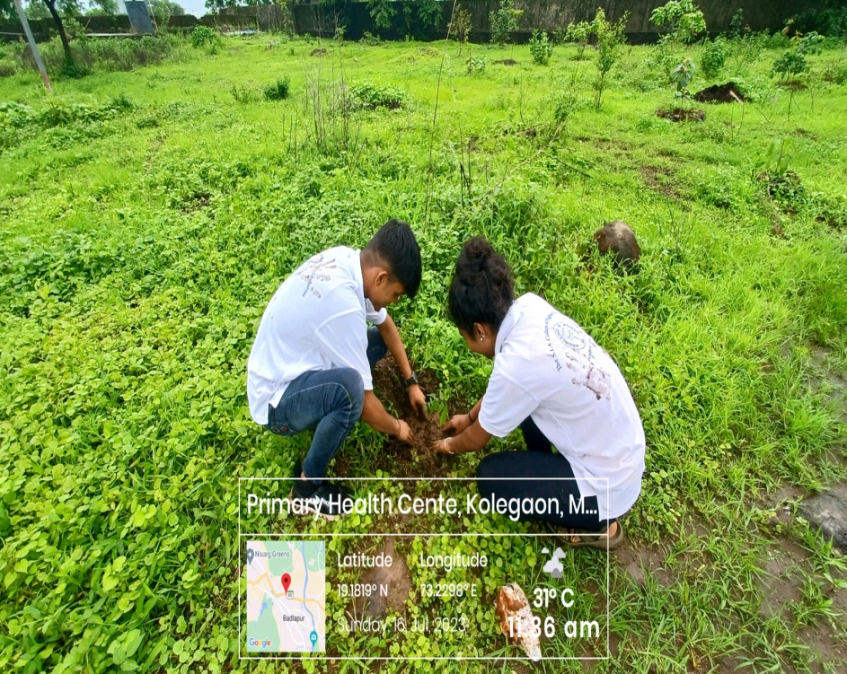
The South Indian Association’s
The S.I.A. College of Higher Education
Affiliated to University of Mumbai
Re-Accredited B+ by NAAC
P-88, MIDC Residential Area Dombivli Gymkhana Road,
Near Balaji Mandir, Dombivli (East), 421203.

Slide 26
The South Indian Association’s
The S.I.A. College of Higher Education
Affiliated to University of Mumbai
Re-Accredited B+ by NAAC
P-88, MIDC Residential Area Dombivli Gymkhana Road,
Near Balaji Mandir, Dombivli (East), 421203.
Activity: Flash-mob on Kargil Vijay Diwas in Community.
Day: Wednesday
Date: 26thJuly 2023
Reflection
2023-24
Reflection
2023-24

Slide 27
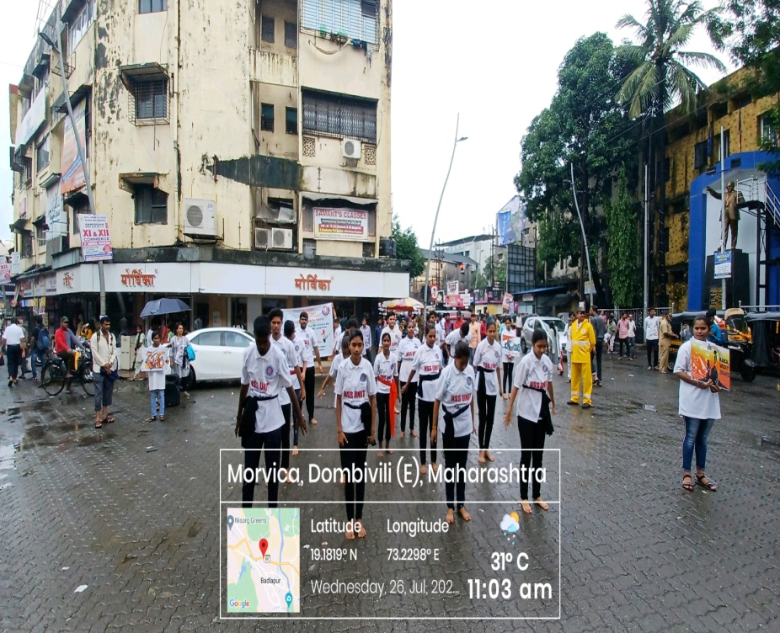
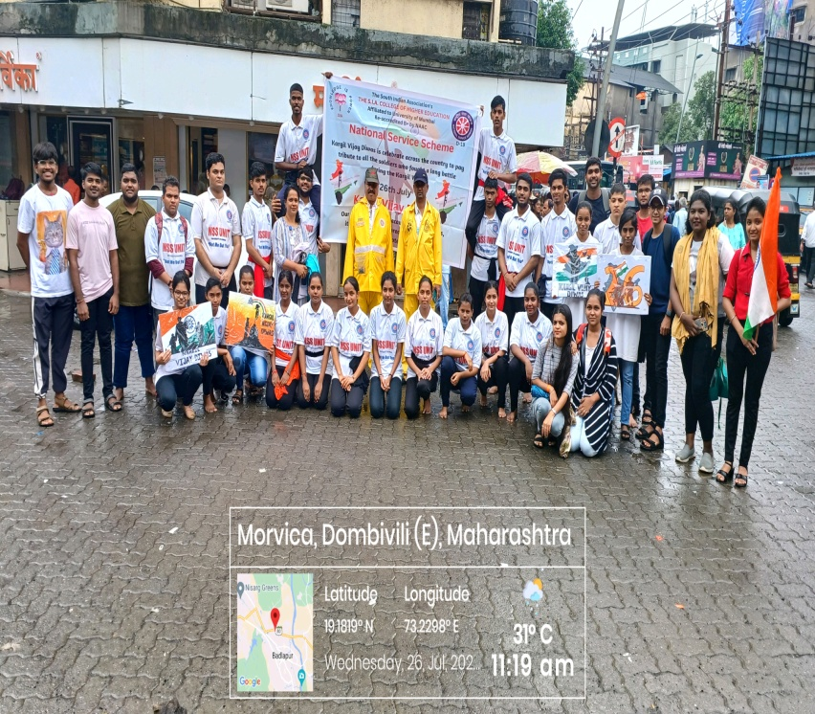
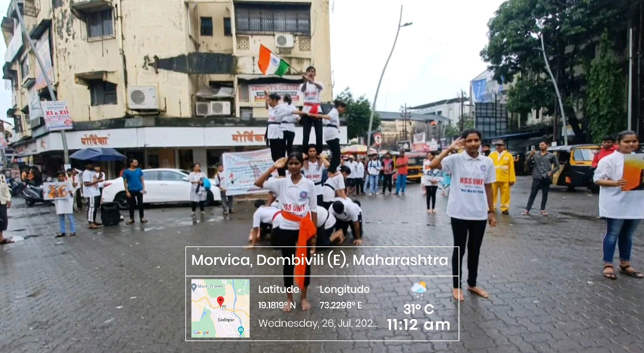
The South Indian Association’s
The S.I.A. College of Higher Education
Affiliated to University of Mumbai
Re-Accredited B+ by NAAC
P-88, MIDC Residential Area Dombivli Gymkhana Road,
Near Balaji Mandir, Dombivli (East), 421203.

Slide 28
The South Indian Association’s
The S.I.A. College of Higher Education
Affiliated to University of Mumbai
Re-Accredited B+ by NAAC
P-88, MIDC Residential Area Dombivli Gymkhana Road,
Near Balaji Mandir, Dombivli (East), 421203.
Activity: Documentary Screening on Kargil Vijay Diwas in Zilla Parishad School.
Day: Wednesday.
Date: 26thJuly 2023
Reflection
2023-24

Slide 29
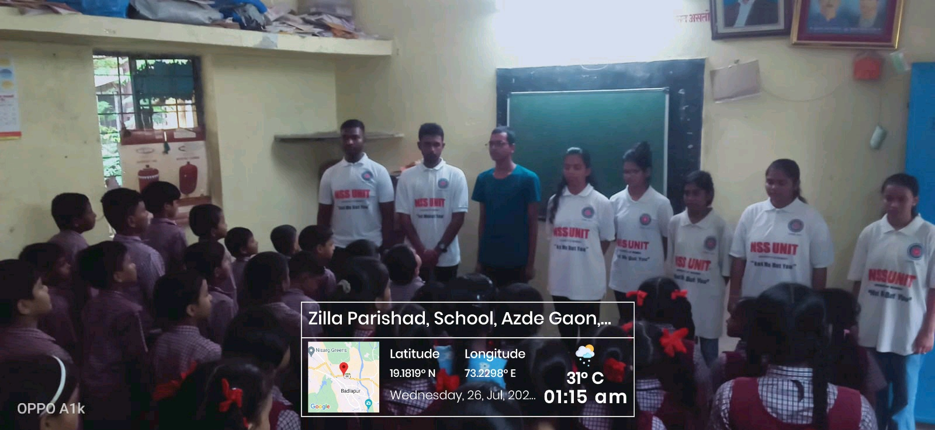
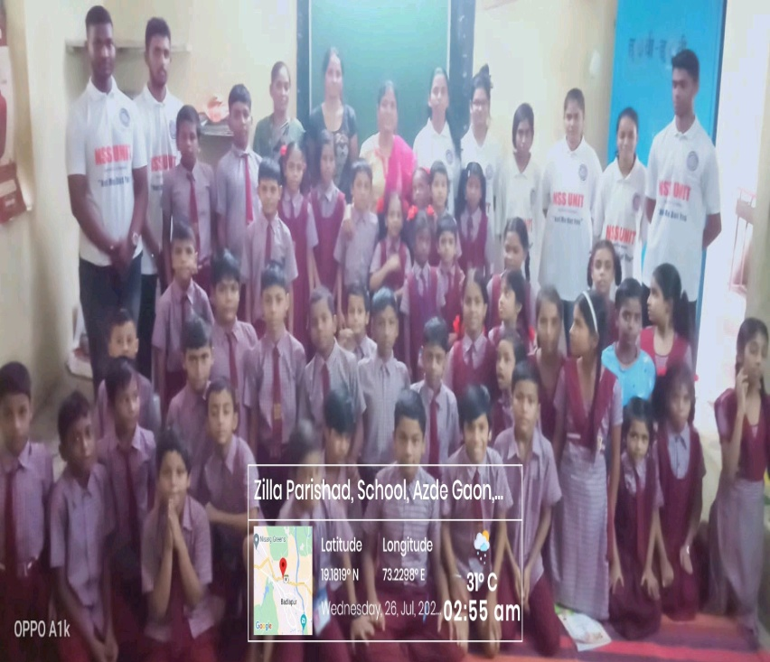
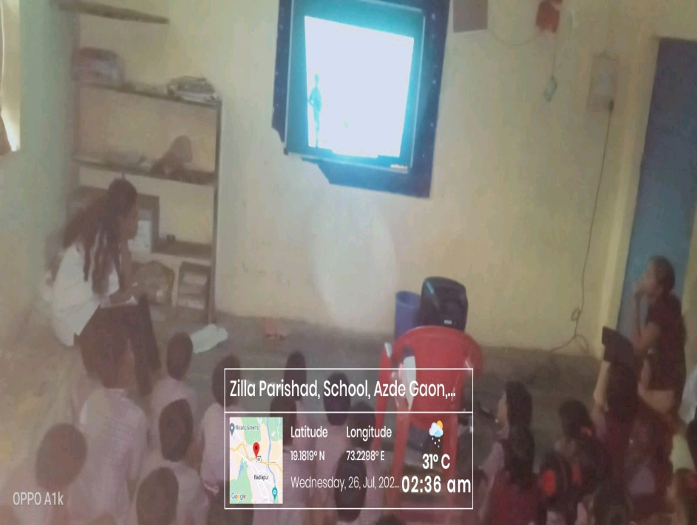
The South Indian Association’s
The S.I.A. College of Higher Education
Affiliated to University of Mumbai
Re-Accredited B+ by NAAC
P-88, MIDC Residential Area Dombivli Gymkhana Road,
Near Balaji Mandir, Dombivli (East), 421203.

Slide 30










The South Indian Association’s
The S.I.A. College of Higher Education
Affiliated to University of Mumbai
Re-Accredited B+ by NAAC
P-88, MIDC Residential Area Dombivli Gymkhana Road,
Near Balaji Mandir, Dombivli (East), 421203.
AUGUST 2023-24
PLEDGE

Slide 31
The South Indian Association’s
The S.I.A. College of Higher Education
Affiliated to University of Mumbai
Re-Accredited B+ by NAAC
P-88, MIDC Residential Area Dombivli Gymkhana Road,
Near Balaji Mandir, Dombivli (East), 421203.
Activity: Paper Bag Making Drive at The S.I.A College of Higher Education, NSS Room.
Day: Tues – Tuesday (2 Weeks)
Date: 01st-15thAugust 2023
Reflection
2023-24

Slide 32
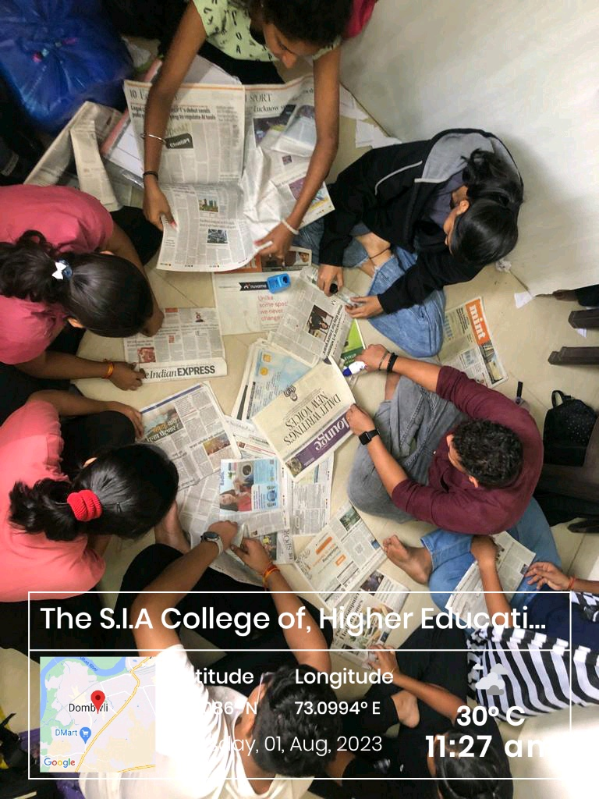
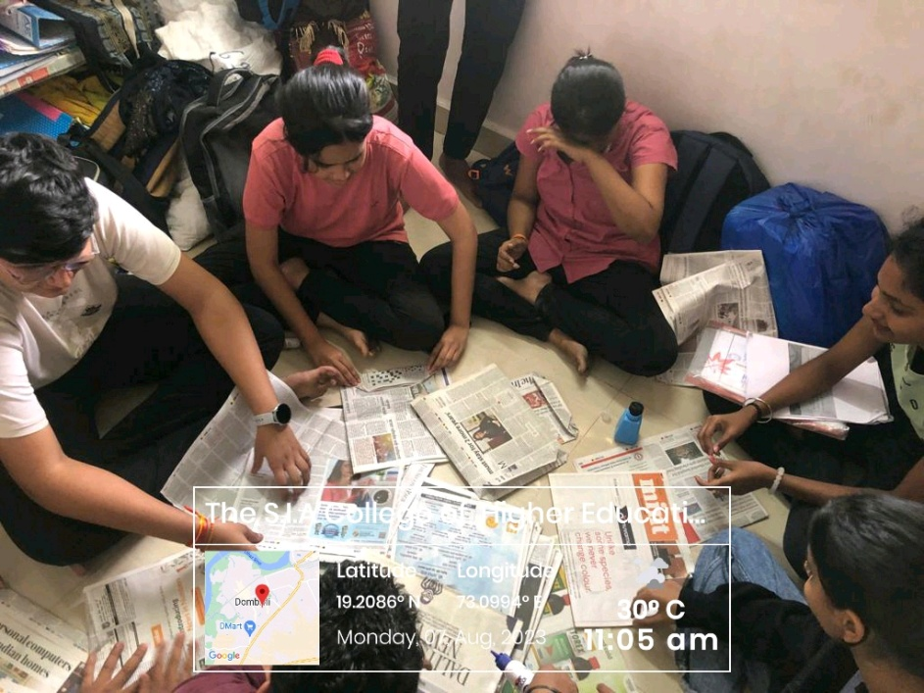
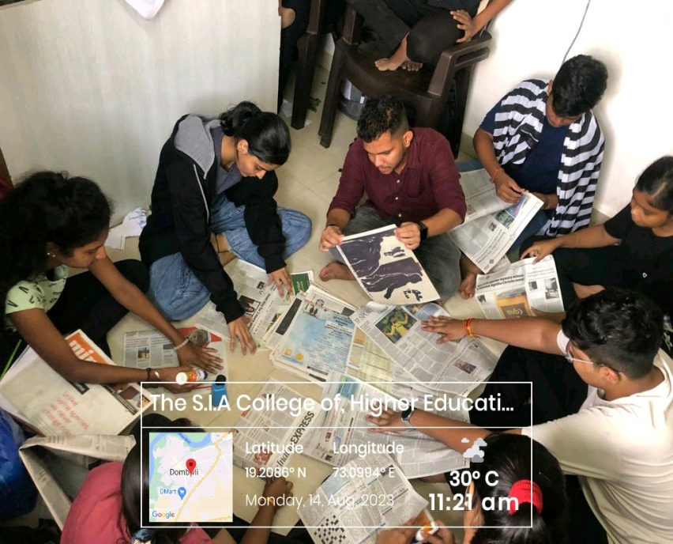
The South Indian Association’s
The S.I.A. College of Higher Education
Affiliated to University of Mumbai
Re-Accredited B+ by NAAC
P-88, MIDC Residential Area Dombivli Gymkhana Road,
Near Balaji Mandir, Dombivli (East), 421203.

Slide 33
The South Indian Association’s
The S.I.A. College of Higher Education
Affiliated to University of Mumbai
Re-Accredited B+ by NAAC
P-88, MIDC Residential Area Dombivli Gymkhana Road,
Near Balaji Mandir, Dombivli (East), 421203.
Activity: Pledge on Swachh Bharat at The S.I.A College of Higher Education, Classroom.
Day: Tuesday
Date: 01st August 2023
Reflection
2023-24

Slide 34
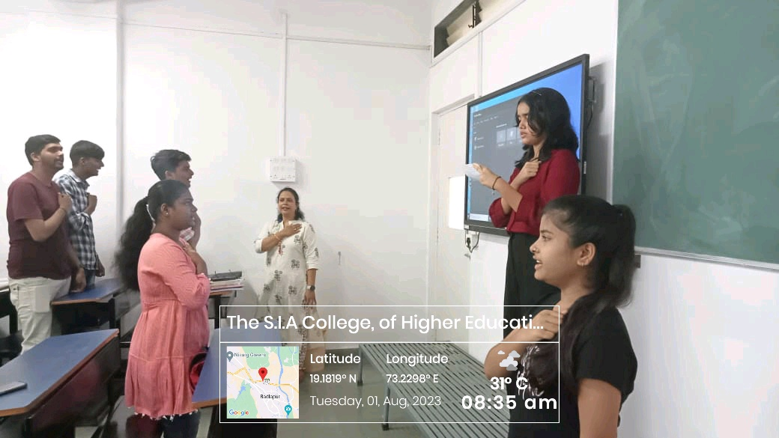
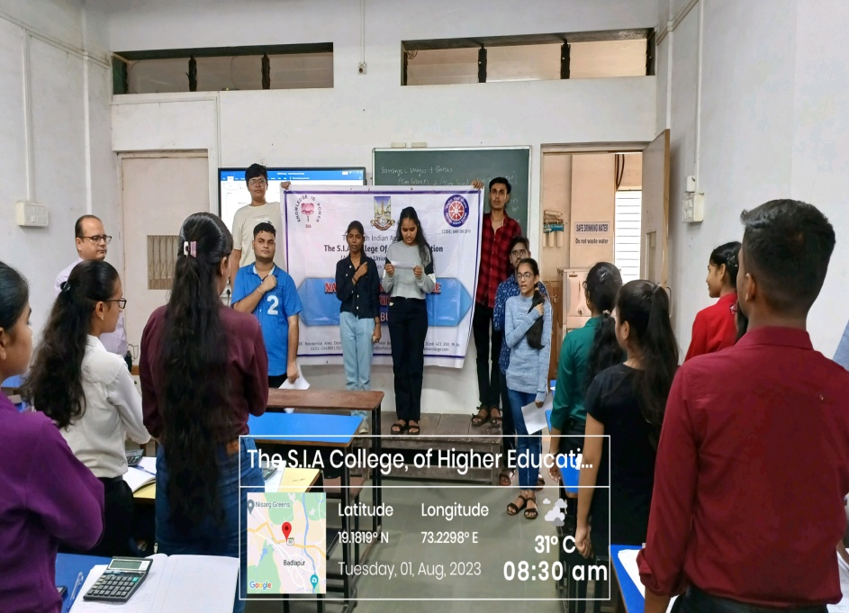
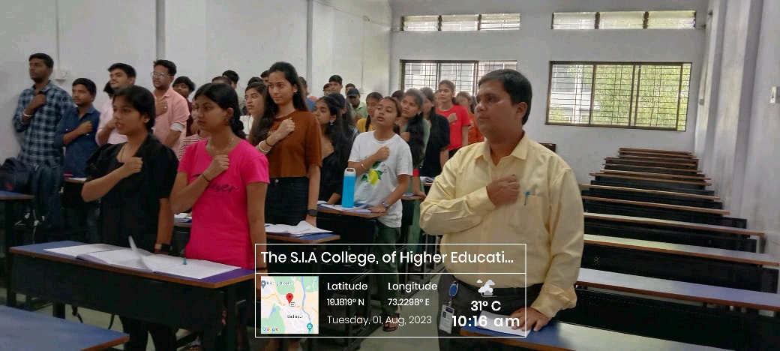
The South Indian Association’s
The S.I.A. College of Higher Education
Affiliated to University of Mumbai
Re-Accredited B+ by NAAC
P-88, MIDC Residential Area Dombivli Gymkhana Road,
Near Balaji Mandir, Dombivli (East), 421203.

Slide 35
The South Indian Association’s
The S.I.A. College of Higher Education
Affiliated to University of Mumbai
Re-Accredited B+ by NAAC
P-88, MIDC Residential Area Dombivli Gymkhana Road,
Near Balaji Mandir, Dombivli (East), 421203.
Activity: Drawing Competition on Swachh Bharat at Zilla Parishad School.
Day: Thursday.
Date :03rd August 2023
Reflection
2023-24

Slide 36
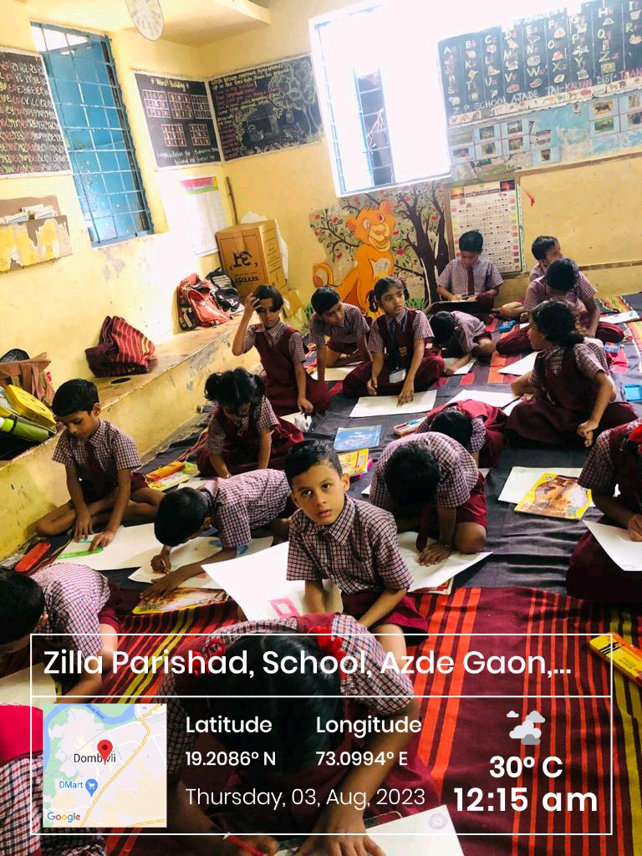
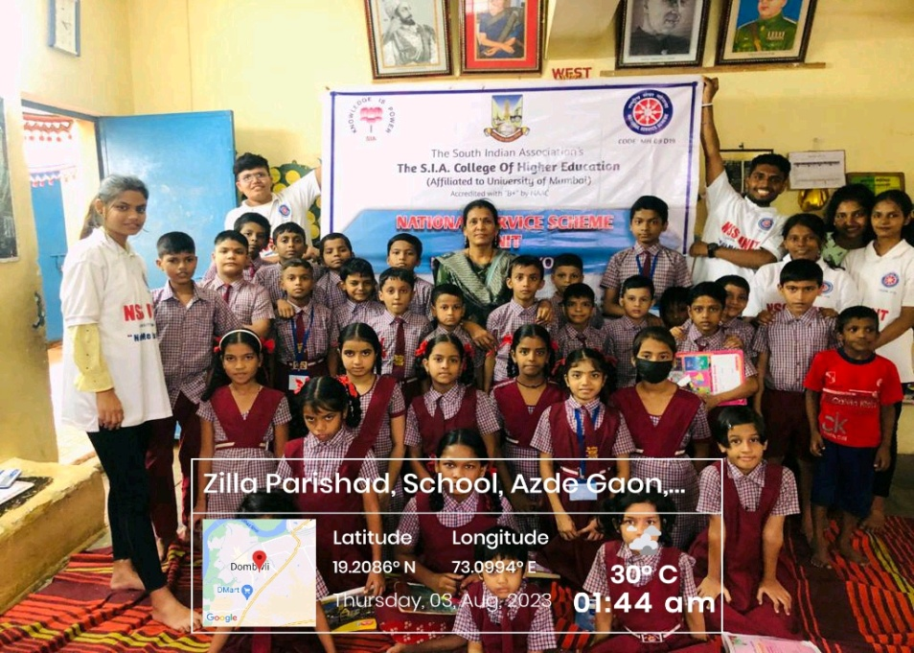
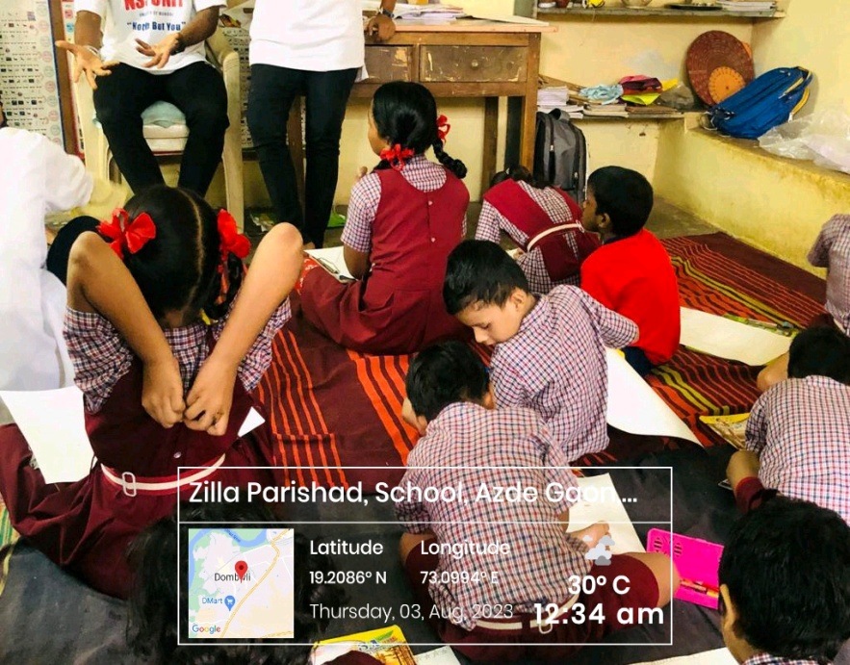
The South Indian Association’s
The S.I.A. College of Higher Education
Affiliated to University of Mumbai
Re-Accredited B+ by NAAC
P-88, MIDC Residential Area Dombivli Gymkhana Road,
Near Balaji Mandir, Dombivli (East), 421203.

Slide 37
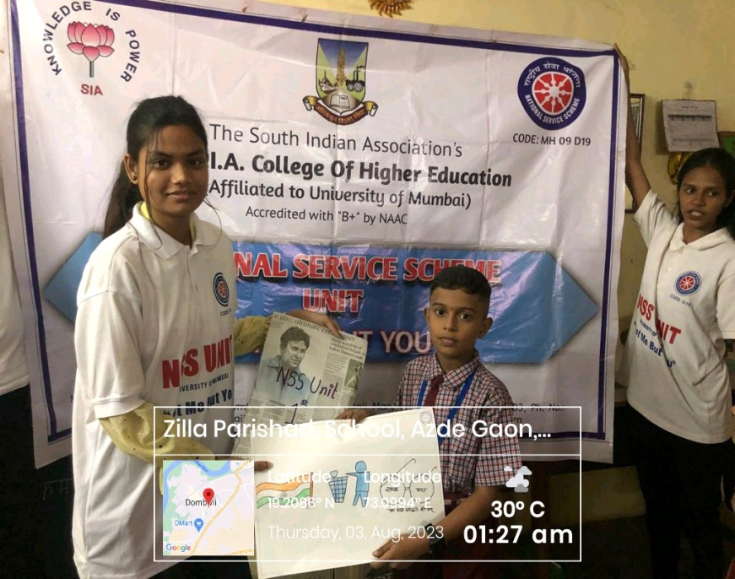


The South Indian Association’s
The S.I.A. College of Higher Education
Affiliated to University of Mumbai
Re-Accredited B+ by NAAC
P-88, MIDC Residential Area Dombivli Gymkhana Road,
Near Balaji Mandir, Dombivli (East), 421203.

Slide 38
The South Indian Association’s
The S.I.A. College of Higher Education
Affiliated to University of Mumbai
Re-Accredited B+ by NAAC
P-88, MIDC Residential Area Dombivli Gymkhana Road,
Near Balaji Mandir, Dombivli (East), 421203.
Activity: Cleanliness Drive at Maitri Old Age Home.
Day: Friday.
Date: 04th August 2023
Reflection
2023-24

Slide 39



The South Indian Association’s
The S.I.A. College of Higher Education
Affiliated to University of Mumbai
Re-Accredited B+ by NAAC
P-88, MIDC Residential Area Dombivli Gymkhana Road,
Near Balaji Mandir, Dombivli (East), 421203.

Slide 40
The South Indian Association’s
The S.I.A. College of Higher Education
Affiliated to University of Mumbai
Re-Accredited B+ by NAAC
P-88, MIDC Residential Area Dombivli Gymkhana Road,
Near Balaji Mandir, Dombivli (East), 421203.
Activity: Awareness on Swachh Bharat Pamphlet Distribution in Community.
Day: Saturday.
Date: 05th August 2023
Reflection
2023-24

Slide 41



The South Indian Association’s
The S.I.A. College of Higher Education
Affiliated to University of Mumbai
Re-Accredited B+ by NAAC
P-88, MIDC Residential Area Dombivli Gymkhana Road,
Near Balaji Mandir, Dombivli (East), 421203.

Slide 42
The South Indian Association’s
The S.I.A. College of Higher Education
Affiliated to University of Mumbai
Re-Accredited B+ by NAAC
P-88, MIDC Residential Area Dombivli Gymkhana Road,
Near Balaji Mandir, Dombivli (East), 421203.
Activity: Cotton Bag Distribution Drive in Community.
Day: Monday.
Date: 07th August 2023
Reflection
2023-24

Slide 43



The South Indian Association’s
The S.I.A. College of Higher Education
Affiliated to University of Mumbai
Re-Accredited B+ by NAAC
P-88, MIDC Residential Area Dombivli Gymkhana Road,
Near Balaji Mandir, Dombivli (East), 421203.

Slide 44
The South Indian Association’s
The S.I.A. College of Higher Education
Affiliated to University of Mumbai
Re-Accredited B+ by NAAC
P-88, MIDC Residential Area Dombivli Gymkhana Road,
Near Balaji Mandir, Dombivli (East), 421203.
Activity: Cleanliness Drive at Dombivli Bus Depo.
Day: Tuesday.
Date: 08th August 2023
Reflection
2023-24

Slide 45



The South Indian Association’s
The S.I.A. College of Higher Education
Affiliated to University of Mumbai
Re-Accredited B+ by NAAC
P-88, MIDC Residential Area Dombivli Gymkhana Road,
Near Balaji Mandir, Dombivli (East), 421203.

Slide 46
The South Indian Association’s
The S.I.A. College of Higher Education
Affiliated to University of Mumbai
Re-Accredited B+ by NAAC
P-88, MIDC Residential Area Dombivli Gymkhana Road,
Near Balaji Mandir, Dombivli (East), 421203.
Activity: Cleanliness Drive at Zilla Parishad School.
Day: Wednesday.
Date: 09th August 2023
Reflection
2023-24

Slide 47



The South Indian Association’s
The S.I.A. College of Higher Education
Affiliated to University of Mumbai
Re-Accredited B+ by NAAC
P-88, MIDC Residential Area Dombivli Gymkhana Road,
Near Balaji Mandir, Dombivli (East), 421203.

Slide 48
The South Indian Association’s
The S.I.A. College of Higher Education
Affiliated to University of Mumbai
Re-Accredited B+ by NAAC
P-88, MIDC Residential Area Dombivli Gymkhana Road,
Near Balaji Mandir, Dombivli (East), 421203.
Activity: MMMD Tree Plantation at Sarvoday School, Kolegaon.
Day: Wednesday.
Date: 09th August 2023
Reflection
2023-24

Slide 49



The South Indian Association’s
The S.I.A. College of Higher Education
Affiliated to University of Mumbai
Re-Accredited B+ by NAAC
P-88, MIDC Residential Area Dombivli Gymkhana Road,
Near Balaji Mandir, Dombivli (East), 421203.

Slide 50
The South Indian Association’s
The S.I.A. College of Higher Education
Affiliated to University of Mumbai
Re-Accredited B+ by NAAC
P-88, MIDC Residential Area Dombivli Gymkhana Road,
Near Balaji Mandir, Dombivli (East), 421203.
Activity: Survey on Wet & Dry Waste in Community.
Day: Thursday.
Date: 10th August 2023
Reflection
2023-24

Slide 51



The South Indian Association’s
The S.I.A. College of Higher Education
Affiliated to University of Mumbai
Re-Accredited B+ by NAAC
P-88, MIDC Residential Area Dombivli Gymkhana Road,
Near Balaji Mandir, Dombivli (East), 421203.

Slide 52
The South Indian Association’s
The S.I.A. College of Higher Education
Affiliated to University of Mumbai
Re-Accredited B+ by NAAC
P-88, MIDC Residential Area Dombivli Gymkhana Road,
Near Balaji Mandir, Dombivli (East), 421203.
Activity: Documentary Screening on Swachh Bharat in Zilla Parishad School.
Day: Friday.
Date: 11th August 2023
Reflection
2023-24

Slide 53





The South Indian Association’s
The S.I.A. College of Higher Education
Affiliated to University of Mumbai
Re-Accredited B+ by NAAC
P-88, MIDC Residential Area Dombivli Gymkhana Road,
Near Balaji Mandir, Dombivli (East), 421203.

Slide 54
The South Indian Association’s
The S.I.A. College of Higher Education
Affiliated to University of Mumbai
Re-Accredited B+ by NAAC
P-88, MIDC Residential Area Dombivli Gymkhana Road,
Near Balaji Mandir, Dombivli (East), 421203.
Activity: MMMD Veeron Ka Vandan at The S.I.A College of Higher Education, Auditorium.
Day: Saturday.
Date: 12th August 2023
Reflection
2023-24

Slide 55





The South Indian Association’s
The S.I.A. College of Higher Education
Affiliated to University of Mumbai
Re-Accredited B+ by NAAC
P-88, MIDC Residential Area Dombivli Gymkhana Road,
Near Balaji Mandir, Dombivli (East), 421203.

Slide 56




The South Indian Association’s
The S.I.A. College of Higher Education
Affiliated to University of Mumbai
Re-Accredited B+ by NAAC
P-88, MIDC Residential Area Dombivli Gymkhana Road,
Near Balaji Mandir, Dombivli (East), 421203.

Slide 57
The South Indian Association’s
The S.I.A. College of Higher Education
Affiliated to University of Mumbai
Re-Accredited B+ by NAAC
P-88, MIDC Residential Area Dombivli Gymkhana Road,
Near Balaji Mandir, Dombivli (East), 421203.
Activity: District Level Poster Making & Article Writing Competition at The S.I.A College of Higher Education, Classroom.
Day: Saturday.
Date: 12th August 2023
Reflection
2023-24

Slide 58





The South Indian Association’s
The S.I.A. College of Higher Education
Affiliated to University of Mumbai
Re-Accredited B+ by NAAC
P-88, MIDC Residential Area Dombivli Gymkhana Road,
Near Balaji Mandir, Dombivli (East), 421203.

Slide 59
The South Indian Association’s
The S.I.A. College of Higher Education
Affiliated to University of Mumbai
Re-Accredited B+ by NAAC
P-88, MIDC Residential Area Dombivli Gymkhana Road,
Near Balaji Mandir, Dombivli (East), 421203.
Activity: Cleanliness Drive at Dombivli Station.
Day: Monday.
Date: 14th August 2023
Reflection
2023-24

Slide 60



The South Indian Association’s
The S.I.A. College of Higher Education
Affiliated to University of Mumbai
Re-Accredited B+ by NAAC
P-88, MIDC Residential Area Dombivli Gymkhana Road,
Near Balaji Mandir, Dombivli (East), 421203.

Slide 61
The South Indian Association’s
The S.I.A. College of Higher Education
Affiliated to University of Mumbai
Re-Accredited B+ by NAAC
P-88, MIDC Residential Area Dombivli Gymkhana Road,
Near Balaji Mandir, Dombivli (East), 421203.
Activity: MMMD Panch Pran Pledge at The S.I.A College of Higher Education, Ground.
Day: Monday.
Date: 14th August 2023.
Reflection
2023-24

Slide 62



The South Indian Association’s
The S.I.A. College of Higher Education
Affiliated to University of Mumbai
Re-Accredited B+ by NAAC
P-88, MIDC Residential Area Dombivli Gymkhana Road,
Near Balaji Mandir, Dombivli (East), 421203.

Slide 63
The South Indian Association’s
The S.I.A. College of Higher Education
Affiliated to University of Mumbai
Re-Accredited B+ by NAAC
P-88, MIDC Residential Area Dombivli Gymkhana Road,
Near Balaji Mandir, Dombivli (East), 421203.
Activity: Paper Bag Distribution Drive in Community.
Day: Tuesday.
Date: 15th August 2023.
Reflection
2023-24

Slide 64



The South Indian Association’s
The S.I.A. College of Higher Education
Affiliated to University of Mumbai
Re-Accredited B+ by NAAC
P-88, MIDC Residential Area Dombivli Gymkhana Road,
Near Balaji Mandir, Dombivli (East), 421203.

Slide 65
The South Indian Association’s
The S.I.A. College of Higher Education
Affiliated to University of Mumbai
Re-Accredited B+ by NAAC
P-88, MIDC Residential Area Dombivli Gymkhana Road,
Near Balaji Mandir, Dombivli (East), 421203.
Activity: Cotton Bag Making Drive at The S.I.A College of Higher Education, NSS Room.
Day: Tue - Thursday (2 Weeks)
Date :15th-31stAugust 2023
Reflection
2023-24

Slide 66



The South Indian Association’s
The S.I.A. College of Higher Education
Affiliated to University of Mumbai
Re-Accredited B+ by NAAC
P-88, MIDC Residential Area Dombivli Gymkhana Road,
Near Balaji Mandir, Dombivli (East), 421203.

Slide 67
The South Indian Association’s
The S.I.A. College of Higher Education
Affiliated to University of Mumbai
Re-Accredited B+ by NAAC
P-88, MIDC Residential Area Dombivli Gymkhana Road,
Near Balaji Mandir, Dombivli (East), 421203.
Activity: Street Play on Swachh Bharat in Community.
Day: Saturday.
Date: 26th August 2023.
Reflection
2023-24

Slide 68



The South Indian Association’s
The S.I.A. College of Higher Education
Affiliated to University of Mumbai
Re-Accredited B+ by NAAC
P-88, MIDC Residential Area Dombivli Gymkhana Road,
Near Balaji Mandir, Dombivli (East), 421203.

Slide 69
The South Indian Association’s
The S.I.A. College of Higher Education
Affiliated to University of Mumbai
Re-Accredited B+ by NAAC
P-88, MIDC Residential Area Dombivli Gymkhana Road,
Near Balaji Mandir, Dombivli (East), 421203.
Activity: Environmental Awareness Session at The S.I.A College of Higher Education, Auditorium.
Day: Monday.
Date :28th August 2023.
Reflection
2023-24

Slide 70



The South Indian Association’s
The S.I.A. College of Higher Education
Affiliated to University of Mumbai
Re-Accredited B+ by NAAC
P-88, MIDC Residential Area Dombivli Gymkhana Road,
Near Balaji Mandir, Dombivli (East), 421203.

Slide 71
The South Indian Association’s
The S.I.A. College of Higher Education
Affiliated to University of Mumbai
Re-Accredited B+ by NAAC
P-88, MIDC Residential Area Dombivli Gymkhana Road,
Near Balaji Mandir, Dombivli (East), 421203.
Activity: FIT India Run 2.0 at 90Feet Road, Khambalpada.
Day: Tuesday.
Date: 29th August 2023.
Reflection
2023-24

Slide 72



The South Indian Association’s
The S.I.A. College of Higher Education
Affiliated to University of Mumbai
Re-Accredited B+ by NAAC
P-88, MIDC Residential Area Dombivli Gymkhana Road,
Near Balaji Mandir, Dombivli (East), 421203.

Slide 73
The South Indian Association’s
The S.I.A. College of Higher Education
Affiliated to University of Mumbai
Re-Accredited B+ by NAAC
P-88, MIDC Residential Area Dombivli Gymkhana Road,
Near Balaji Mandir, Dombivli (East), 421203.
Activity: Rakhi Making Drive at The S.I.A College of Higher Education, NSS Room.
Day: Tuesday.
Date: 29th August 2023.
Reflection
2023-24

Slide 74



The South Indian Association’s
The S.I.A. College of Higher Education
Affiliated to University of Mumbai
Re-Accredited B+ by NAAC
P-88, MIDC Residential Area Dombivli Gymkhana Road,
Near Balaji Mandir, Dombivli (East), 421203.

Slide 75
The South Indian Association’s
The S.I.A. College of Higher Education
Affiliated to University of Mumbai
Re-Accredited B+ by NAAC
P-88, MIDC Residential Area Dombivli Gymkhana Road,
Near Balaji Mandir, Dombivli (East), 421203.
Activity: Celebrating Rakshabandhan at Ramnagar Police Station & RTO.
Day: Thursday.
Date: 31st August 2023.
Reflection
2023-24

Slide 76



The South Indian Association’s
The S.I.A. College of Higher Education
Affiliated to University of Mumbai
Re-Accredited B+ by NAAC
P-88, MIDC Residential Area Dombivli Gymkhana Road,
Near Balaji Mandir, Dombivli (East), 421203.

Slide 77



The South Indian Association’s
The S.I.A. College of Higher Education
Affiliated to University of Mumbai
Re-Accredited B+ by NAAC
P-88, MIDC Residential Area Dombivli Gymkhana Road,
Near Balaji Mandir, Dombivli (East), 421203.

Slide 78




The South Indian Association’s
The S.I.A. College of Higher Education
Affiliated to University of Mumbai
Re-Accredited B+ by NAAC
P-88, MIDC Residential Area Dombivli Gymkhana Road,
Near Balaji Mandir, Dombivli (East), 421203.
SEPTEMBER 2023-24

Slide 79
The South Indian Association’s
The S.I.A. College of Higher Education
Affiliated to University of Mumbai
Re-Accredited B+ by NAAC
P-88, MIDC Residential Area Dombivli Gymkhana Road,
Near Balaji Mandir, Dombivli (East), 421203.
Activity: Pre – SRD Selection at The S.I.A College of Higher Education, Ground.
Day: Tuesday.
Date: 05th September 2023.
Reflection
2023-24

Slide 80



The South Indian Association’s
The S.I.A. College of Higher Education
Affiliated to University of Mumbai
Re-Accredited B+ by NAAC
P-88, MIDC Residential Area Dombivli Gymkhana Road,
Near Balaji Mandir, Dombivli (East), 421203.

Slide 81
The South Indian Association’s
The S.I.A. College of Higher Education
Affiliated to University of Mumbai
Re-Accredited B+ by NAAC
P-88, MIDC Residential Area Dombivli Gymkhana Road,
Near Balaji Mandir, Dombivli (East), 421203.
Activity: Amrit Kalash Making Drive at The S.I.A College of Higher Education, NSS Room.
Day: Friday & Saturday.
Date: 08th & 09th September 2023.
Reflection
2023-24

Slide 82






The South Indian Association’s
The S.I.A. College of Higher Education
Affiliated to University of Mumbai
Re-Accredited B+ by NAAC
P-88, MIDC Residential Area Dombivli Gymkhana Road,
Near Balaji Mandir, Dombivli (East), 421203.

Slide 83
The South Indian Association’s
The S.I.A. College of Higher Education
Affiliated to University of Mumbai
Re-Accredited B+ by NAAC
P-88, MIDC Residential Area Dombivli Gymkhana Road,
Near Balaji Mandir, Dombivli (East), 421203.
Activity: Amrit Kalash at The S.I.A College of Higher Education, Ground.
Day: Monday.
Date: 11th September 2023.
Reflection
2023-24

Slide 84



The South Indian Association’s
The S.I.A. College of Higher Education
Affiliated to University of Mumbai
Re-Accredited B+ by NAAC
P-88, MIDC Residential Area Dombivli Gymkhana Road,
Near Balaji Mandir, Dombivli (East), 421203.

Slide 85
The South Indian Association’s
The S.I.A. College of Higher Education
Affiliated to University of Mumbai
Re-Accredited B+ by NAAC
P-88, MIDC Residential Area Dombivli Gymkhana Road,
Near Balaji Mandir, Dombivli (East), 421203.
Activity: UNICEF Session on Anameia at The S.I.A College of Higher Education, Auditorium.
Day: Monday.
Date: 18th September 2023.
Reflection
2023-24

Slide 86




The South Indian Association’s
The S.I.A. College of Higher Education
Affiliated to University of Mumbai
Re-Accredited B+ by NAAC
P-88, MIDC Residential Area Dombivli Gymkhana Road,
Near Balaji Mandir, Dombivli (East), 421203.

Slide 87
The South Indian Association’s
The S.I.A. College of Higher Education
Affiliated to University of Mumbai
Re-Accredited B+ by NAAC
P-88, MIDC Residential Area Dombivli Gymkhana Road,
Near Balaji Mandir, Dombivli (East), 421203.
Activity: Mandal Awareness on Nirmalya at Dombivli West.
Day: Monday.
Date: 18th September 2023.
Reflection
2023-24

Slide 88


The South Indian Association’s
The S.I.A. College of Higher Education
Affiliated to University of Mumbai
Re-Accredited B+ by NAAC
P-88, MIDC Residential Area Dombivli Gymkhana Road,
Near Balaji Mandir, Dombivli (East), 421203.

Slide 89
The South Indian Association’s
The S.I.A. College of Higher Education
Affiliated to University of Mumbai
Re-Accredited B+ by NAAC
P-88, MIDC Residential Area Dombivli Gymkhana Road,
Near Balaji Mandir, Dombivli (East), 421203.
Activity: Nirmalya Mandal Awareness Drive on at Dombivli West.
Day: Wednesday.
Date: 20th September 2023.
Reflection
2023-24

Slide 90



The South Indian Association’s
The S.I.A. College of Higher Education
Affiliated to University of Mumbai
Re-Accredited B+ by NAAC
P-88, MIDC Residential Area Dombivli Gymkhana Road,
Near Balaji Mandir, Dombivli (East), 421203.

Slide 91
The South Indian Association’s
The S.I.A. College of Higher Education
Affiliated to University of Mumbai
Re-Accredited B+ by NAAC
P-88, MIDC Residential Area Dombivli Gymkhana Road,
Near Balaji Mandir, Dombivli (East), 421203.
Activity: Nirmalya Drive at Khumbarkhan Pada.
Day: Wednesday.
Date: 20th September 2023.
Reflection
2023-24

Slide 92



The South Indian Association’s
The S.I.A. College of Higher Education
Affiliated to University of Mumbai
Re-Accredited B+ by NAAC
P-88, MIDC Residential Area Dombivli Gymkhana Road,
Near Balaji Mandir, Dombivli (East), 421203.

Slide 93
The South Indian Association’s
The S.I.A. College of Higher Education
Affiliated to University of Mumbai
Re-Accredited B+ by NAAC
P-88, MIDC Residential Area Dombivli Gymkhana Road,
Near Balaji Mandir, Dombivli (East), 421203.
Activity: Nirmalya Drive at Juni Dombivli.
Day: Wednesday.
Date: 20th September 2023.
Reflection
2023-24

Slide 94



The South Indian Association’s
The S.I.A. College of Higher Education
Affiliated to University of Mumbai
Re-Accredited B+ by NAAC
P-88, MIDC Residential Area Dombivli Gymkhana Road,
Near Balaji Mandir, Dombivli (East), 421203.

Slide 95
The South Indian Association’s
The S.I.A. College of Higher Education
Affiliated to University of Mumbai
Re-Accredited B+ by NAAC
P-88, MIDC Residential Area Dombivli Gymkhana Road,
Near Balaji Mandir, Dombivli (East), 421203.
Activity: Nirmalya Drive at Reti Bandar.
Day: Wednesday.
Date: 20th September 2023.
Reflection
2023-24

Slide 96



The South Indian Association’s
The S.I.A. College of Higher Education
Affiliated to University of Mumbai
Re-Accredited B+ by NAAC
P-88, MIDC Residential Area Dombivli Gymkhana Road,
Near Balaji Mandir, Dombivli (East), 421203.

Slide 97
The South Indian Association’s
The S.I.A. College of Higher Education
Affiliated to University of Mumbai
Re-Accredited B+ by NAAC
P-88, MIDC Residential Area Dombivli Gymkhana Road,
Near Balaji Mandir, Dombivli (East), 421203.
Activity: Nirmalya Drive at Saat-Pool Jetty.
Day: Wednesday.
Date: 20th September 2023.
Reflection
2023-24

Slide 98



The South Indian Association’s
The S.I.A. College of Higher Education
Affiliated to University of Mumbai
Re-Accredited B+ by NAAC
P-88, MIDC Residential Area Dombivli Gymkhana Road,
Near Balaji Mandir, Dombivli (East), 421203.

Slide 99
The South Indian Association’s
The S.I.A. College of Higher Education
Affiliated to University of Mumbai
Re-Accredited B+ by NAAC
P-88, MIDC Residential Area Dombivli Gymkhana Road,
Near Balaji Mandir, Dombivli (East), 421203.
Activity: Nirmalya Mandal Collection Drive at Dombivli East.
Day: Thursday.
Date: 21st September 2023.
Reflection
2023-24

Slide 100



The South Indian Association’s
The S.I.A. College of Higher Education
Affiliated to University of Mumbai
Re-Accredited B+ by NAAC
P-88, MIDC Residential Area Dombivli Gymkhana Road,
Near Balaji Mandir, Dombivli (East), 421203.

Slide 101
The South Indian Association’s
The S.I.A. College of Higher Education
Affiliated to University of Mumbai
Re-Accredited B+ by NAAC
P-88, MIDC Residential Area Dombivli Gymkhana Road,
Near Balaji Mandir, Dombivli (East), 421203.
Activity: Amrit Vatika at The S.I.A College of Higher Education
Day: Thursday.
Date: 21st September 2023.
Reflection
2023-24

Slide 102



The South Indian Association’s
The S.I.A. College of Higher Education
Affiliated to University of Mumbai
Re-Accredited B+ by NAAC
P-88, MIDC Residential Area Dombivli Gymkhana Road,
Near Balaji Mandir, Dombivli (East), 421203.

Slide 103
The South Indian Association’s
The S.I.A. College of Higher Education
Affiliated to University of Mumbai
Re-Accredited B+ by NAAC
P-88, MIDC Residential Area Dombivli Gymkhana Road,
Near Balaji Mandir, Dombivli (East), 421203.
Activity: Nirmalya Drive at khumarkhan Pada.
Day: Saturday.
Date: 23rd September 2023.
Reflection
2023-24

Slide 104



The South Indian Association’s
The S.I.A. College of Higher Education
Affiliated to University of Mumbai
Re-Accredited B+ by NAAC
P-88, MIDC Residential Area Dombivli Gymkhana Road,
Near Balaji Mandir, Dombivli (East), 421203.

Slide 105
The South Indian Association’s
The S.I.A. College of Higher Education
Affiliated to University of Mumbai
Re-Accredited B+ by NAAC
P-88, MIDC Residential Area Dombivli Gymkhana Road,
Near Balaji Mandir, Dombivli (East), 421203.
Activity: Nirmalya Drive at Juni Dombivli.
Day: Saturday.
Date: 23rd September 2023.
Reflection
2023-24

Slide 106



The South Indian Association’s
The S.I.A. College of Higher Education
Affiliated to University of Mumbai
Re-Accredited B+ by NAAC
P-88, MIDC Residential Area Dombivli Gymkhana Road,
Near Balaji Mandir, Dombivli (East), 421203.

Slide 107
The South Indian Association’s
The S.I.A. College of Higher Education
Affiliated to University of Mumbai
Re-Accredited B+ by NAAC
P-88, MIDC Residential Area Dombivli Gymkhana Road,
Near Balaji Mandir, Dombivli (East), 421203.
Activity: Nirmalya Drive at Reti Bandar.
Day: Saturday.
Date: 23rd September 2023.
Reflection
2023-24

Slide 108



The South Indian Association’s
The S.I.A. College of Higher Education
Affiliated to University of Mumbai
Re-Accredited B+ by NAAC
P-88, MIDC Residential Area Dombivli Gymkhana Road,
Near Balaji Mandir, Dombivli (East), 421203.

Slide 109
The South Indian Association’s
The S.I.A. College of Higher Education
Affiliated to University of Mumbai
Re-Accredited B+ by NAAC
P-88, MIDC Residential Area Dombivli Gymkhana Road,
Near Balaji Mandir, Dombivli (East), 421203.
Activity: Nirmalya Drive at Saat-Pool Jetty.
Day: Saturday.
Date: 23rd September 2023.
Reflection
2023-24

Slide 110



The South Indian Association’s
The S.I.A. College of Higher Education
Affiliated to University of Mumbai
Re-Accredited B+ by NAAC
P-88, MIDC Residential Area Dombivli Gymkhana Road,
Near Balaji Mandir, Dombivli (East), 421203.

Slide 111
The South Indian Association’s
The S.I.A. College of Higher Education
Affiliated to University of Mumbai
Re-Accredited B+ by NAAC
P-88, MIDC Residential Area Dombivli Gymkhana Road,
Near Balaji Mandir, Dombivli (East), 421203.
Activity: Poster Making Drive.
Day: Thursday.
Date: 23rd September 2023.
Reflection
2023-24

Slide 112



The South Indian Association’s
The S.I.A. College of Higher Education
Affiliated to University of Mumbai
Re-Accredited B+ by NAAC
P-88, MIDC Residential Area Dombivli Gymkhana Road,
Near Balaji Mandir, Dombivli (East), 421203.

Slide 113
The South Indian Association’s
The S.I.A. College of Higher Education
Affiliated to University of Mumbai
Re-Accredited B+ by NAAC
P-88, MIDC Residential Area Dombivli Gymkhana Road,
Near Balaji Mandir, Dombivli (East), 421203.
Activity: Gender Sensitization Awareness Campaign at Ayregaon.
Day: Thursday.
Date: 24th September 2023.
Reflection
2023-24

Slide 114



The South Indian Association’s
The S.I.A. College of Higher Education
Affiliated to University of Mumbai
Re-Accredited B+ by NAAC
P-88, MIDC Residential Area Dombivli Gymkhana Road,
Near Balaji Mandir, Dombivli (East), 421203.

Slide 115
The South Indian Association’s
The S.I.A. College of Higher Education
Affiliated to University of Mumbai
Re-Accredited B+ by NAAC
P-88, MIDC Residential Area Dombivli Gymkhana Road,
Near Balaji Mandir, Dombivli (East), 421203.
Activity: Pamphlet Distribution on Plastic Free Society at Sagarli Gaon
Day: Friday.
Date: 25th September 2023.
Reflection
2023-24

Slide 116



The South Indian Association’s
The S.I.A. College of Higher Education
Affiliated to University of Mumbai
Re-Accredited B+ by NAAC
P-88, MIDC Residential Area Dombivli Gymkhana Road,
Near Balaji Mandir, Dombivli (East), 421203.

Slide 117
The South Indian Association’s
The S.I.A. College of Higher Education
Affiliated to University of Mumbai
Re-Accredited B+ by NAAC
P-88, MIDC Residential Area Dombivli Gymkhana Road,
Near Balaji Mandir, Dombivli (East), 421203.
Activity: Nirmalya Mandal Collection Drive at Dombivli East.
Day: Monday.
Date: 25th September 2023.
Reflection
2023-24

Slide 118



The South Indian Association’s
The S.I.A. College of Higher Education
Affiliated to University of Mumbai
Re-Accredited B+ by NAAC
P-88, MIDC Residential Area Dombivli Gymkhana Road,
Near Balaji Mandir, Dombivli (East), 421203.

Slide 119
The South Indian Association’s
The S.I.A. College of Higher Education
Affiliated to University of Mumbai
Re-Accredited B+ by NAAC
P-88, MIDC Residential Area Dombivli Gymkhana Road,
Near Balaji Mandir, Dombivli (East), 421203.
Activity: De-addiction Awareness Campaign at Dombivli Station .
Day: Tuesday.
Date: 26th September 2023.
Reflection
2023-24

Slide 120



The South Indian Association’s
The S.I.A. College of Higher Education
Affiliated to University of Mumbai
Re-Accredited B+ by NAAC
P-88, MIDC Residential Area Dombivli Gymkhana Road,
Near Balaji Mandir, Dombivli (East), 421203.

Slide 121
The South Indian Association’s
The S.I.A. College of Higher Education
Affiliated to University of Mumbai
Re-Accredited B+ by NAAC
P-88, MIDC Residential Area Dombivli Gymkhana Road,
Near Balaji Mandir, Dombivli (East), 421203.
Activity: Skit Play on New Voter’s Registration at The S.I.A College of Higher Education.
Day: Wednesday.
Date: 27th September 2023.
Reflection
2023-24

Slide 122



The South Indian Association’s
The S.I.A. College of Higher Education
Affiliated to University of Mumbai
Re-Accredited B+ by NAAC
P-88, MIDC Residential Area Dombivli Gymkhana Road,
Near Balaji Mandir, Dombivli (East), 421203.

Slide 123
The South Indian Association’s
The S.I.A. College of Higher Education
Affiliated to University of Mumbai
Re-Accredited B+ by NAAC
P-88, MIDC Residential Area Dombivli Gymkhana Road,
Near Balaji Mandir, Dombivli (East), 421203.
Activity: Documentary Screening on New Voter’s Registration at The S.I.A College of Higher Education.
Day: Wednesday.
Date: 27th September 2023.
Reflection
2023-24

Slide 124



The South Indian Association’s
The S.I.A. College of Higher Education
Affiliated to University of Mumbai
Re-Accredited B+ by NAAC
P-88, MIDC Residential Area Dombivli Gymkhana Road,
Near Balaji Mandir, Dombivli (East), 421203.

Slide 125
The South Indian Association’s
The S.I.A. College of Higher Education
Affiliated to University of Mumbai
Re-Accredited B+ by NAAC
P-88, MIDC Residential Area Dombivli Gymkhana Road,
Near Balaji Mandir, Dombivli (East), 421203.
Activity: Nirmalya Drive at Khumbarkhan Pada.
Day: Thursday.
Date: 28th September 2023.
Reflection
2023-24

Slide 126



The South Indian Association’s
The S.I.A. College of Higher Education
Affiliated to University of Mumbai
Re-Accredited B+ by NAAC
P-88, MIDC Residential Area Dombivli Gymkhana Road,
Near Balaji Mandir, Dombivli (East), 421203.

Slide 127
The South Indian Association’s
The S.I.A. College of Higher Education
Affiliated to University of Mumbai
Re-Accredited B+ by NAAC
P-88, MIDC Residential Area Dombivli Gymkhana Road,
Near Balaji Mandir, Dombivli (East), 421203.
Activity: Nirmalya Drive at Juni Dombivli.
Day: Thursday.
Date: 28th September 2023.
Reflection
2023-24

Slide 128



The South Indian Association’s
The S.I.A. College of Higher Education
Affiliated to University of Mumbai
Re-Accredited B+ by NAAC
P-88, MIDC Residential Area Dombivli Gymkhana Road,
Near Balaji Mandir, Dombivli (East), 421203.

Slide 129
The South Indian Association’s
The S.I.A. College of Higher Education
Affiliated to University of Mumbai
Re-Accredited B+ by NAAC
P-88, MIDC Residential Area Dombivli Gymkhana Road,
Near Balaji Mandir, Dombivli (East), 421203.
Activity: Nirmalya Drive at Reti Bandar.
Day: Thursday.
Date: 28th September 2023.
Reflection
2023-24

Slide 130



The South Indian Association’s
The S.I.A. College of Higher Education
Affiliated to University of Mumbai
Re-Accredited B+ by NAAC
P-88, MIDC Residential Area Dombivli Gymkhana Road,
Near Balaji Mandir, Dombivli (East), 421203.

Slide 131
The South Indian Association’s
The S.I.A. College of Higher Education
Affiliated to University of Mumbai
Re-Accredited B+ by NAAC
P-88, MIDC Residential Area Dombivli Gymkhana Road,
Near Balaji Mandir, Dombivli (East), 421203.
Activity: Nirmalya Drive at Saat-Pool Jetty.
Day: Thursday.
Date: 28th September 2023.
Reflection
2023-24

Slide 132



The South Indian Association’s
The S.I.A. College of Higher Education
Affiliated to University of Mumbai
Re-Accredited B+ by NAAC
P-88, MIDC Residential Area Dombivli Gymkhana Road,
Near Balaji Mandir, Dombivli (East), 421203.

Slide 133
The South Indian Association’s
The S.I.A. College of Higher Education
Affiliated to University of Mumbai
Re-Accredited B+ by NAAC
P-88, MIDC Residential Area Dombivli Gymkhana Road,
Near Balaji Mandir, Dombivli (East), 421203.
Activity: Street Play on Plastic Free Society at NSS Adopted Area, Sagarli Gaon.
Day: Friday.
Date: 29th September 2023.
Reflection
2023-24

Slide 134



The South Indian Association’s
The S.I.A. College of Higher Education
Affiliated to University of Mumbai
Re-Accredited B+ by NAAC
P-88, MIDC Residential Area Dombivli Gymkhana Road,
Near Balaji Mandir, Dombivli (East), 421203.

Slide 135



The South Indian Association’s
The S.I.A. College of Higher Education
Affiliated to University of Mumbai
Re-Accredited B+ by NAAC
P-88, MIDC Residential Area Dombivli Gymkhana Road,
Near Balaji Mandir, Dombivli (East), 421203.
OCTOBER 2023-24

Slide 136
The South Indian Association’s
The S.I.A. College of Higher Education
Affiliated to University of Mumbai
Re-Accredited B+ by NAAC
P-88, MIDC Residential Area Dombivli Gymkhana Road,
Near Balaji Mandir, Dombivli (East), 421203.
Activity: Cleanliness Drive at S.IA College of Higher Education, Outside College under Swachhta Hi Seva.
Day: Sunday.
Date: 01st October 2023.
Reflection
2023-24

Slide 137



The South Indian Association’s
The S.I.A. College of Higher Education
Affiliated to University of Mumbai
Re-Accredited B+ by NAAC
P-88, MIDC Residential Area Dombivli Gymkhana Road,
Near Balaji Mandir, Dombivli (East), 421203.

Slide 138
The South Indian Association’s
The S.I.A. College of Higher Education
Affiliated to University of Mumbai
Re-Accredited B+ by NAAC
P-88, MIDC Residential Area Dombivli Gymkhana Road,
Near Balaji Mandir, Dombivli (East), 421203.
Activity: Observing Gandhi Jayanti at The S.I.A College of Higher Education.
Day: Monday.
Date: 02nd October 2023.
Reflection
2023-24

Slide 139



The South Indian Association’s
The S.I.A. College of Higher Education
Affiliated to University of Mumbai
Re-Accredited B+ by NAAC
P-88, MIDC Residential Area Dombivli Gymkhana Road,
Near Balaji Mandir, Dombivli (East), 421203.

Slide 140



The South Indian Association’s
The S.I.A. College of Higher Education
Affiliated to University of Mumbai
Re-Accredited B+ by NAAC
P-88, MIDC Residential Area Dombivli Gymkhana Road,
Near Balaji Mandir, Dombivli (East), 421203.

Slide 141
The South Indian Association’s
The S.I.A. College of Higher Education
Affiliated to University of Mumbai
Re-Accredited B+ by NAAC
P-88, MIDC Residential Area Dombivli Gymkhana Road,
Near Balaji Mandir, Dombivli (East), 421203.
Activity: Bhajan Sandhya on Gandhi Jayanti at Gateway Of India, CSMT.
Day: Monday.
Date: 02nd October 2023.
Reflection
2023-24

Slide 142



The South Indian Association’s
The S.I.A. College of Higher Education
Affiliated to University of Mumbai
Re-Accredited B+ by NAAC
P-88, MIDC Residential Area Dombivli Gymkhana Road,
Near Balaji Mandir, Dombivli (East), 421203.

Slide 143
The South Indian Association’s
The S.I.A. College of Higher Education
Affiliated to University of Mumbai
Re-Accredited B+ by NAAC
P-88, MIDC Residential Area Dombivli Gymkhana Road,
Near Balaji Mandir, Dombivli (East), 421203.
Activity: Blood Donation Awareness Campaign.
Day: Tuesday.
Date: 04th October 2023.
Reflection
2023-24

Slide 144





The South Indian Association’s
The S.I.A. College of Higher Education
Affiliated to University of Mumbai
Re-Accredited B+ by NAAC
P-88, MIDC Residential Area Dombivli Gymkhana Road,
Near Balaji Mandir, Dombivli (East), 421203.

Slide 145
The South Indian Association’s
The S.I.A. College of Higher Education
Affiliated to University of Mumbai
Re-Accredited B+ by NAAC
P-88, MIDC Residential Area Dombivli Gymkhana Road,
Near Balaji Mandir, Dombivli (East), 421203.
Activity: Street Play on Plastic Free Society at Morvica, Dombivli Station.
Day: Thursday.
Date: 05th October 2023.
Reflection
2023-24

Slide 146



The South Indian Association’s
The S.I.A. College of Higher Education
Affiliated to University of Mumbai
Re-Accredited B+ by NAAC
P-88, MIDC Residential Area Dombivli Gymkhana Road,
Near Balaji Mandir, Dombivli (East), 421203.

Slide 147


The South Indian Association’s
The S.I.A. College of Higher Education
Affiliated to University of Mumbai
Re-Accredited B+ by NAAC
P-88, MIDC Residential Area Dombivli Gymkhana Road,
Near Balaji Mandir, Dombivli (East), 421203.
November 2023-24

Slide 148
The South Indian Association’s
The S.I.A. College of Higher Education
Affiliated to University of Mumbai
Re-Accredited B+ by NAAC
P-88, MIDC Residential Area Dombivli Gymkhana Road,
Near Balaji Mandir, Dombivli (East), 421203.
Activity: Diwali Celebration in Maitri Old-Age Home.
Day: Thursday.
Date: 12th November 2023.
Reflection
2023-24

Slide 149




The South Indian Association’s
The S.I.A. College of Higher Education
Affiliated to University of Mumbai
Re-Accredited B+ by NAAC
P-88, MIDC Residential Area Dombivli Gymkhana Road,
Near Balaji Mandir, Dombivli (East), 421203.

Slide 150




The South Indian Association’s
The S.I.A. College of Higher Education
Affiliated to University of Mumbai
Re-Accredited B+ by NAAC
P-88, MIDC Residential Area Dombivli Gymkhana Road,
Near Balaji Mandir, Dombivli (East), 421203.

Slide 151
The South Indian Association’s
The S.I.A. College of Higher Education
Affiliated to University of Mumbai
Re-Accredited B+ by NAAC
P-88, MIDC Residential Area Dombivli Gymkhana Road,
Near Balaji Mandir, Dombivli (East), 421203.
Activity: Children’s Day Celebration at Ayegaon, Kopar .
Day: Tuesday.
Date: 14th November 2023.
Reflection
2023-24

Slide 152




The South Indian Association’s
The S.I.A. College of Higher Education
Affiliated to University of Mumbai
Re-Accredited B+ by NAAC
P-88, MIDC Residential Area Dombivli Gymkhana Road,
Near Balaji Mandir, Dombivli (East), 421203.

Slide 153
The South Indian Association’s
The S.I.A. College of Higher Education
Affiliated to University of Mumbai
Re-Accredited B+ by NAAC
P-88, MIDC Residential Area Dombivli Gymkhana Road,
Near Balaji Mandir, Dombivli (East), 421203.
Activity: Street Play on "Road Safety" at Morvika.
Day: Friday.
Date: 23rd November 2023.
Reflection
2023-24

Slide 154



The South Indian Association’s
The S.I.A. College of Higher Education
Affiliated to University of Mumbai
Re-Accredited B+ by NAAC
P-88, MIDC Residential Area Dombivli Gymkhana Road,
Near Balaji Mandir, Dombivli (East), 421203.

Slide 155



The South Indian Association’s
The S.I.A. College of Higher Education
Affiliated to University of Mumbai
Re-Accredited B+ by NAAC
P-88, MIDC Residential Area Dombivli Gymkhana Road,
Near Balaji Mandir, Dombivli (East), 421203.
December 2023-24

Slide 156
The South Indian Association’s
The S.I.A. College of Higher Education
Affiliated to University of Mumbai
Re-Accredited B+ by NAAC
P-88, MIDC Residential Area Dombivli Gymkhana Road,
Near Balaji Mandir, Dombivli (East), 421203.
Activity: World Aids Day at Dombivli Station.
Day: Friday.
Date: 01st December 2023.
Reflection
2023-24

Slide 157



The South Indian Association’s
The S.I.A. College of Higher Education
Affiliated to University of Mumbai
Re-Accredited B+ by NAAC
P-88, MIDC Residential Area Dombivli Gymkhana Road,
Near Balaji Mandir, Dombivli (East), 421203.

Slide 158
The South Indian Association’s
The S.I.A. College of Higher Education
Affiliated to University of Mumbai
Re-Accredited B+ by NAAC
P-88, MIDC Residential Area Dombivli Gymkhana Road,
Near Balaji Mandir, Dombivli (East), 421203.
Activity: Blood Donation at The S.I.A College of Higher Education.
Day: Monday.
Date: 04th December 2023.
Reflection
2023-24

Slide 159



The South Indian Association’s
The S.I.A. College of Higher Education
Affiliated to University of Mumbai
Re-Accredited B+ by NAAC
P-88, MIDC Residential Area Dombivli Gymkhana Road,
Near Balaji Mandir, Dombivli (East), 421203.

Slide 160
The South Indian Association’s
The S.I.A. College of Higher Education
Affiliated to University of Mumbai
Re-Accredited B+ by NAAC
P-88, MIDC Residential Area Dombivli Gymkhana Road,
Near Balaji Mandir, Dombivli (East), 421203.
Activity: Pulse Polio Drive in Dombivli East.
Day: Sunday.
Date: 10th December 2023.
Reflection
2023-24

Slide 161




The South Indian Association’s
The S.I.A. College of Higher Education
Affiliated to University of Mumbai
Re-Accredited B+ by NAAC
P-88, MIDC Residential Area Dombivli Gymkhana Road,
Near Balaji Mandir, Dombivli (East), 421203.

Slide 162
The South Indian Association’s
The S.I.A. College of Higher Education
Affiliated to University of Mumbai
Re-Accredited B+ by NAAC
P-88, MIDC Residential Area Dombivli Gymkhana Road,
Near Balaji Mandir, Dombivli (East), 421203.
Activity: Residential Camp.
Day: Thursday - Wednesday.
Date: 14th - 20th December 2023.
Reflection
2023-24

Slide 163



The South Indian Association’s
The S.I.A. College of Higher Education
Affiliated to University of Mumbai
Re-Accredited B+ by NAAC
P-88, MIDC Residential Area Dombivli Gymkhana Road,
Near Balaji Mandir, Dombivli (East), 421203.

Slide 164




The South Indian Association’s
The S.I.A. College of Higher Education
Affiliated to University of Mumbai
Re-Accredited B+ by NAAC
P-88, MIDC Residential Area Dombivli Gymkhana Road,
Near Balaji Mandir, Dombivli (East), 421203.

Slide 165

The South Indian Association’s
The S.I.A. College of Higher Education
Affiliated to University of Mumbai
Re-Accredited B+ by NAAC
P-88, MIDC Residential Area Dombivli Gymkhana Road,
Near Balaji Mandir, Dombivli (East), 421203.
January 2023-24

Slide 166
The South Indian Association’s
The S.I.A. College of Higher Education
Affiliated to University of Mumbai
Re-Accredited B+ by NAAC
P-88, MIDC Residential Area Dombivli Gymkhana Road,
Near Balaji Mandir, Dombivli (East), 421203.
Activity: Street Play on "Traffic Control" at Morvika.
Day: Tuesday.
Date: 08th January 2024.
Reflection
2023-24

Slide 167


The South Indian Association’s
The S.I.A. College of Higher Education
Affiliated to University of Mumbai
Re-Accredited B+ by NAAC
P-88, MIDC Residential Area Dombivli Gymkhana Road,
Near Balaji Mandir, Dombivli (East), 421203.

Slide 168
The South Indian Association’s
The S.I.A. College of Higher Education
Affiliated to University of Mumbai
Re-Accredited B+ by NAAC
P-88, MIDC Residential Area Dombivli Gymkhana Road,
Near Balaji Mandir, Dombivli (East), 421203.
Activity: Street Play on "Self Defence" at Saraswati Devi Sports Complex, Malad.
Day: Saturday.
Date: 13th January 2024.
Reflection
2023-24

Slide 169




The South Indian Association’s
The S.I.A. College of Higher Education
Affiliated to University of Mumbai
Re-Accredited B+ by NAAC
P-88, MIDC Residential Area Dombivli Gymkhana Road,
Near Balaji Mandir, Dombivli (East), 421203.

Slide 170
The South Indian Association’s
The S.I.A. College of Higher Education
Affiliated to University of Mumbai
Re-Accredited B+ by NAAC
P-88, MIDC Residential Area Dombivli Gymkhana Road,
Near Balaji Mandir, Dombivli (East), 421203.
Activity: Flashmob Pyramid as a “Tribute to Lord Ram” at Saraswati Devi Sports Complex, Malad.
Day: Saturday.
Date: 08th January 2024.
Reflection
2023-24

Slide 171



The South Indian Association’s
The S.I.A. College of Higher Education
Affiliated to University of Mumbai
Re-Accredited B+ by NAAC
P-88, MIDC Residential Area Dombivli Gymkhana Road,
Near Balaji Mandir, Dombivli (East), 421203.

Slide 172
The South Indian Association’s
The S.I.A. College of Higher Education
Affiliated to University of Mumbai
Re-Accredited B+ by NAAC
P-88, MIDC Residential Area Dombivli Gymkhana Road,
Near Balaji Mandir, Dombivli (East), 421203.
Activity: Food Distribution Needy People on the occasion of Republic Day at Dombivli Station.
Day: Friday.
Date: 26th January 2024.
Reflection
2023-24

Slide 173





The South Indian Association’s
The S.I.A. College of Higher Education
Affiliated to University of Mumbai
Re-Accredited B+ by NAAC
P-88, MIDC Residential Area Dombivli Gymkhana Road,
Near Balaji Mandir, Dombivli (East), 421203.

Slide 174


The South Indian Association’s
The S.I.A. College of Higher Education
Affiliated to University of Mumbai
Re-Accredited B+ by NAAC
P-88, MIDC Residential Area Dombivli Gymkhana Road,
Near Balaji Mandir, Dombivli (East), 421203.
February 2023-24

Slide 175
The South Indian Association’s
The S.I.A. College of Higher Education
Affiliated to University of Mumbai
Re-Accredited B+ by NAAC
P-88, MIDC Residential Area Dombivli Gymkhana Road,
Near Balaji Mandir, Dombivli (East), 421203.
Activity: Skit Play on World Cancer Day at Shelar Chowk.
Day: Sunday.
Date: 04th February 2024.
Reflection
2023-24

Slide 176





The South Indian Association’s
The S.I.A. College of Higher Education
Affiliated to University of Mumbai
Re-Accredited B+ by NAAC
P-88, MIDC Residential Area Dombivli Gymkhana Road,
Near Balaji Mandir, Dombivli (East), 421203.

Slide 177
The South Indian Association’s
The S.I.A. College of Higher Education
Affiliated to University of Mumbai
Re-Accredited B+ by NAAC
P-88, MIDC Residential Area Dombivli Gymkhana Road,
Near Balaji Mandir, Dombivli (East), 421203.
Activity: NSS Price Distribution Ceremony.
Day: Monday.
Date: 26th February 2024.
Reflection
2023-24

Slide 178





The South Indian Association’s
The S.I.A. College of Higher Education
Affiliated to University of Mumbai
Re-Accredited B+ by NAAC
P-88, MIDC Residential Area Dombivli Gymkhana Road,
Near Balaji Mandir, Dombivli (East), 421203.

Slide 179
The South Indian Association’s
The S.I.A. College of Higher Education
Affiliated to University of Mumbai
Re-Accredited B+ by NAAC
P-88, MIDC Residential Area Dombivli Gymkhana Road,
Near Balaji Mandir, Dombivli (East), 421203.
Activity: Book Donation at Zilla Parishad School.
Day: Tuesday.
Date: 27th February 2024.
Reflection
2023-24

Slide 180





The South Indian Association’s
The S.I.A. College of Higher Education
Affiliated to University of Mumbai
Re-Accredited B+ by NAAC
P-88, MIDC Residential Area Dombivli Gymkhana Road,
Near Balaji Mandir, Dombivli (East), 421203.

Slide 181


The South Indian Association’s
The S.I.A. College of Higher Education
Affiliated to University of Mumbai
Re-Accredited B+ by NAAC
P-88, MIDC Residential Area Dombivli Gymkhana Road,
Near Balaji Mandir, Dombivli (East), 421203.
March 2023-24

Slide 182
The South Indian Association’s
The S.I.A. College of Higher Education
Affiliated to University of Mumbai
Re-Accredited B+ by NAAC
P-88, MIDC Residential Area Dombivli Gymkhana Road,
Near Balaji Mandir, Dombivli (East), 421203.
Activity: Pulse Polio Drive in Dombivli East.
Day: Sunday.
Date: 03rd March 2024.
Reflection
2023-24

Slide 183






The South Indian Association’s
The S.I.A. College of Higher Education
Affiliated to University of Mumbai
Re-Accredited B+ by NAAC
P-88, MIDC Residential Area Dombivli Gymkhana Road,
Near Balaji Mandir, Dombivli (East), 421203.

Slide 184
The South Indian Association’s
The S.I.A. College of Higher Education
Affiliated to University of Mumbai
Re-Accredited B+ by NAAC
P-88, MIDC Residential Area Dombivli Gymkhana Road,
Near Balaji Mandir, Dombivli (East), 421203.
Activity: Celebrating International Women's Day at Sarovar Nagar, Dombivli (W).
Day: Friday.
Date: 08th March 2024.
Reflection
2023-24

Slide 185




The South Indian Association’s
The S.I.A. College of Higher Education
Affiliated to University of Mumbai
Re-Accredited B+ by NAAC
P-88, MIDC Residential Area Dombivli Gymkhana Road,
Near Balaji Mandir, Dombivli (East), 421203.

Slide 186
The South Indian Association’s
The S.I.A. College of Higher Education
Affiliated to University of Mumbai
Re-Accredited B+ by NAAC
P-88, MIDC Residential Area Dombivli Gymkhana Road,
Near Balaji Mandir, Dombivli (East), 421203.
Activity: Awareness Program on New Voter's Registration through Skit Play at The S.I.A College of Higher Education.
Day: Saturday.
Date: 09th March 2024.
Reflection
2023-24

Slide 187




The South Indian Association’s
The S.I.A. College of Higher Education
Affiliated to University of Mumbai
Re-Accredited B+ by NAAC
P-88, MIDC Residential Area Dombivli Gymkhana Road,
Near Balaji Mandir, Dombivli (East), 421203.

